Slide 1
Anemia
DR.KHALDOON GHANI JASIM
CONSULTANT IN MEDICINE

Slide 2
Anemia
It refers to the state of low level of hemoglobin below the reference value for patients age & sex. In pregnancy there is state of physiological anemia due to hemodilution { expanded plasma volume).Normal reference values for hemoglobin are (13.5-15.5gm\dl in females & 14.5-17.5 gm\dl for adult males). In true anemic patients , there will be insufficient oxygen supply to the body tissues, leading to different manifestations in these patients. The rapidity in which anemia occurs lead to more profound manifestations, this is also true in patients with cardiopulmonary diseases.Anaemia can occur alone , or with combination of other blood cell disorders , & can be seen in patients with hematologic & non- hematologic conditions , so the proper history taking with full systemic examination is important to reach provisional diagnosis & correct treatment.

Slide 3
Clinical manifestations of anemia
As we mentioned before , anemia can be the primary condition or be part of clinical manifestation of other disease , in which the patient will have combinations of the symptoms & signs related to both conditions.
The clinical manifestations of anemia is related to low hemoglobin level , which will cause inadequate tissue supply with oxygen , this can be adequate in resting , inactive patients. Weakness , loss of energy & easy fatigability , dyspnea & palpitation , loss of appetite & depression can occur in anemic persons , either alone , or as combination of symptoms. On examination we can notice that the patient is pale, with grey hair color, koilonychia , angular stomatitis, telangiectasia & skin crease pallor {≤ 7gm\dl) . Lymphadenopathy with splenomegaly can be seen in these patients. Tachycardia & large pulse volume is a usual finding .
Some patients present with clear picture of heart failure( high output heart failure) , especially in elderly with preexisting cardiac diseases, or in cases of rapid onset of anemia ( blood loss).
If anemia occurs due to underlying cause ( malignancy , CRF , Chronic liver disease) , the features of these diseases could also be seen .

Slide 4
Classification of Anemia
Anemia could be classified according to the etiology\ or depending on the blood film findings, which can give us a clue to the etiological cause .
Classification according to the etiological factor are:
1-Nutritional deficiency causes ( Fe, B12, Folate, Vitamin C ).
2-Anaemia of chronic diseases ( Rheumatoid arthritis, CRF , CHF )
3 –Ineffective Bone marrow erythropoiesis ( aplastic anemia , sideroblastic anemia, infiltration of bone marrow by malignant cell in leukemia or disseminated malignancy , TB.).
4- Anemia due to excessive blood loss ( acute or chronic loss).
5- Anemia due to shortened red cell life span ( haemoglobinopathies, autoimmune hemolytic conditions, PNH, incompatible blood transfusion).

Slide 5
classification of anemia
The other practical way to classify anemia is by blood film finding (CBF & the RBC indices. By this way , the etiology of the anemia can be found sometimes. It is worth to mention that normal mean corpuscular volume is used for classification & normal ( MCV ) is ( 76-100 fl).
It depends on the size , morphology & presence of excess newly formed RBSs in the blood film (Reticulocytes) .These groups are:
1- Normochromic normocytic anemia , seen mainly in chronic inflammatory & systemic diseases. Such as rheumatoid arthritis , malignancy associated anemia.
2- Hypochromic microcytic anemia , the most common cause of anemia in Fe deficient patients, also could be seen in hereditary conditions such as thalassemia minor, or lead poisoning.
3- Megaloblastic Macrocytic anemia , seen mainly in B12 & Folate deficiency states. This types also can be seen in patients with chronic liver diseases & alcoholic patients..
It is important to mention that combination of anemia can be found on the same blood film ( dimorphic ) such in cases of malabsorption syndromes ( macrocytic with microcytic blood picture).

Slide 6
Normocytic normochromic anemia
Causes :
1- Acute blood loss.
2-Hemolytic crisis.
3-Pregnacy.
4-Anemia of chronic illness.
5-Endocrine ( myxedema ).

Slide 7
Hypochromic microcytic & HEMOLYTIC anemias
Due Fe deficiency ( hypochromic microcytic ) . Causes :
1-Hemorrhage . Especially chronic blood loss such as peptic ulcer ,helminths.
2- Dietary .
3- Malabsorption.
Causes of hemolytic anemias:
1-Hereditary membrane or enzymatic defects , spherocytosis, G6PD deficiency.
2-Hemoglobinopathies : thalassemia , sickle cell anemia.
3- Auto-immune hemolytic anemia, due to IgG , IgM , & complement mediated.
4- Hemolytic disease of new born ( ABO & Rh incompatibility ).

Slide 8
Megaloblastic anemia, types & causes
A- due to folate deficiency : causes of folate deficiency are:
1-Inadequate dietary intake.
2-Malabsorption.
3- Increased body demands : such as in pregnancy , hemolytic anemias .
4- Antifolate drugs e.g. Methotrexate .
B- due to vitamin B12 deficiency , causes of B12 deficiency :
1- Malabsorption. ( lack of intrinsic factor or ileal resection . )
2- Excessive bacterial or parasitic utilization.
C-with normal folate & vitamin B12 level . Causes :
1-Aplastic anemia. 2- chronic liver disease. 3-cytotoxic drugs , e.g. hydroxyurea.

Slide 9
INVESTIGATIONS
Complete blood film is the most important investigation in anemic patients.
It gives us the red cell indices , especially MCV , by which we can classify the anemia whether it is normocytic, microcytic or macrocytic type.
It also can gives us a clue to the etiology of the anemia , & if we suspect any malignant cells (blasts ) or abnormality in red cell morphology , siderocytes, target cells, spherocytes, we can proceed to perform blood film examination by hematologist .
Investigations of the aetiologic causes should also be done especially , S.Fe, IBC, S.Ferritin , TSAT., B12 & Folate level , thyroid hormone , RFT & LFT, GSE & GUE.
Other investigations may be needed such as HB. Electrophoresis, endoscopy ( GIT blood loss) , radiology & ultrasound exam. Serological examinations for autoimmune diseases may be needed also.

Slide 10
treatment
It depends on the causative factor , whether nutritional deficiency ( Fe, B12 , Folate) , or due to intestinal helminths especially in children. Or bad habit of eating food, which all should be corrected.
Anemia secondary to other causes need to be treated accordingly .( chronic diseases , hormonal deficiency such as thyroid hormones & erythropoietin.).
Hereditary causes such as hemoglobinopathies need genetic counselling , & treatment is available.
Bone marrow transplantation sometimes adopted in hereditary anemia , & aplastic or sideroblastic anemia.

Slide 11
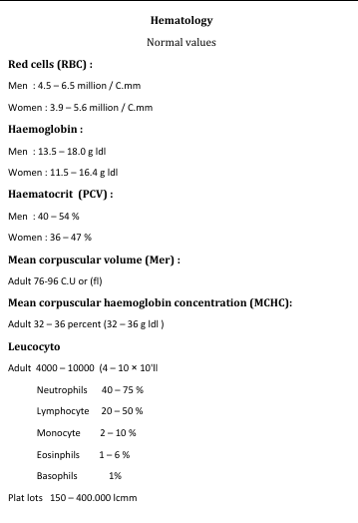
Hematologic values

Slide 12
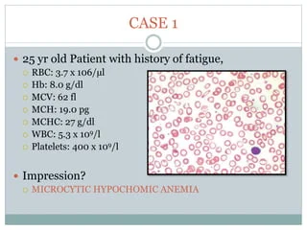
RED CELL INDICIES

Slide 13
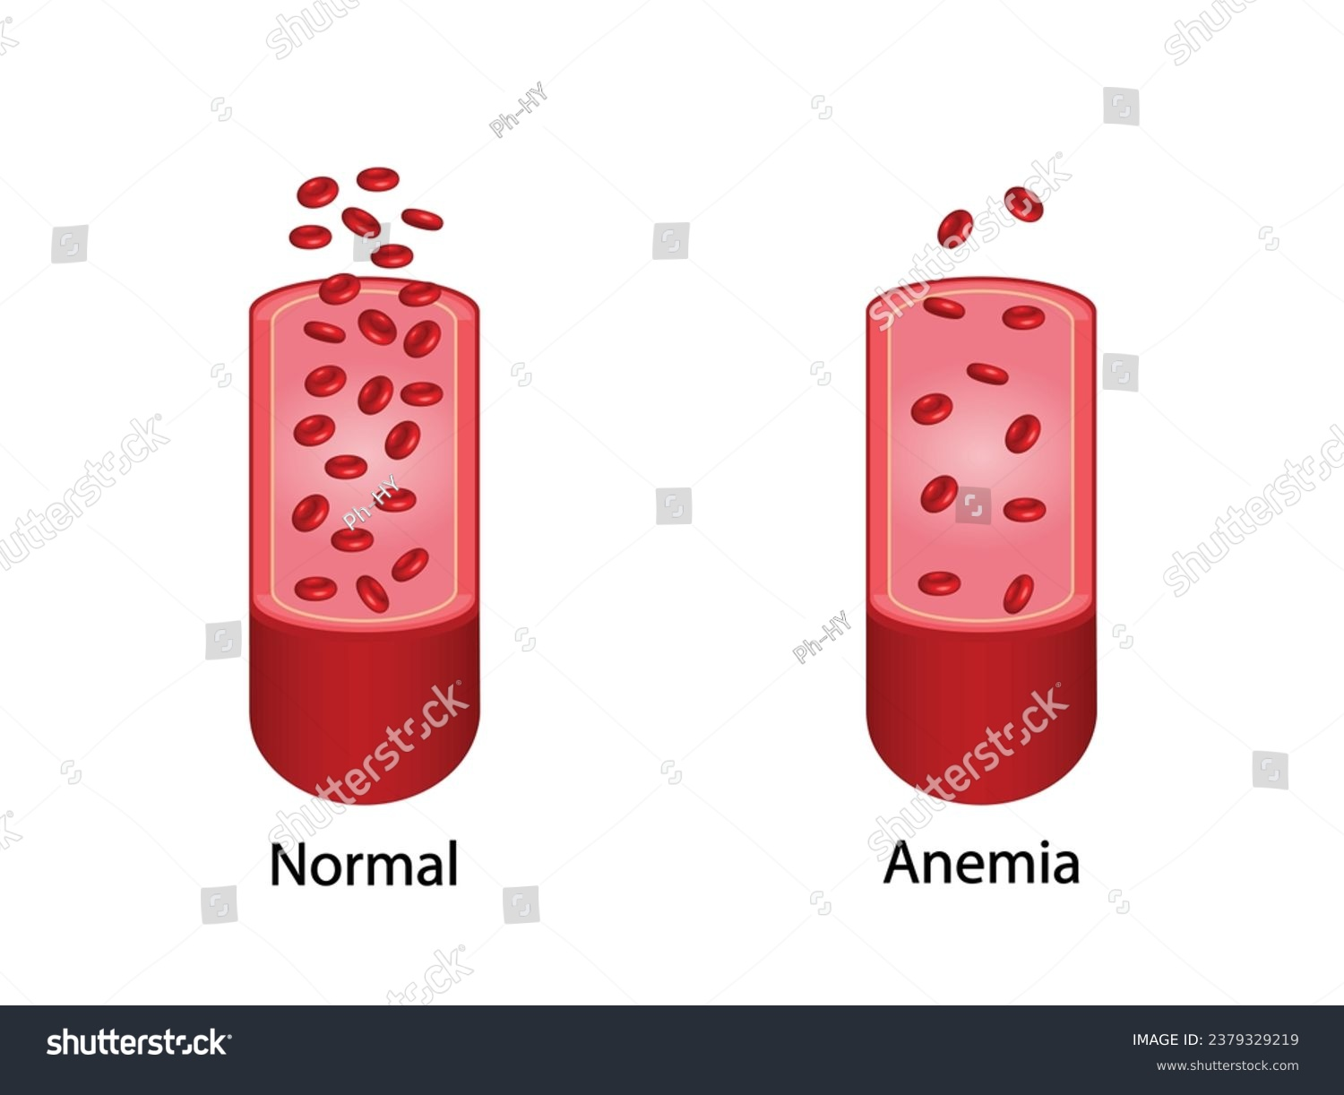
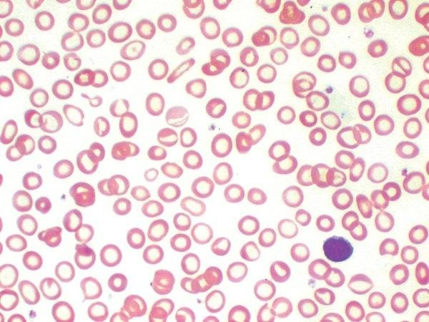
Iron deficiency anemia

Slide 14
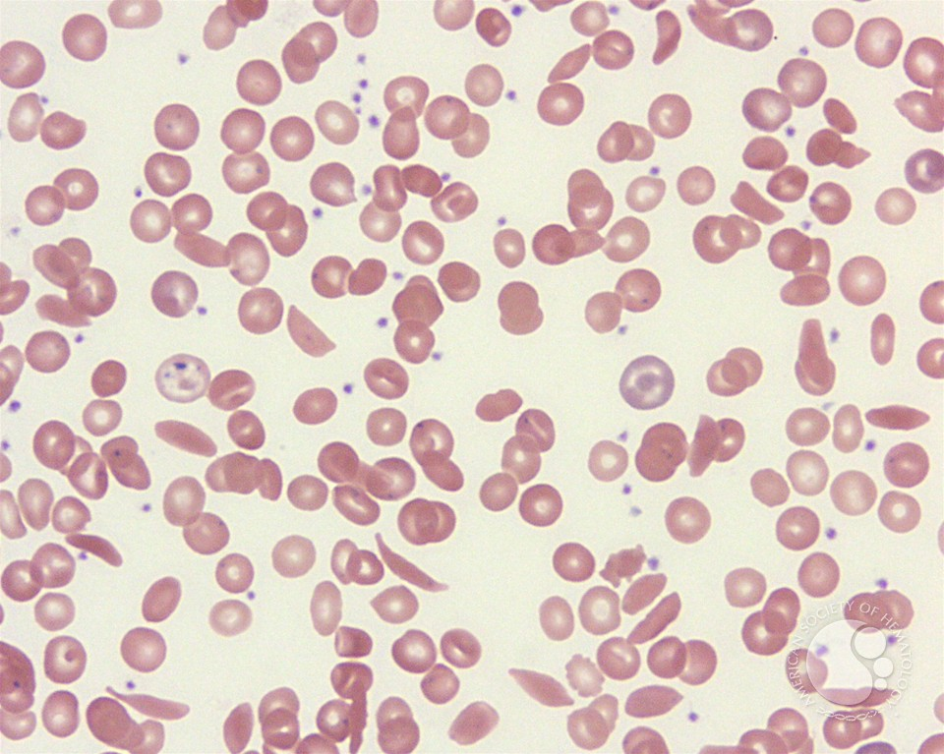
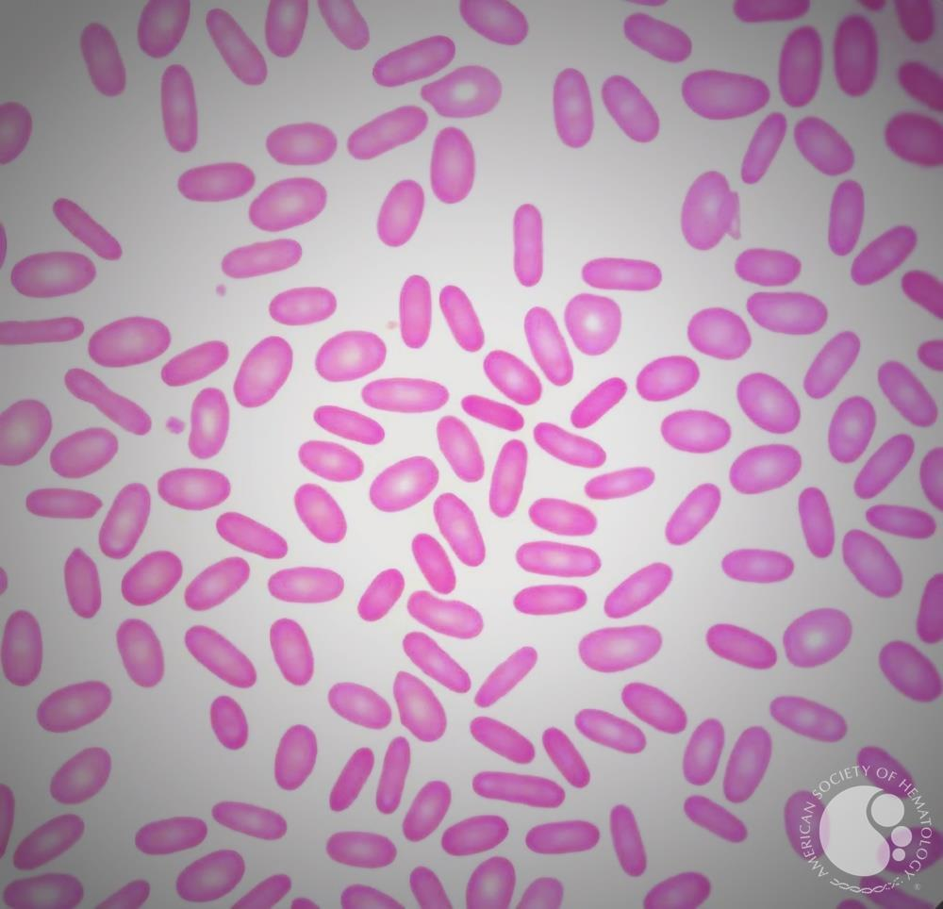
Sickle cell & ELLEPTOCYTOSIS

Slide 15
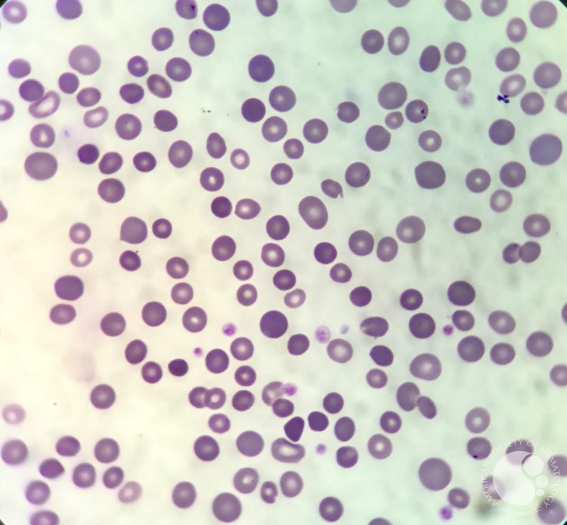
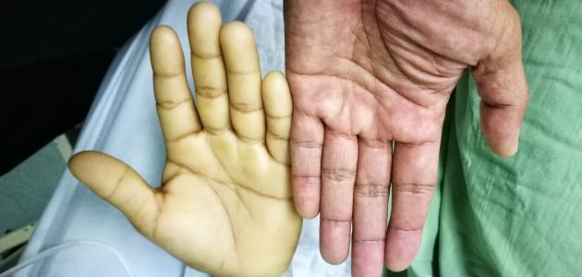
SPHEROCYTOSIS , PALLOR OF SKIN CREASE

Slide 16
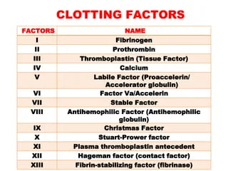
Clotting factors

Slide 17
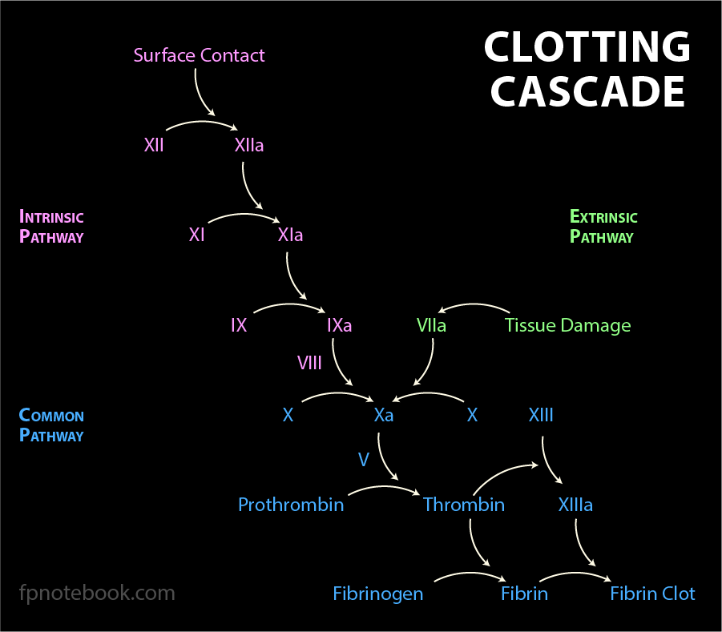
Coagulation cascade pathways

Slide 18
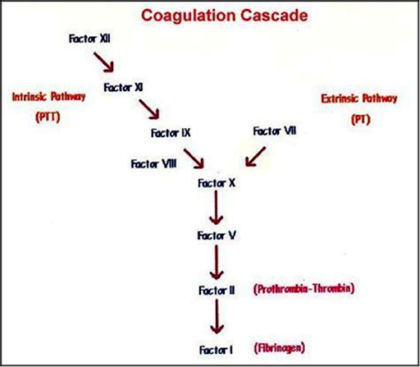
Coagulation cascade pathways

Slide 19
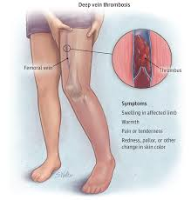
Deep Venous thrombosis ( dvt ).

Slide 20
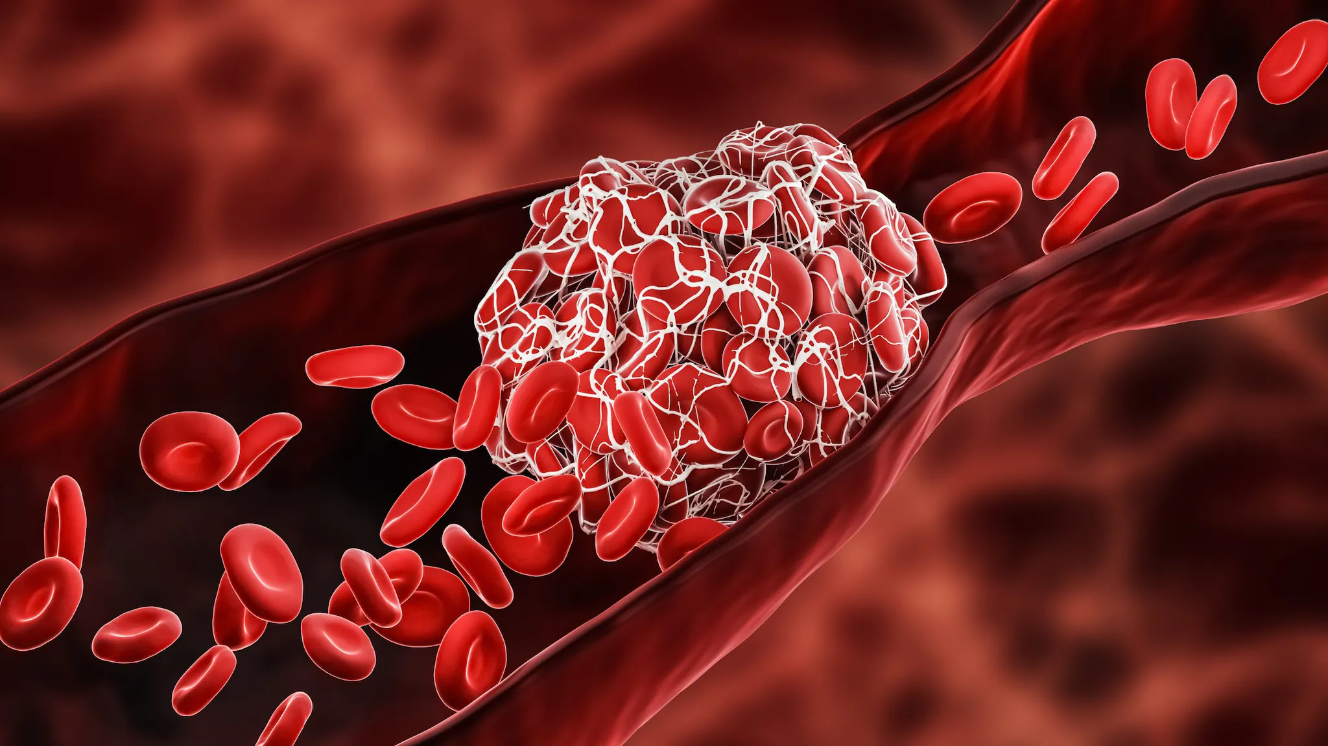
Deep venous thrombosis ( dvt )

Slide 21
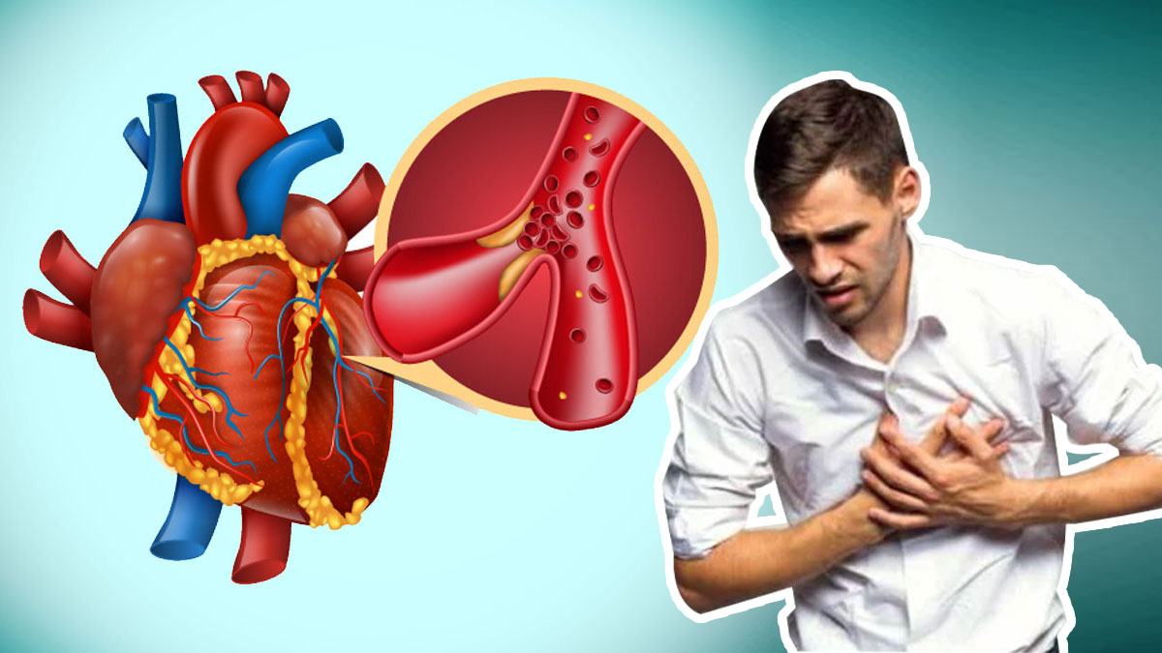
Acute MYOCARDIAL INFARCTION ( MI )

Slide 22
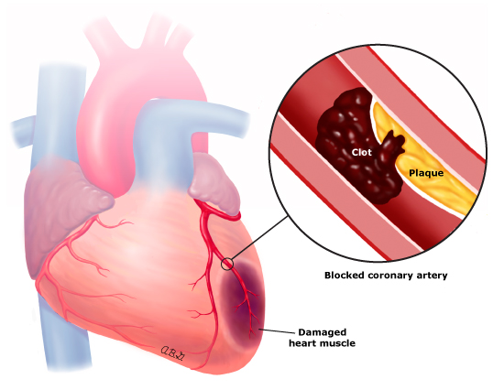
Acute MYOCARDIAL INFARCTION ( MI )

Slide 23
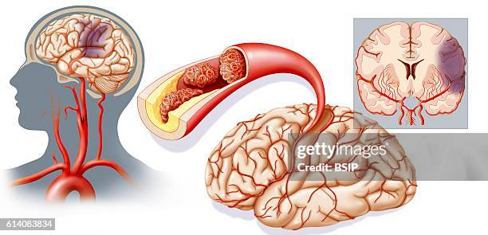
Arterial thrombosis ( stroke )

