Slide 1
Clinical chemistry
Second year
Lab (1)
By : Assistant lecturer
Shahad Monther Mahmoud

Slide 2
Objectives
Introduction of clinical biochemistry.
Types of specimens in clinical biochemistry analysis.
Calorimetric analysis.
Beer- lambert’s law.
Transmittance.
Absorbance.
Spectrophotometer.

Slide 3
Introduction of clinical biochemistry
Clinical Biochemistry is the division of laboratory medicine that deals with the measurement of chemicals (both natural and unnatural) in blood, urine and other body fluids. These test results are useful for detecting health problems, determining prognosis and guiding the therapy of a patient .

Slide 4
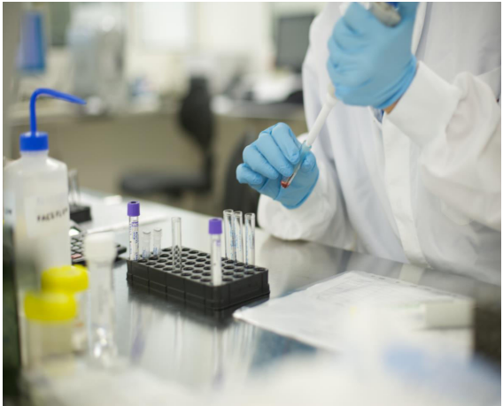

Slide 5
Types of specimens in clinical biochemistry analysis
A wide variety of specimen types may be collected for storge , and in many molecular epidemiology studies depending on the study goals.
Adequate patient preparation, specimen collection, and specimen handling are essential prerequisites for accurate test results. The accuracy of test results is dependent on the integrity of specimens.

Slide 6
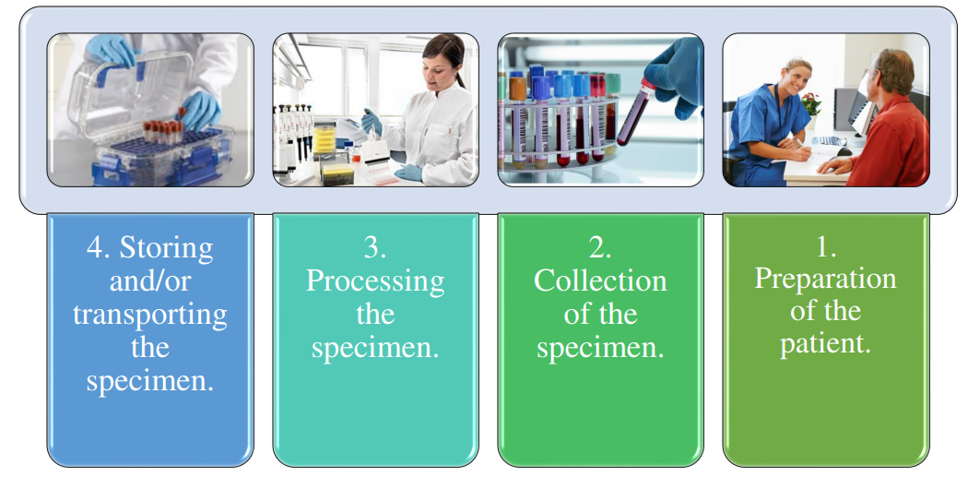
There are four steps involved in obtaining a good quality specimen for testing:

Slide 7
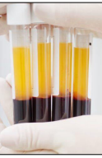
Serum
It's the watery part of blood which is obtained by collected the blood in a tube and left the sample in water bath with 37C for 15 minutes then centrifuge for 10 minute . Serum contain albumin and globulin without fibrinogen or the other clotting factors.

Slide 8
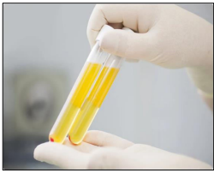
Plasma
It's essentially the same as serum but it's obtained by centrifuging the blood sample that collected in a tube containing anticoagulant (like heparin), the upper layer is the plasma contains fibrinogen in addition to the albumin and globulin.

Slide 9
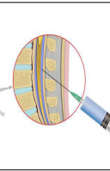
Cerebrospinal spinal fluid (CSF)
CSF is a clear fluid present in the brain and spine which is largely similar to blood plasma though it differs by containing nearly no protein. It is usually analyzed in clinical chemistry to identify or rule out meningitis .

Slide 10
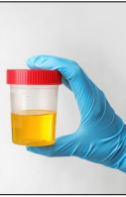
Urine
Clinical tests usually require a 24-hour urine collection. The collection container usually contains a preservative.

Slide 11


