Slide 1
Fourth lecture

Slide 2
Protocol layering
In data communication and networking, a protocol defines the rules that both the sender and receiver and all intermediate devices need to follow to be able to communicate effectively. When communication is simple, we may need only one simple protocol; when communication is complex, we may need to divide the task between different layers, in which case we need a protocol at each layer or protocol layering.

Slide 3
The OSI Model
Established in 1947, the International Organization for Standardization (ISO) is a multinational body dedicated to worldwide agreement on international standards. Almost three-fourths of the countries in the world are represented in the ISO. An ISO standard that covers all aspects of network communications is the Open Systems Interconnection (OSI) model. It was first introduced in the late 1970s.
An open system is a set of protocols that allows any two different systems to communicate regardless of their underlying architecture.
The purpose of the OSI model is to show how to facilitate communication between different systems without requiring changes to the logic of the underlying hardware and software. The OSI model is not a protocol; it is a model for understanding and designing a network architecture that is flexible, robust, and interoperable. The OSI model was intended to be the basis for the creation of the protocols .

Slide 4
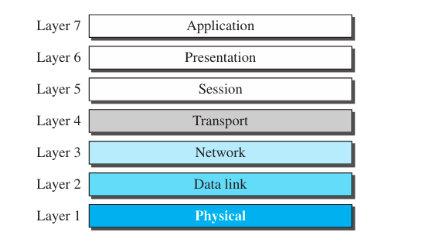
ISO is the organization; OSI is the model.
The OSI model is a layered framework for the design of network systems that allows communication between all types of computer systems. It consists of seven separate but related layers, each of which defines a part of the process of moving information across a network (see Figure 1).
Figure 1 The OSI model

Slide 5
Layered Architecture
Figure below shows the layers involved when a message is sent from device A to device B.
As the message travels from A to B, it may pass through many intermediate nodes.
These intermediate nodes usually involve only the first three layers of the OSI model.
Device A sends a message to device B (through intermediate nodes).
At the sending site, the message is moved down from layer 7 to layer 1.
At layer 1 (physical layer) the entire package is converted to a form that can be transferred to the receiving site.
At the receiving site, the message is moved up from layer 1 to layer 7.
The passing of the data and network information down through the layers of the sending device and back up through the layers of the receiving device is made possible by an interface between each pair of adjacent layers.
The term “interface” is a generic meaning refers to connecting just about anything together

Slide 6
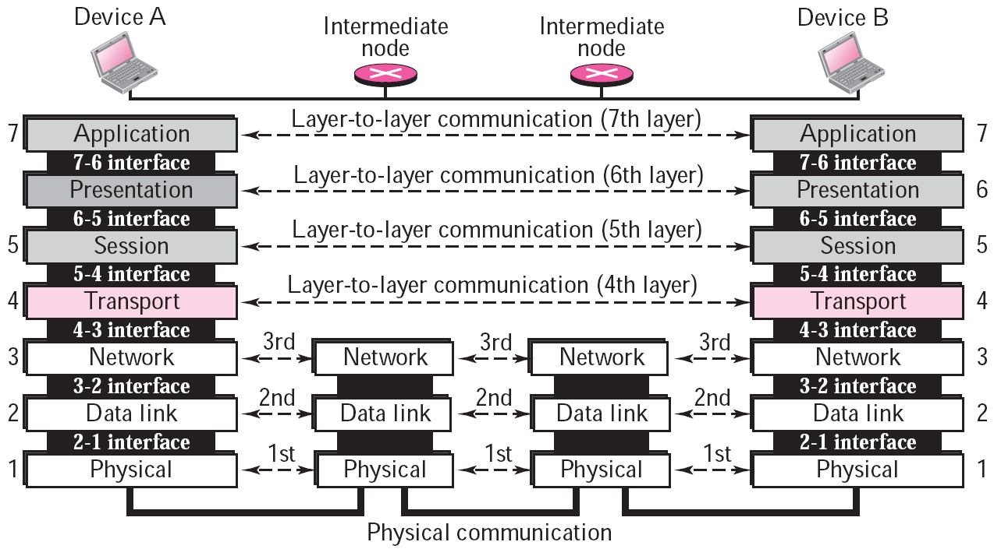
Figure 2 OSI layers

Slide 7
Organization of the Layers
The seven layers can be thought of as belonging to three subgroups.
Layers 1, 2, and 3—physical, data link, and network—are the network support layers; they deal with the physical aspects of moving data from one device to another (such as electrical specifications, physical connections, physical addressing, and transport timing and reliability).
Layers 5, 6, and 7—session, presentation, and application—can be thought of as the user support layers; they allow interoperability التشغيل البيني among unrelated software systems.
Layer 4, the transport layer, links the two subgroups and ensures that what the lower layers have transmitted is in a form that the upper layers can use.
The upper OSI layers are almost always implemented in software;
The lower layers are a combination of hardware and software, except for the physical layer, which is mostly hardware.

Slide 8
Layers in the OSI Model
Physical Layer
The physical layer is responsible for moving individual bits from one (node) to the next.
Physical characteristics of interfaces and media.
It also defines the type of transmission media.
Representation of bits.
Data rate.
Synchronization of bits.
Line configuration.
Physical topology.
Transmission mode.

Slide 9
Data Link Layer
The data link layer transforms the physical layer, to a reliable link.
It makes the physical layer appear error-free to the upper layer (network layer).
Framing.
Physical addressing.
Flow control.
Error control.
Access control.
Network Layer
The network layer is responsible for the source-to-destination delivery of a packet, possibly across multiple networks (links).
Whereas the data link layer supervises the delivery of the packet between two systems on the same network (link)(node-to-node), the network layer ensures that each packet gets from its point of origin to its final destination.

Slide 10
If two systems are connected to the same network, there is usually no need for a network layer.
However, if the two systems are attached to different networks (links) with connecting devices between the networks (links), there is often a need for the network layer to accomplish source-to-destination delivery.
Other responsibilities of the network layer include the following:
1- Logical addressing
The address in layer-2 (MAC address or Physical address) is responsible for local identification
While the address in layer-3 (IP address or logical address) is for global identification.
The MAC address is 48 bit (for Ethernet)
The IP address is 32 bit (in IPv4)
2- Routing: Choosing the path of packet

Slide 11
Transport Layer
The transport layer is responsible for process-to-process delivery of the entire message.
A process is an application program.
Whereas the network layer supervises source-to- destination delivery of individual packets, it does not recognize any relationship between those packets.
The transport layer, on the other hand, ensures that the whole message arrives intact and in order, supervising both error control and flow control at the source-to-destination level.
Service-point (port) addressing.
Segmentation and reassembly.
Connection control.
Flow control.
Error control.

Slide 12
Session Layer
The session layer is the network dialog controller.
It establishes, maintains, and synchronizes the interaction between communicating systems.
Dialog control.
Synchronization.
Presentation Layer
The presentation layer is concerned with the syntax and semantics of the information exchanged between two systems.
Translation.
Encryption.
Compression.

Slide 13
Application Layer
The application layer enables the user, whether human or software, to access the network.
It provides user interfaces and support for services such as electronic mail, remote file access and transfer, shared database management,….etc.
File transfer, access, and management (FTAM).
E-mail services
Directory services.

Slide 14
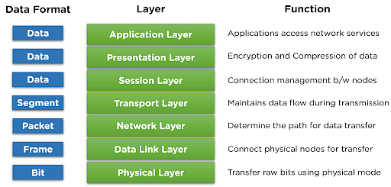
The Figure 3 shows a summary of duties for each layer.
Figure 3 the summary of duties for each layer.

Slide 15
TCP/IP Protocol Suite
TCP/IP (Transmission Control Protocol/Internet Protocol) is a protocol suite (a set of protocols organized in different layers) used in the Internet today. It is a hierarchical protocol made up of interactive modules, each of which provides a specific functionality. The term hierarchical means that each upper-level protocol is supported by the services provided by one or more lower-level protocols. The original TCP/IP protocol suite was defined as four software layers built upon the hardware. Today, however, TCP/IP is thought of as a five-layer model. Figure 4 shows both configurations.

Slide 16
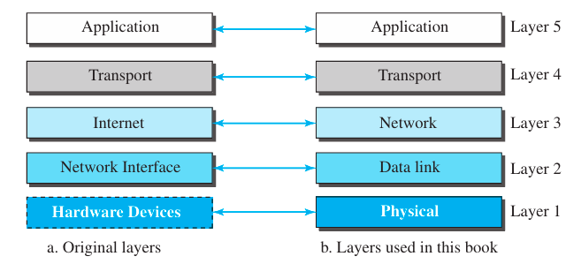
Figure 4 Layers in the TCP/IP protocol suite

Slide 17
To show how the layers in the TCP/IP protocol suite are involved in communication between two hosts, we assume that we want to use the suite in a small internet made up of three LANs (links), each with a link-layer switch. We also assume that the links are connected by one router, as shown in Figure 5.
Each device is involved with a set of layers depending on the role of the device in the internet. The two hosts are involved in all five layers; the source host needs to create a message in the application layer and send it down the layers so that it is physically sent to the destination host. The destination host needs to receive the communication at the physical layer and then deliver it through the other layers to the application layer.
The router is involved in only three layers; there is no transport or application layer in a router as long as the router is used only for routing.
A link-layer switch in a link, however, is involved only in two layers, data-link and physical. Although each switch in the above figure has two different connections, the connections are in the same link, which uses only one set of protocols. This means that, unlike a router, a link-layer switch is involved only in one data-link and one physical layer

Slide 18
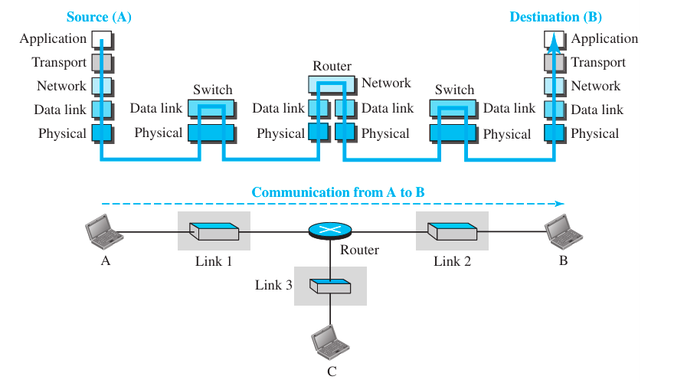
Figure 5 Communication through an internet

Slide 19
Layers in the TCP/IP Protocol Suite
Using logical connections makes it easier for us to think about the duty of each layer, as show in figure 6.
As the figure shows, the duty of the application, transport, and network layers is end-to-end.
However, the duty of the data-link and physical layers is hop-to-hop, in which
The domain of duty of the top three layers is the internet, and the domain of duty of the two lower layers is the link.
Another way of thinking of the logical connections is to think about the data unit created from each layer. In the top three layers, the data unit (packets) should not be changed by any router or link-layer switch. In the bottom two layers, the packet created by the host is changed only by the routers, not by the link-layer switches.

Slide 20
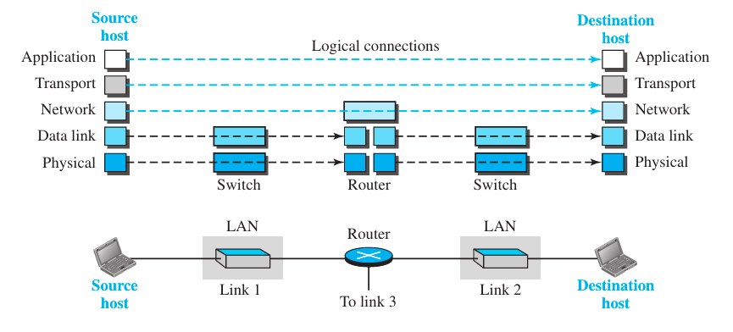
Figure 6 Logical connections between layers of the TCP/IP protocol suite

Slide 21
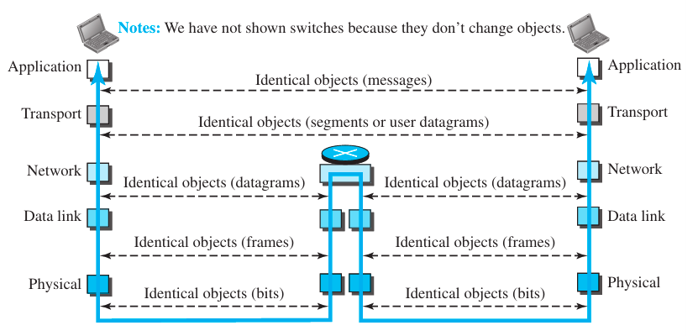
Figure 2.7 shows the identical objects below each layer related to each device.

Slide 22
Physical layer
The physical layer is responsible for carrying individual bits in a frame across the link.
The communication between two devices at the physical layer is still logical communication because there is another, hidden layer, the transmission media, under the physical layer. Two devices are connected by a transmission medium (cable or air).
The transmission medium does not carry bits; it carries electrical or optical signals. So the bits received in a frame from the data-link layer are transformed and sent through the transmission media.
The logical unit between two physical layers in two devices is a bit.

Slide 23
Data-link Layer
The internet is made up of several links (LANs and WANs) connected by routers. There may be several overlapping sets of links that a datagram can travel from the host to the destination. The routers are responsible for choosing the best links.
However, when the next link to travel is determined by the router, the data-link layer is responsible for taking the datagram and moving it across the link.
The link can be a wired LAN with a link-layer switch, a wireless LAN, a wired WAN, or a wireless WAN. We can also have different protocols used with any link type.
In each case, the data-link layer is responsible for moving the packet through the link.
TCP/IP does not define any specific protocol for the data-link layer. It supports all the standard and proprietary protocols.
The data-link layer takes a datagram and encapsulates it in a packet called a frame.
Each link-layer protocol may provide a different service. Some link-layer protocols provide complete error detection and correction, some provide only error correction.

Slide 24
Network Layer
The network layer is responsible for creating a connection between the source computer and the destination computer. The communication at the network layer is host-to-host.
However, since there can be several routers from the source to the destination, the routers in the path are responsible for choosing the best route for each packet. We can say that the network layer is responsible for host-to-host communication and routing the packet through possible routes.
The network layer in the Internet includes the main protocol:
A- Internet Protocol (IP):
Which defines the format of the packet, called a datagram at the network layer.
IP also defines the format and the structure of addresses used in this layer.
IP is also responsible for routing a packet from its source to its destination, which is achieved by each router forwarding the datagram to the next router in its path.
IP is a connectionless protocol that provides no flow control, no error control, and no congestion control services. This means that if any of these services is required for an application, the application should rely only on the transport-layer protocol.

Slide 25
B-The network layer also includes unicast (one-to-one) and multicast (one-to-many) routing protocols. A routing protocol does not take part in routing (it is the responsibility of IP), but it creates forwarding tables for routers to help them in the routing process.
C-The network layer also has some auxiliary protocols that help IP in its delivery and routing tasks. The Internet Control Message Protocol (ICMP) helps IP to report some problems when routing a packet.
D- The Internet Group Management Protocol (IGMP) is another protocol that helps IP in multitasking.
E-The Dynamic Host Configuration Protocol (DHCP) helps IP to get the network-layer address for a host.
F-The Address Resolution Protocol (ARP) is a protocol that helps IP to find the link-layer address of a host or a router when its network-layer address is given.

Slide 26
Transport Layer
The logical connection at the transport layer is also end-to-end. The transport layer at the source host gets the message from the application layer, encapsulates it in a transport layer packet (called a segment or a user datagram in different protocols), and sends it, through the logical (imaginary) connection, to the transport layer at the destination host.
In other words, the transport layer is responsible for giving services to the application layer: to get a message from an application program running on the source host and deliver it to the corresponding application program on the destination host.
The transport layer should be independent of the application layer. In addition, we will see that we have more than one protocol in the transport layer, which means that each application program can use the protocol that best matches its requirements.

Slide 27
As we said, there are a few transport-layer protocols on the Internet, each designed for some specific task.
A-The main protocol, Transmission Control Protocol (TCP):
Is a connection-oriented protocol that first establishes a logical connection between transport layers at two hosts before transferring data.
It creates a logical pipe between two TCPs for transferring a stream of bytes.
TCP provides flow control (matching the sending data rate of the source host with the receiving data rate of the destination host to prevent overwhelming the destination), error control (to guarantee that the segments arrive at the destination without error and resending the corrupted ones), and congestion control to reduce the loss of segments due to congestion in the network.

Slide 28
B-The other common protocol, User Datagram Protocol (UDP)
Is a connectionless protocol that transmits user datagrams without first creating a logical connection.
In UDP, each user datagram is an independent entity without being related to the previous or the next one (the meaning of the term connectionless).
UDP is a simple protocol that does not provide flow, error, or congestion control.
Its simplicity, which means small overhead, is attractive to an application program that needs to send short messages and cannot afford the retransmission of the packets involved in TCP when a packet is corrupted or lost.
C-A new protocol, Stream Control Transmission Protocol (SCTP) is designed to respond to new applications that are emerging in multimedia.

Slide 29
Application Layer
The logical connection between the two application layers is end-to-end.
The two application layers exchange messages between each other as though there were a bridge between the two layers. However, we should know that the communication is done through all the layers. Communication at the application layer is between two processes (two programs running at this layer).
To communicate, a process sends a request to the other process and receives a response. Process-to-process communication is the duty of the application layer.

Slide 30
The application layer on the Internet includes many predefined protocols:
A-The Hypertext Transfer Protocol (HTTP) is a vehicle for accessing the World Wide Web (WWW).
B-The Simple Mail Transfer Protocol (SMTP) is the main protocol used in electronic mail (e-mail) service.
C-The File Transfer Protocol (FTP) is used for transferring files from one host to another. The Terminal Network (TELNET) and Secure Shell (SSH) are used for accessing a site remotely.
D-The Simple Network Management Protocol (SNMP) is used by an administrator to manage the Internet at global and local levels.
E-The Domain Name System (DNS) is used by other protocols to find the network-layer address of a computer.
F-The Internet Group Management Protocol (IGMP) is used to collect membership in a group.

Slide 31
OSI versus TCP/IP
When we compare the two models, we find that two layers, session and presentation, are missing from the TCP/IP protocol suite. These two layers were not added to the TCP/IP protocol suite after the publication of the OSI model. The application layer in the suite is usually considered to be the combination of three layers in the OSI model, as shown in Figure 8.
Two reasons were mentioned for this decision:
First, TCP/IP has more than one transport-layer protocol. Some of the functionalities of the session layer are available in some of the transport-layer protocols.
Second, the application layer is not only one piece of software. Many applications can be developed at this layer. If some of the functionalities mentioned in the session and presentation layers are needed for a particular application, they can be included in the development of that piece of software.

Slide 32
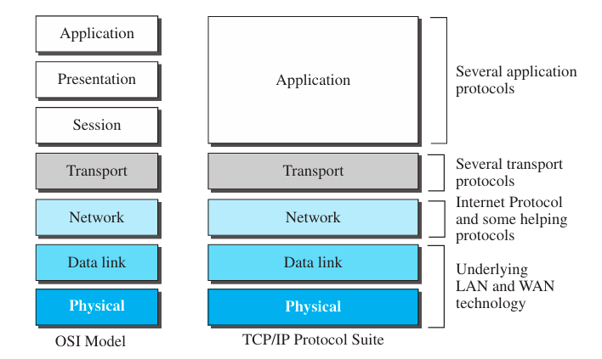
Figure 8 TCP/IP and OSI model

