Slide 1
Biosafety Barriers in Labs
Personal protective equipments (PPE)
Ass. Lec. Jihad N. Abid

Slide 2






PRIMARY BARRIERS
(control hazard at source)
BSC
SECONDARY BARRIERS
(structure surrounding primary barrier)
3

Slide 3


Physical barriers or personal protective equipments (PPE) for lab worker Gloves, masks, Goggles, aprons, suits, special breathing apparatuses
Primary containment equipment
  BSC
  Sealed centrifuge

Slide 4




Secondary barriers: structural aspects of the laboratory that make working environment safer against infection such as Sinks for hand washing, Special containment areas, Special air ventilation patterns and Sterilization equipments.
HEPA filters (high efficiency particulate air)
Liquid effluent treatment
Sealed laboratory walls and floors

Slide 5





Practice and procedures
Standard practices
Special practices and considerations
Safety equipment
Facility design and construction
Increasing levels of protection

Slide 6


Primary containment barrier
Minimize exposure to hazard
  Engineering controls / equipment
  PPE
  Biological safety cabinets

Slide 7
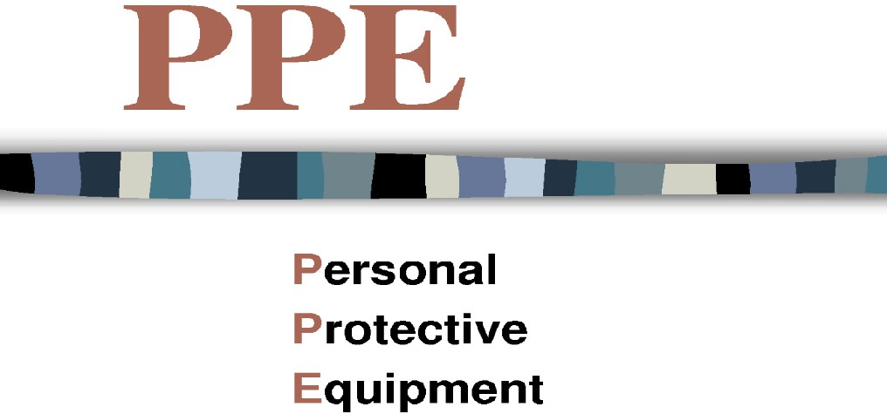

“Specialized clothing / equipment worn by an employee for protection against infectious materials”
Provides protection from
(bio) hazards
It is removable and/or disposable (prevents contamination of community and environment)
Must be worn when handling hazards (including infectious materials)
Must be removed before leaving the work place

Slide 8

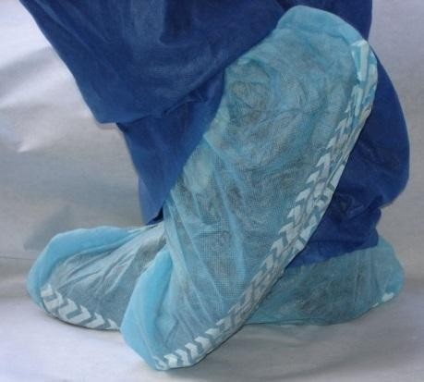
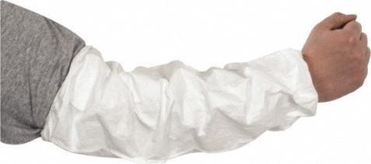
TYPES OF PPE
Body protection
Head Protection:
Protect hair and scalp from contamination
Hair covers
Foot Protection:
Protect entire foot
Disposable shoe covers (additional layer of protection)
Rubber boots
Dedicated lab shoes
Non-slip footwear
Additional Body Protection (based on risk assessment):
Disposable sleeve covers
Scrubs

Slide 9
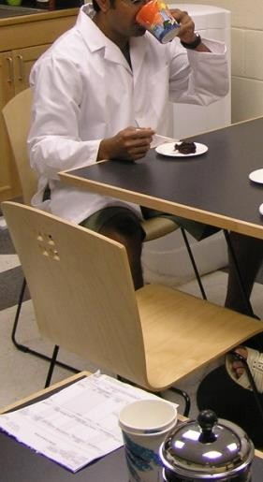




Lab Coats and gowns
  used to protect from infectious fluids
  Don’t wear lab coats outside of the lab
or take them home
  Cuffed sleeves can protect the wrists and lower arms
14

Slide 10
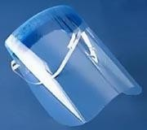
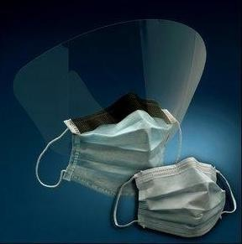
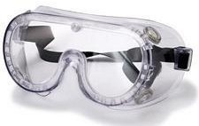
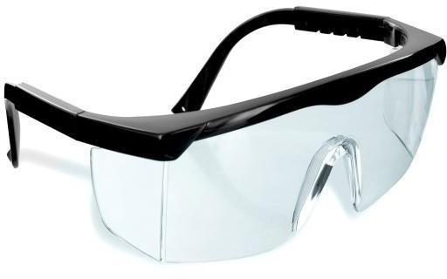
Face protection
Worn when potential risk for splashing / splattering
Prevents splashing of infectious materials into eyes, nose, and/or
mouth
Protects mucous membranes from exposure
Examples:
  Face shield
  Surgical mask
  Indirectly vented safety goggles

Slide 11
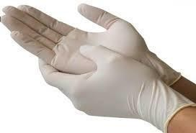
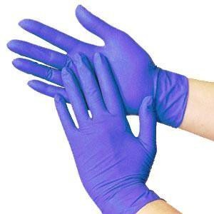
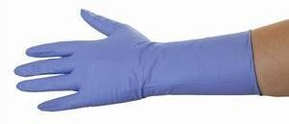
Hand protection
Reduces potential of hand contamination
Reduces risks associated with ingestion and skin contact
Gloves are made of different materials Latex, nitrile, vinyl, polyethylene, etc.
Should be selected for specific activity and hazard
Suitability of glove needs to be verified prior to handling infectious materials

Slide 12
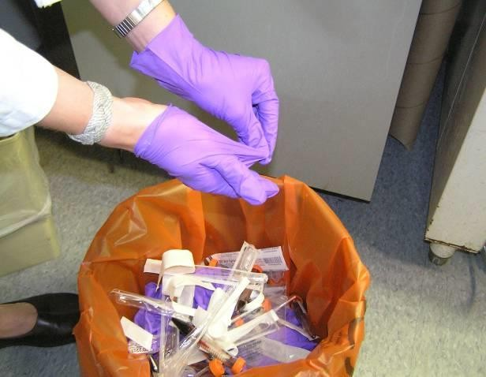
Gloves
  Avoid latex gloves (may cause allergies)
  Do not reuse gloves
  Do not wear gloves outside of the laboratory
  Wash hands after removing gloves

Slide 13
Respiratory Protection
  Two types: air supplying and air purifying
  Full face, half face, PAPR (Powered Air Purifying Respirator)
  Special considerations: fit testing; facial hair; comfort; care and maintenance

Slide 14
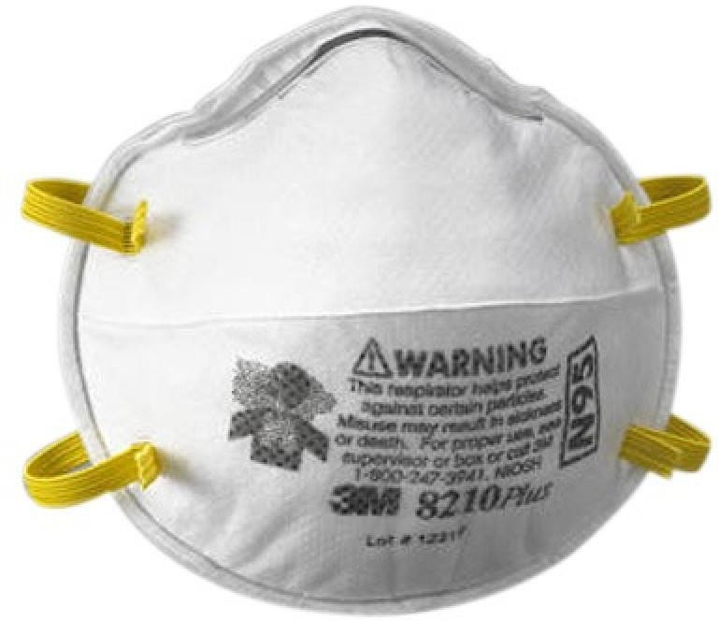
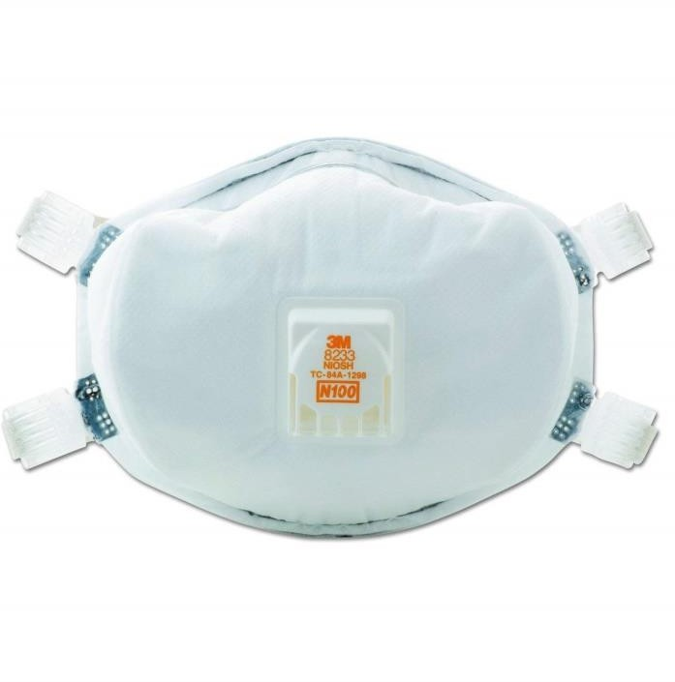
Respiratory Protection
  N95 respirators
  N100 respirators

Slide 15
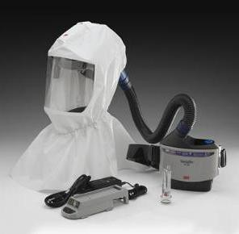
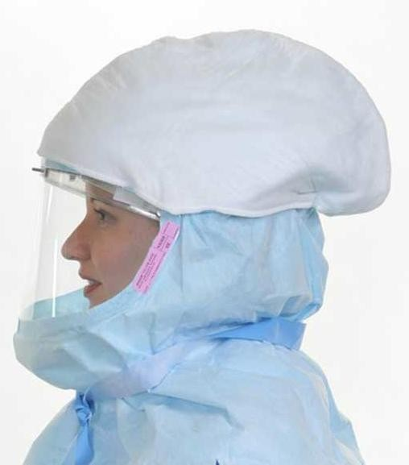
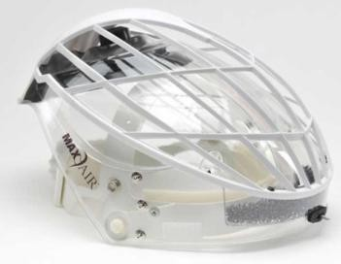
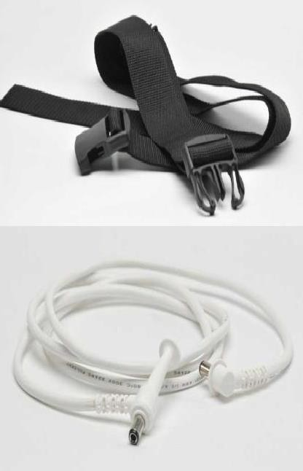
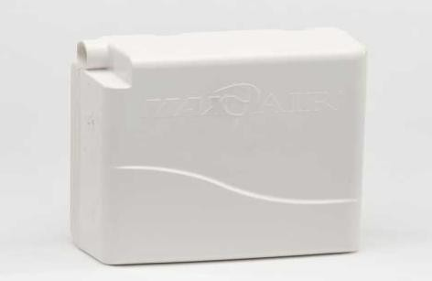
Air-purifying respirators

Slide 16
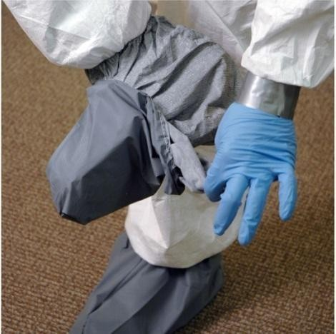
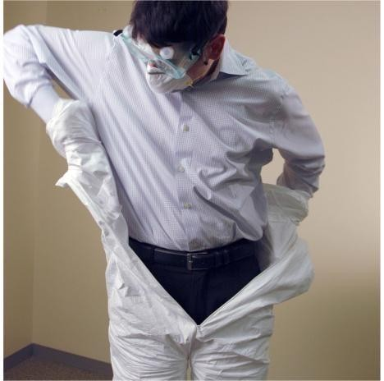


donning PPE
PPE should be carefully inspected for damages/breaches prior to
Change gloves as needed
Gloves become means of spreading infectious materials when contaminated
Doffing PPE must be performed carefully to minimize contamination
Doffing PPE needs to be immediately followed by handwashing
Proper disposal of PPE as biohazard waste
Proper decontamination and laundering of reusable PPE
Proper use/removal

Slide 17


Fume Hood
Laminar Flow Cabinet (LFC)
Biohazard Safety Cabinet (BSC)

Slide 18

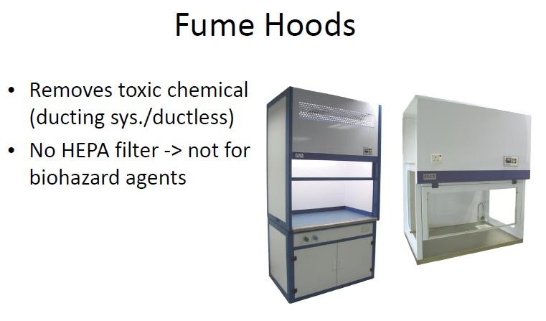

Slide 19

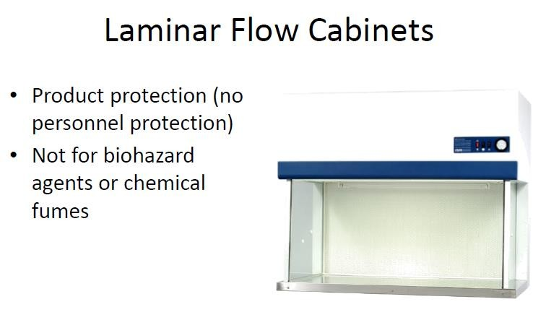

Slide 20

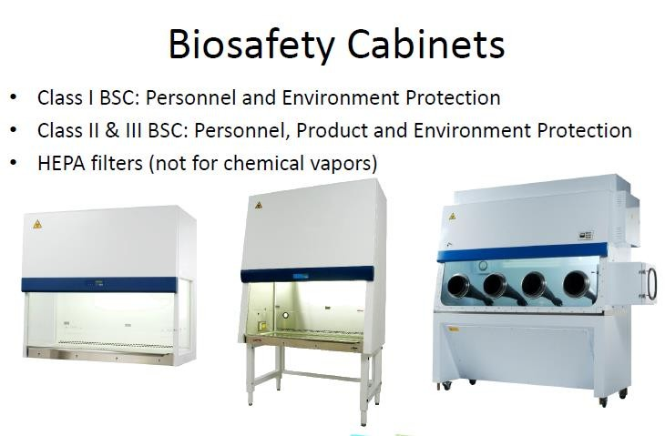

Slide 21




