Slide 1
Medical Terminology lecture 2
Prof.Dr.Mohammad Alfaham
M.Sc.Ph.D

Slide 2
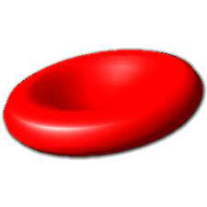
Terminology of blood
Erythrocyte(red blood cell RBC) : biconcave disc without nucleus transport oxygen to body tissues
Hemoglobin : a protein contains reduced iron found in erythrocytes
Reticulocyte : immature red blood cells with a nucleus

Slide 3
Leukocytes( white blood cells WBC) : help in defense mechanism against infections
1.Granulocytes (contain granules ): they are
- neutrophils : 60% of WBC .. Phagocytic
- Eosinophils : 3% of WBC they increased in parasitic infections
- Basophils : release heparin as anticoagulant

Slide 4
2.Agranulocytes : they are :
- Monocyte : large cell , phagocytic
- Lymphocyte: help in immune response
Thrombocytes (platelets) help in clotting
Blood groups
Antigens : molecules on the surface of all body cells act as a foreign to the immune system of another individual that may trigger an immune response

Slide 5
Antibodies : protein secreted by lymphocytes(WBC) that bind with foreign antigens to stop its destructive effect
ABO system
1-A group (A antigens – B antibodies)
2-B group (B antigen – A antibodies)
3-AB group(A antigen – B antigen – NO antibodies) *universal recipient*
4-O group (No antigens – A antibodies – B antibodies) *universal donor*

Slide 6
Terminology in pathology
Abscess: a closed and painful pocket containing pus
Atrophy: a localized thinning of skin
Bullous: a blister greater than 0.5cm in size which contain clear fluid
Carcinoma : a malignant tumor
Cyst : enclosed sac in the skin which contain fluid or solid material

Slide 7
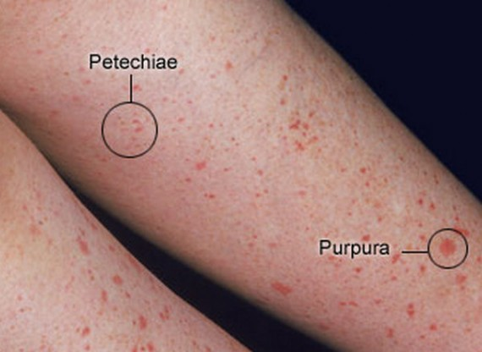
k
Petechia : collection of blood in the skin smaller than 0.5cm in diameter
Ecchymosis : collection of blood in the skin larger than 0.5cm in diameter

Slide 8
Epithelium : a specialized type of tissue lines the surfaces and cavities of the body
Fissure : a thin linear crack in the skin
Inflammation : unwanted tissue reactions against microorganism
Necrosis: a process cause tissue death

Slide 9
Polyp(skin tag) : mushroom like structure with rounded head attached to surface of skin by stalk
Scar : dense collection of collagen fibers which form after injury to the skin
Ulcer : a full thickness loss of the skin that heals by scar

Slide 10
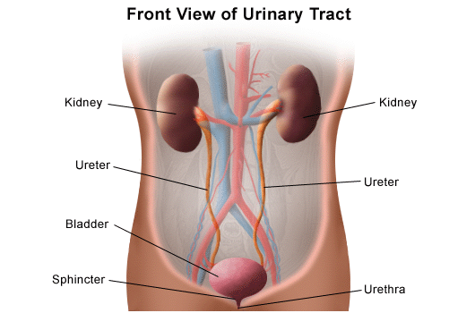
Renal system
Consist of :
1 kidneys
2 ureters
3 urinary bladder
4 urethra

Slide 11
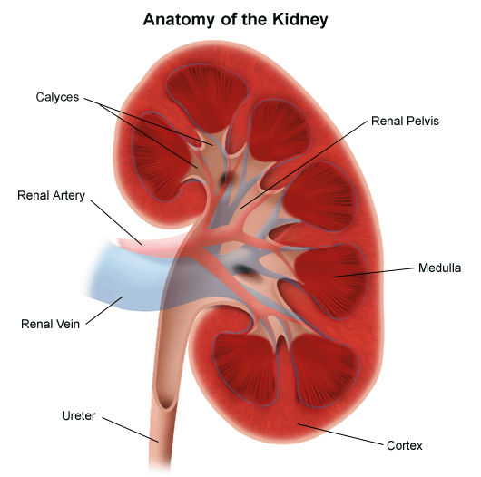
kidneys
Composed of:
1 cortex
2medulla
3pyramids
4 pelvis
5 calyces
6 renal artery
And vein

Slide 12
Thank you

