Slide 1
Skeleton System:
Skeleton is a group of bones connected to each other and
arranged in a coordinated order to give the body upright posture on
his feet. This arrangement is coordinated in a manner that facilitates
the distribution of the weight of the body on the legs as two areas of
attribution and reliance.

Slide 2
Main function of bones:
1-Support and protect the skeleton support the softer tissue and protect
brain, vertebrate ,spinal cord and the ribcage protect the heart and
lung.
2- Assisting in movement the skeletal muscle are attached to bones so
causes the bones to move.
3-Storage of mineral eg. calcium and phosphorus
4-Production of blood cell, the red bone marrow inside some larger bones.

Slide 3


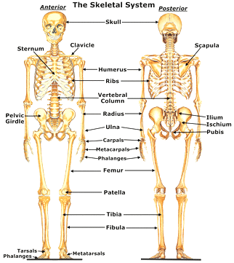
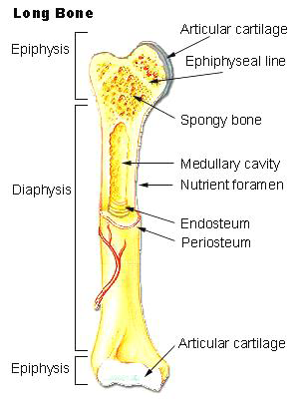
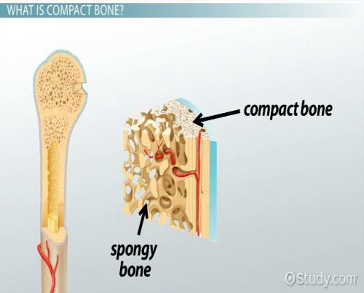
Type of bones:
1- Long bones: Consists of shaft
(diaphysis), and two end enlarged
extremities (epiphysis),and contain
medullar(marrow)cavity. e.g: found in
limbs. Mostly in compact bones.
2- Short bone: It consist of thin cortical
layer surrounding the spongy bone it
found in (carpal and tarsal bones). Mostly
in spongy bones.
3-Flat bones: Its consist of two plates of
compact bone substance, lamina externa
and lamina interna, separated by spongy
layer. (scapula, skull).
4-Irregular bones: are unpaired bones
located on the median plane.(vertebrate).
5-Sesamoid Bones: Sesamoid bones are
usually short or irregular bones,
embedded in a tendon. The most obvious
example of this is the Patella.

Slide 4
Division of the skeleton:
The skeleton may be divided into two main groups of bones:
1-The axial(central) skeleton; which includes the bony framework
of head(skull) and the trunk (vertebral column).
2-The appendicular (peripheral)skeleton; which forms framework
for the upper limb and lower limb.

Slide 5
Axial skeleton
The Skull:
The skull is a bony structure that forms
the head in vertebrates. It supports the structures of
the face and provides a protective cavity for the brain,
bones of the skull can be divided into two groups:
a-Bones of cranium.
b-Bones of Face.

Slide 6

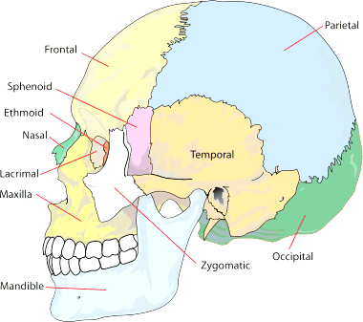
Bones of cranium:
1-Frontal bone :form the forehead
2-Parietal bones : form most top
&side wall.
3-Occipital bone forms back &part of
base of skull
4-Temporal bones form part of the
side and some of the base of the
skull
5-Sphenoid bone :crossing behind
the orbital cavities
6-Ethmoid bone located between
the eyes,

Slide 7

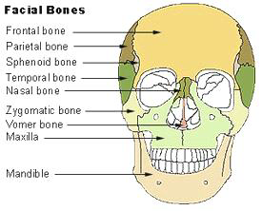

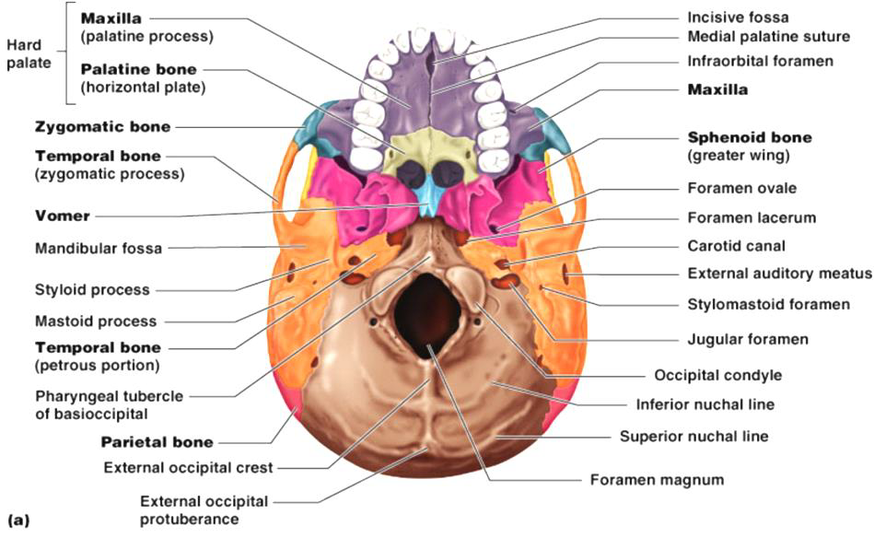
Bones of face:
1- Zygomatic bones form the
prominences of cheeks
2- Maxillae upper jaw
3- Nasal bones
4- Lacrimal bones
5- Vomer forms lower part of
nasal septum.
6- Palatine bones form the
back part of hard palate
7- Inferior nasal conchae
8- Mandible(lower jaw):the
only movable bone in skull.

Slide 8

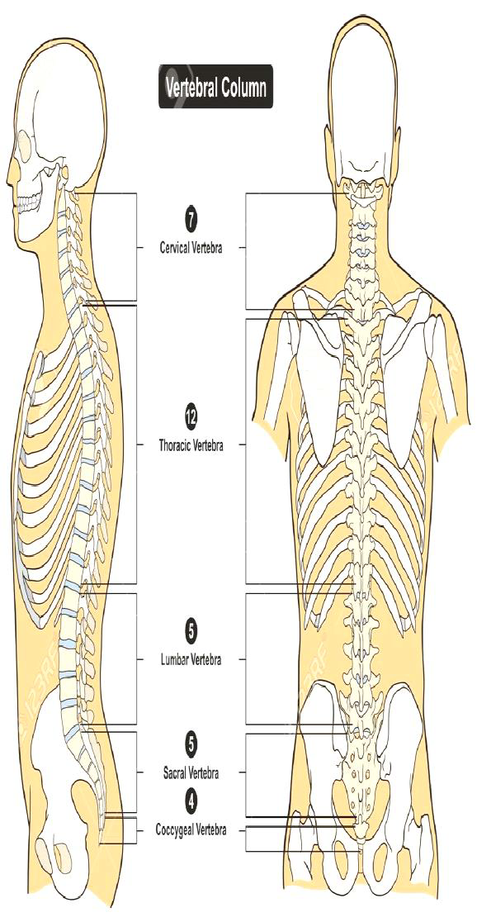
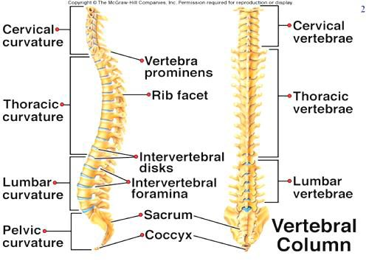

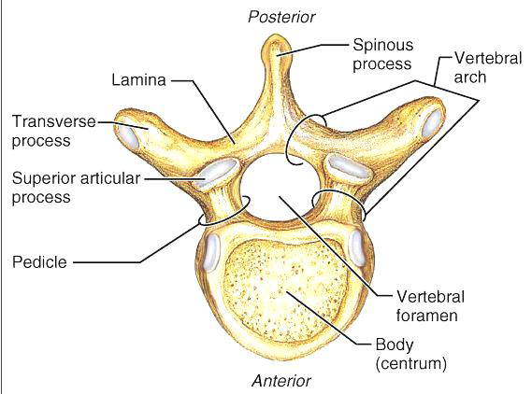
The vertebral column:
is made of a series of irregular bones. it
composed from 33 vertebrae.
1-Cervical vertebrae, (7) in number are
located in neck. The first vertebra, called (the
Atlas),which articulate with the occipital bone
of skull by Atlano-occipital joint. The second
vertebrae called Axis which support the
movement of the atlas vertebrae and skull.
2-Thoracic vertebrae,(12) in number, are
located in the thorax. The posterior ends of
the ribs(12pairs) are attached to these
vertebrae.
3-Lumber vertebrae,(5) in number, are located
in the small of the back they are larger and
heavier than the other vertebrae to support
more weight.
4- Sacral vertebrae.(5)separate bones in the
child. they eventually fuse to form a single
bone called the sacrum in the adult.
5-Coccyx vertebrae, consist of ( 4 or 5 )tiny
bones in the child, these fuse to form a single
bone in the adult.
The typical vertebrae consist from (body,
vertebrae arch, vertebrae foramen, spin
process, transverse process, and articular
process.

Slide 9
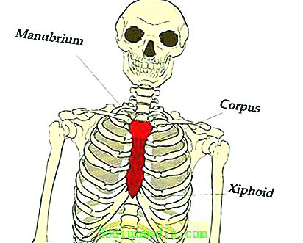
The thoracic cage:
It is composed of bones and muscle. The bones consist of (12) thoracic vertebrae
posteriorly, the sternum anteriorly and the encircling ribs.
The sternum :it forms the middle portion of the anterior wall of the thorax, it consist
of three parts(manubrium, body, xiphoid process).

Slide 10

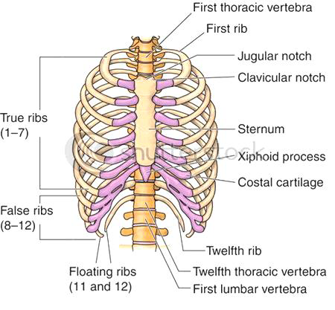
The ribs:
1-there are usually (12)ribs on
each side
2-articulate posteriorly with the
vertebrae column.
3-the upper seven ribs connected
to the sternum through the costal
cartilages.
4- the (eight, ninth, tenth)ribs
have cartilage which are attached
to each other and join to seventh
costal cartilage .
5- the (eleven and twelfths)ribs
are called floating ribs since their
anterior ends are free.

Slide 11


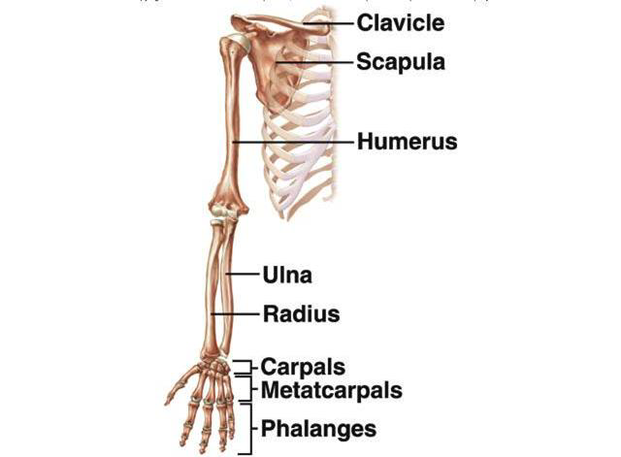

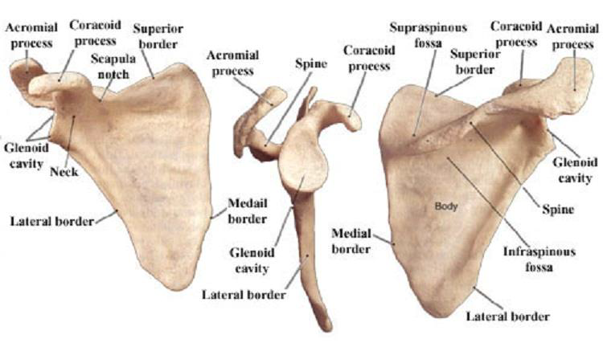
Appendicular skeleton:
The appendicular skeleton may
considered in two division :upper and
lower,
The bones of upper division may be
divided into two groups for ease of
study:
A-The shoulder girdle :consists of two
bones:
-The clavicle bone: is along slender bone
lies horizontal across the neck. Its
Articulated with sternum medially and
scapula laterally.
-The scapula bone: is a flat triangular
bone that lies on the posterior thoracic
wall between the 2nd and 7th rib. there
are two surface( anterior and posterior).
there are three angle to the
scapula(superior, inferior, lateral
angle),and three borders (superior,
medial, lateral).
There are two process that project:
Coracoid process, Acromial process which
articulate with clavicle,while coracoids
process articulate to muscle and
ligament.
The anterior surface is concave form
Supra-scapular fossa, while the posterior
surface divided by spine into Supra-
spinatus fossa and infra spinatus fossa.

Slide 12

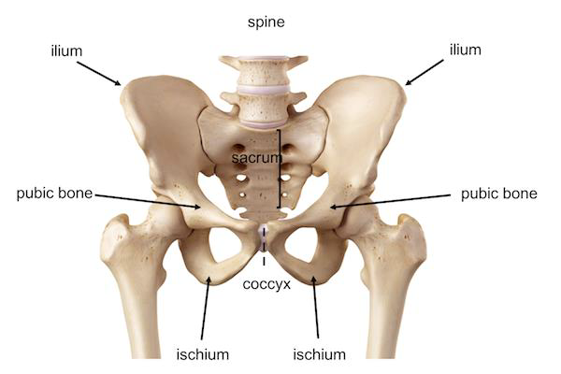

The bones of lower division may be
divided
into two groups:
A-The pelvic girdle
is a strong bony ring that forms the walls of
pelvis. It composed of two hip bones, which
form the front and side of the ring, and sacrum,
which articulates with the hip bones to
complete the ring at the back(posteriorly).Each
hip bone consist of three separated parts:
1-Ilium: Which forms the upper part.
2-Pubis: Which forms the anterior part, the
joint formed by the union of the two hip bones
anteriorly is called the symphysis pubis.
3-Ischium;which is the lowest and strongest
part.
Symphy
sis joint

Slide 13

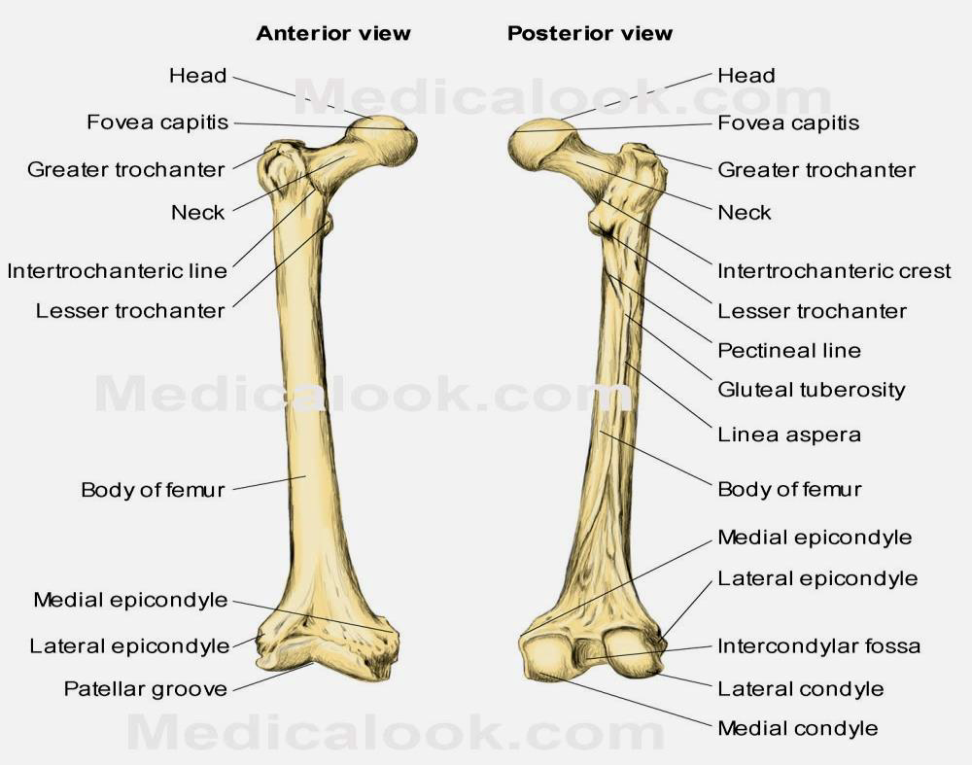
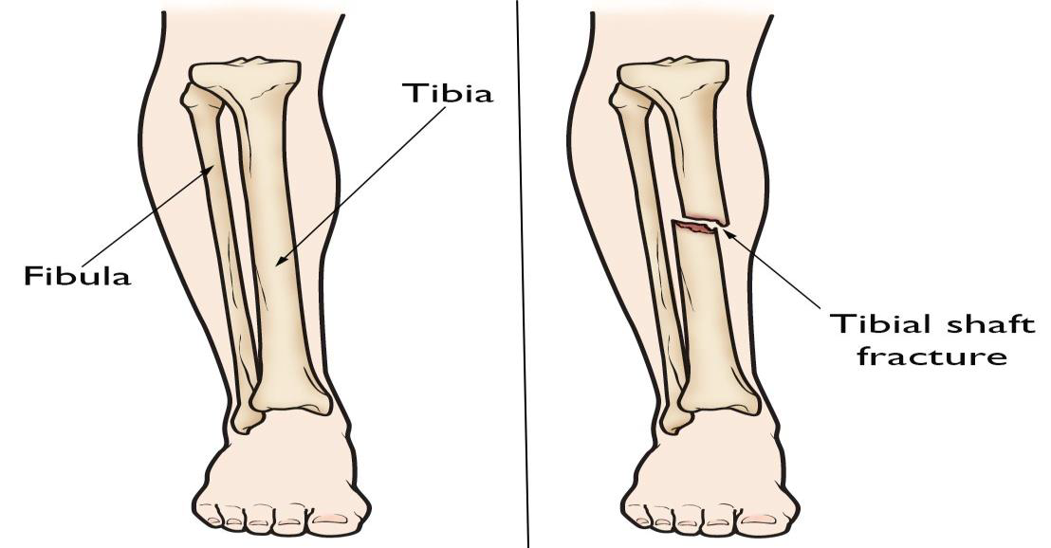
B-Each lower extremity :consists of the
following bones:
1-Thigh bone, called the femur, is the
longest and strong bones in the body.
its has (head, neck, greater and lesser
trochanter ,shaft, lower end (lateral
and medial condoyle).the lower end
articulated to knee joint to articulate to
patella.
2-Patella; it’s the largest sesamoid
bone, triangle in shape, its attached to
tendon of Quadriceps femoris muscle.
3-Leg; there are two bones in the leg,
medially(on the big toe side)the Tibia,
is longer, weight –bearing bone.
Laterally, the slender Fibula.

Slide 14

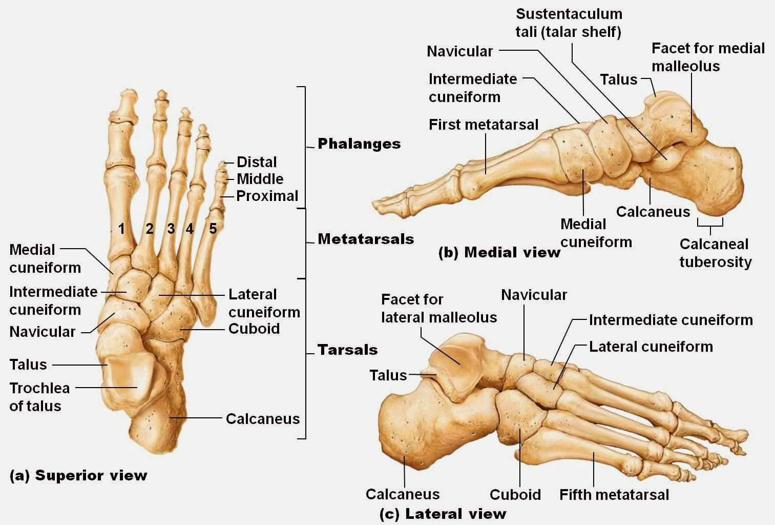
3-Skeleton of the ankle: The structure of the
foot is similar to that of the hand,
the foot support the weight of the body, so it
is stronger and less mobile than
hand ,there are (seven )tarsal bones
associated with ankle and foot; the largest
of these is the Calcaneus bone, talus, cuboid
,navicular,(lateral,intermediate,
medial)cuneiform.
4-Skeleton of the sole> they consist from
(five)metatarsal bone ,each has base
articulate with the anterior row of ankle
bone and apex articulated with the
phalanges of foot .
5-Skeleton of the toes: the phalanges of the
toes are counterparts of those in finger.
There are three in each toe except for greater
toe, which has only two.

