Slide 1
Lecture - 1
Symbols and abbreviation, units, Electric circuit and it’s Elements

Slide 2
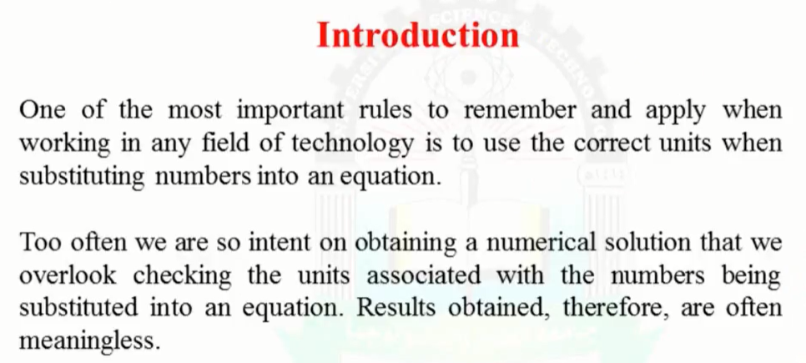
Introduction

Slide 3
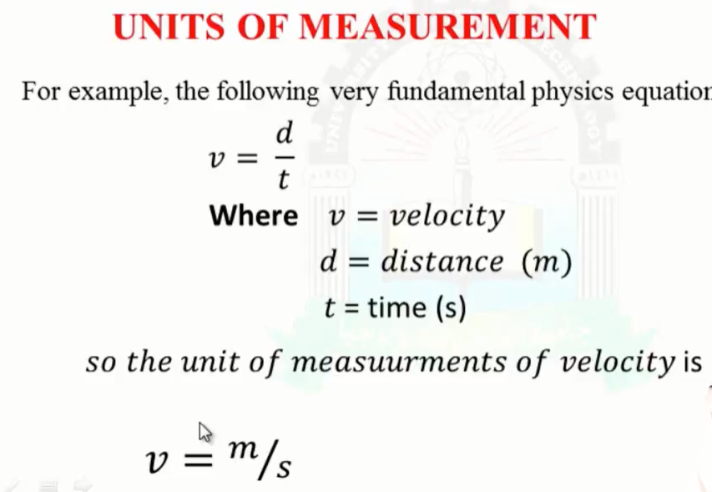
Units of measurement

Slide 4
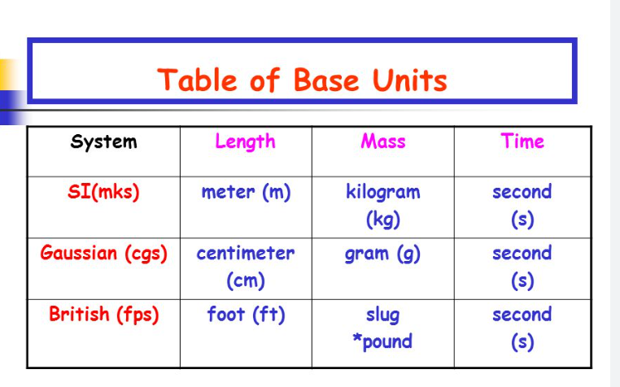
System of units

Slide 6
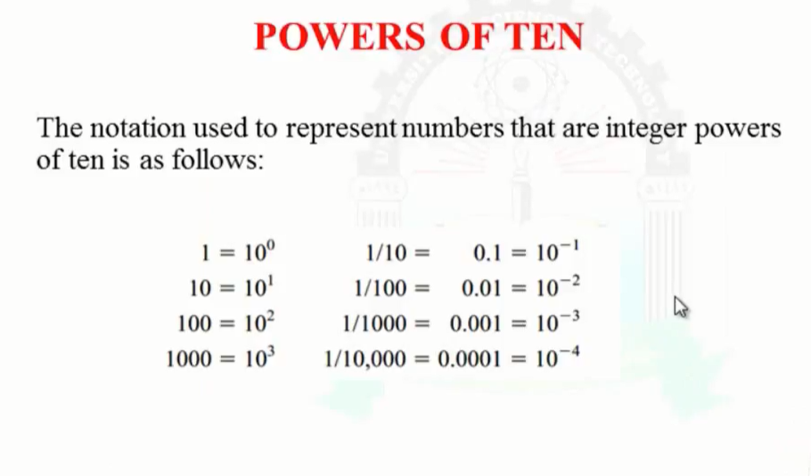
Power of ten

Slide 7
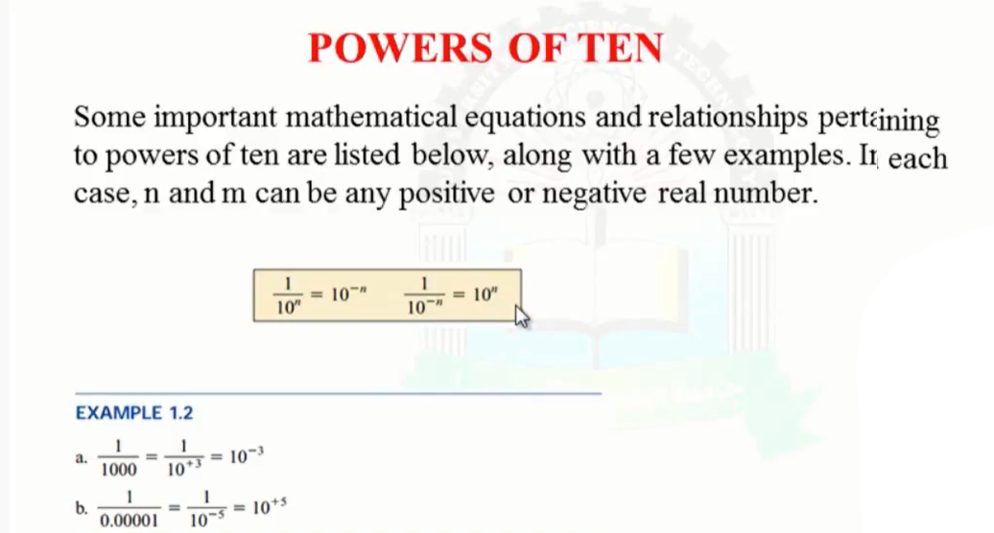
Powers of ten

Slide 8
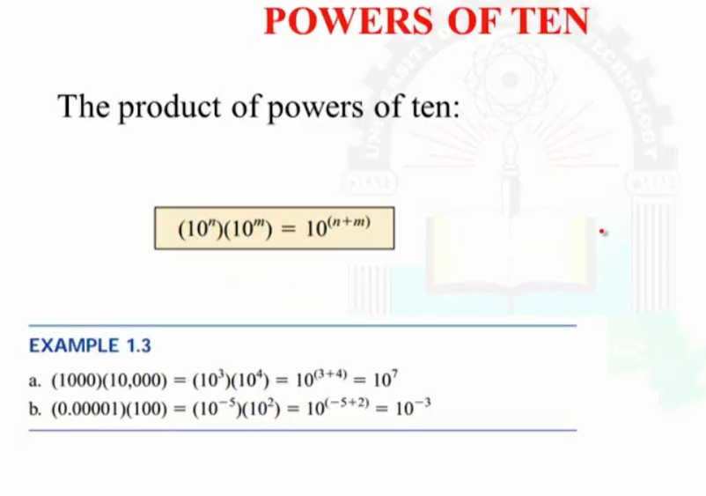
continue

Slide 9
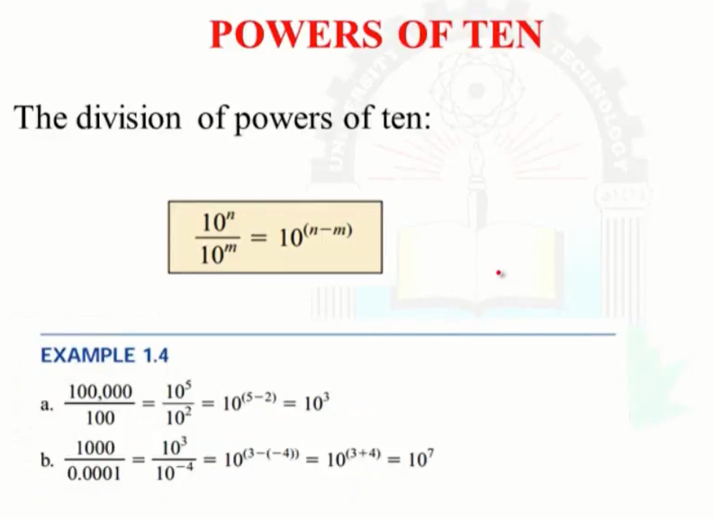
continue

Slide 10
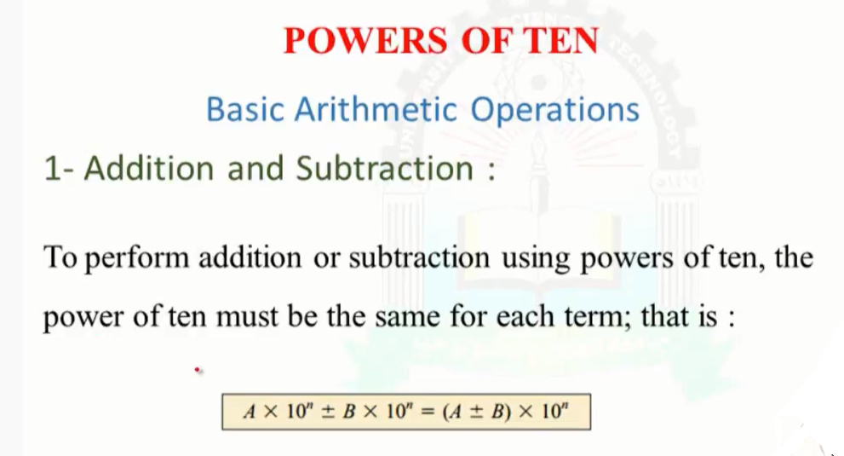
Addition and subtraction

Slide 11
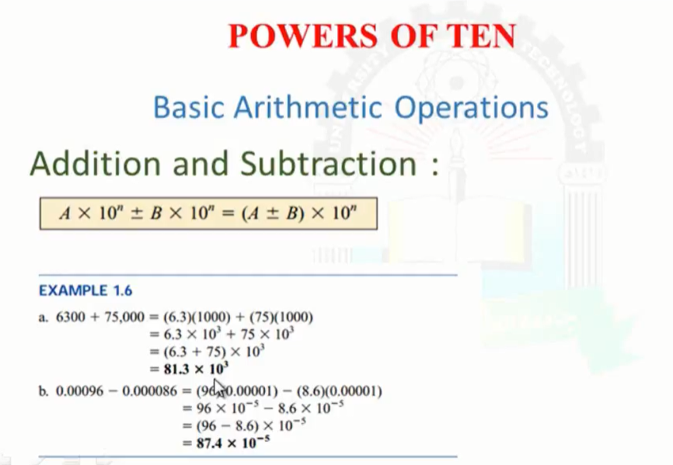
1. Addition and subtraction

Slide 12
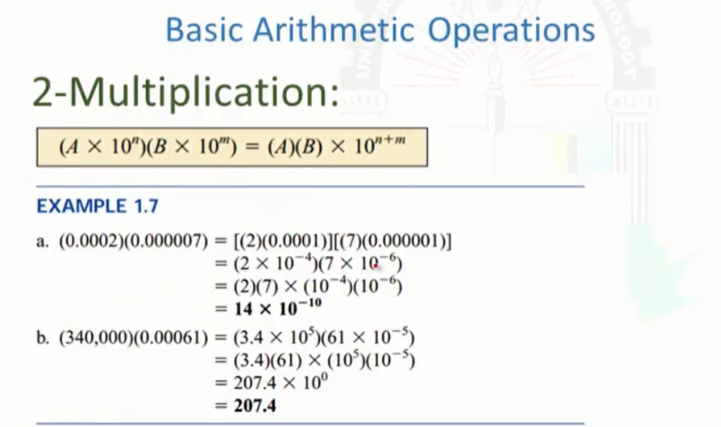
2. Multiplication

Slide 13
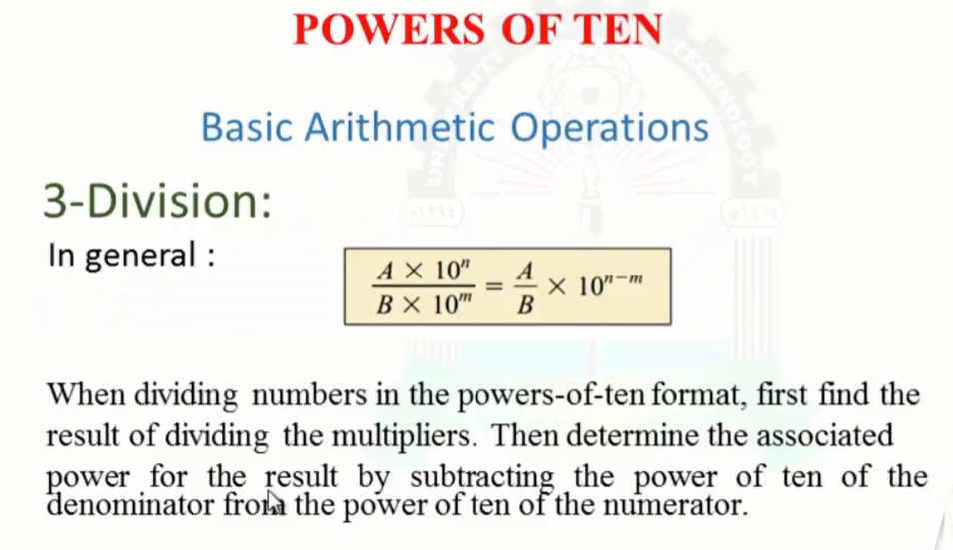
3. Division

Slide 14
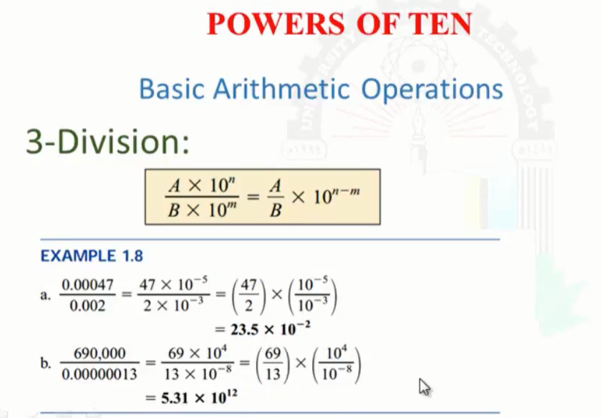
continue

Slide 15
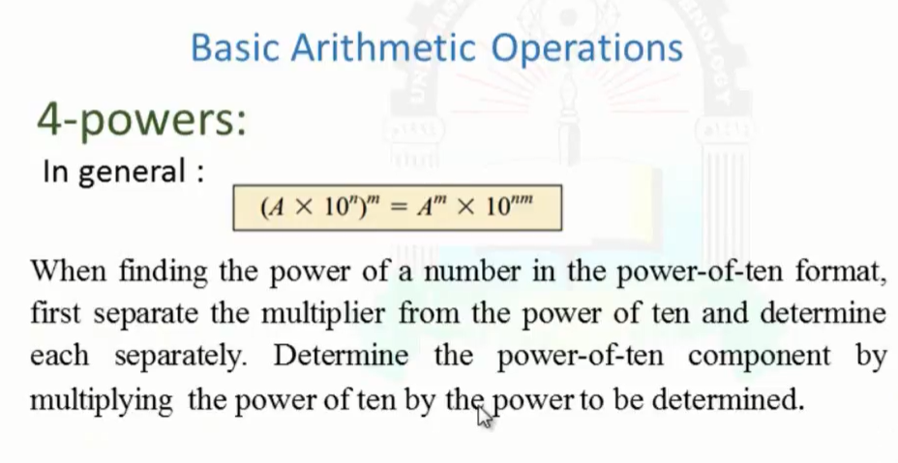
4. Powers

Slide 16
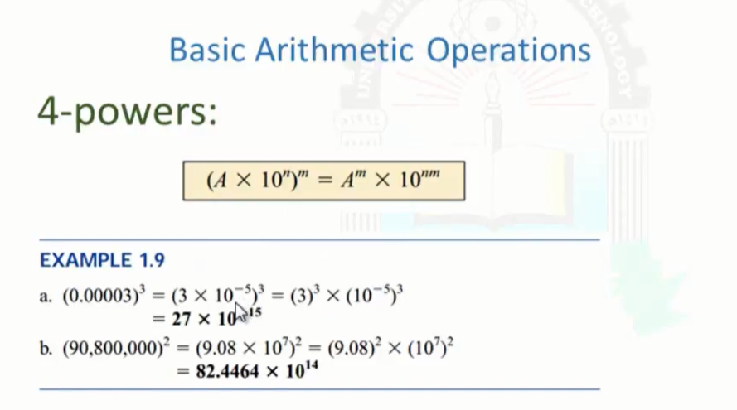
continue

Slide 17
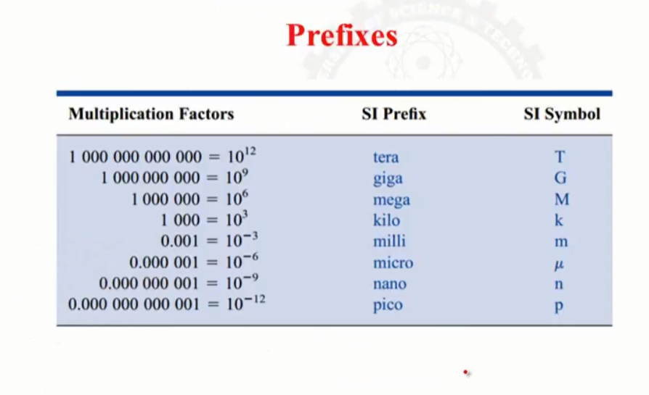
prefixes

Slide 18
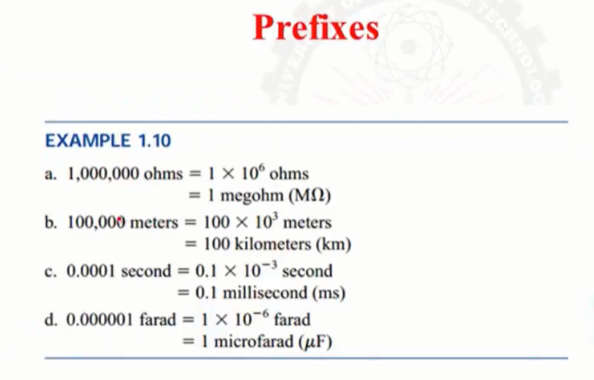
continue

Slide 19
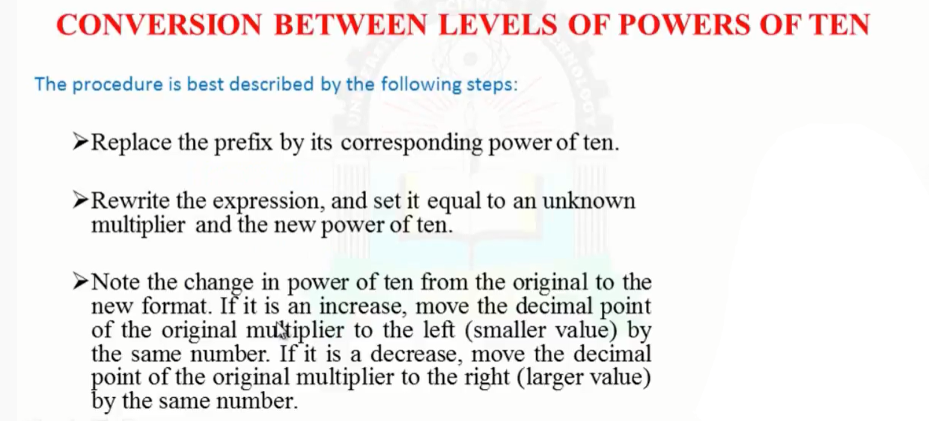
CONVERSION BETWEEN LEVELS OF POWER OF TEN

Slide 20
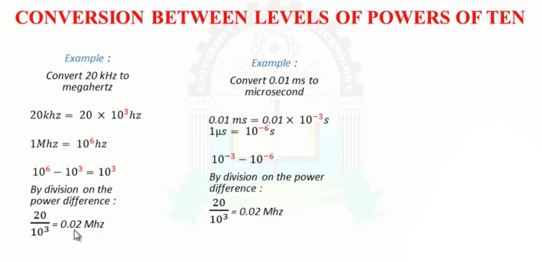
continue

Slide 21
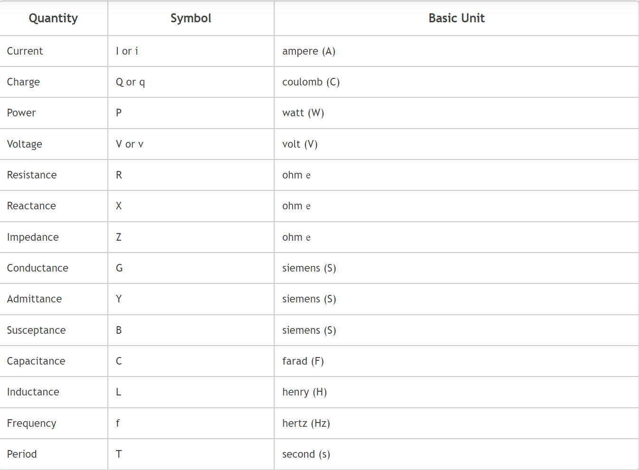
Electrical symbols and abbreviations and units

Slide 22
Electric Circuit and its elements
A circuit is an interconnection of elements. Based on their capability to generate energy these elements are classified into active or passive elements.
Electric circuits are made up of three circuit components. These are resistance, inductance, and capacitance.
These are called passive circuit elements and they do not transfer electrical energy.
On the other hand, there are active elements like voltage and current sources which transfer electrical energy to the circuits.

Slide 23
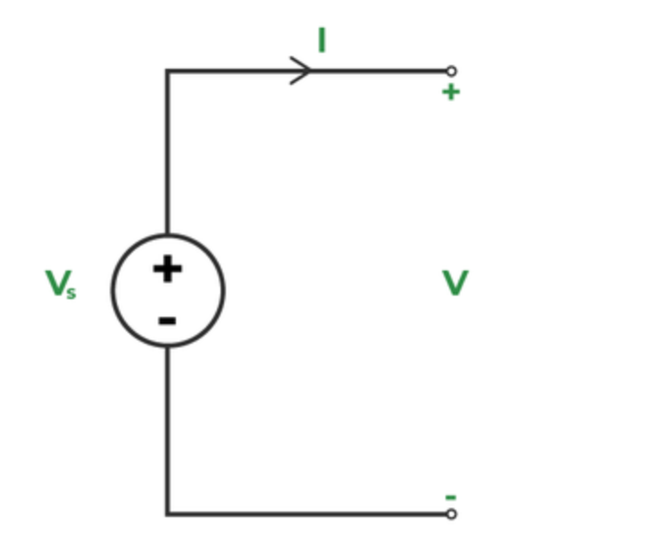
Active Elements
The term “active element” refers to an independent source that can continually produce or absorb energy. They are Voltage source and current source
An independent voltage source is shown as,

Slide 24
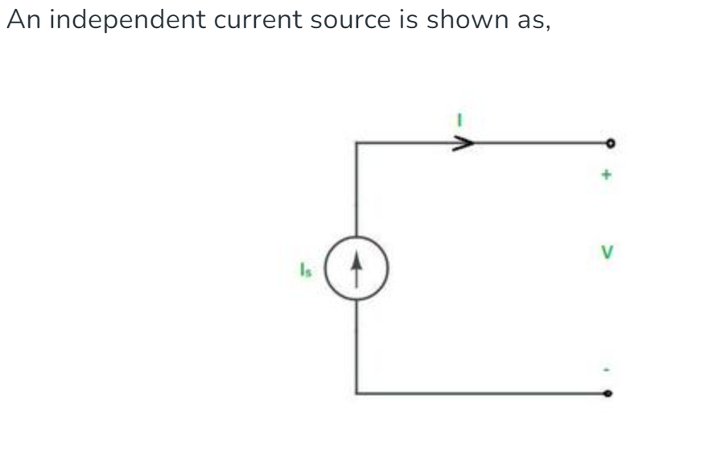
continue

Slide 25
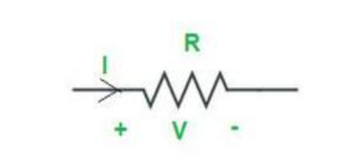
Passive Elements
Elements like resistance, inductance, and capacitance are called passive elements.
1. Resistance :
Resistance is defined as the property of a substance that opposes the flow of charge or electricity through it. Conductors offer very little resistance and hence readily allow electricity to flow through them, whereas insulating materials offer such a high resistance that they allow practically no electricity to flow through them. The practical unit of resistance is the ohm (Ω). The resistance of a conductor will be 1Ω when it allows 1A current to flow through it on the application of 1V across its terminals.

Slide 26
Ohm’s Law
Ohm’s law states that the voltage across a resistor equals the product of the current flowing through it and the resistance of the resistor. It may be expressed mathematically as
V = IR
⇒ I = V/R
The resistance offered by a conducting material varies as follows:
It is directly proportional to its length.
It is inversely proportional to the conductor’s cross-sectional area.
It depends on the nature of the material.
It is also affected by the conductor’s temperature.

Slide 27
continue
Thus, the resistance R offered by the conductor is given by,
R = ρ l/A
where l is the length of the conductor, A is the cross-sectional area and ρ is a constant of the material, generally known as the specific resistance or resistivity of the material.
The resistivity of a material depends on its nature and the temperature of the conductor, but not on its shape and size.

Slide 28
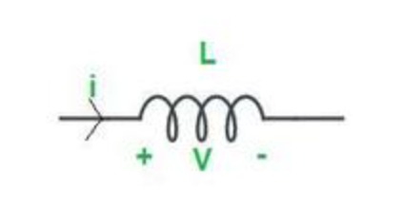
2. Inductance
Inductance is the storage element that can store and deliver energy but its energy-handling capacity is limited.
Inductor stores energy in the form of magnetic field. When a conductor is wound like a spring, then it is said to be a coil. The coil will exhibit ideally inductance(L) and practically some leakage resistance (R), which is modeled in series with the inductance. Henry is the practical unit of inductance (H).
An inductor is a practical inductance.

Slide 29
Continue
The inductance of an inductor or a coil depends on the following factors :
It is directly proportional to the permeability of the magnetic material over which the coil is wound.
It is directly proportional to the coil’s cross-sectional area.
It is inversely proportional to the coil’s length.
It is directly proportional to the square of the number of the coil.

Slide 30
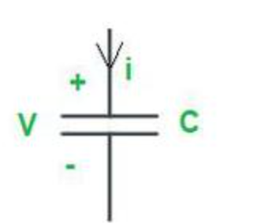
3-Capacitance
A Capacitor is a Passive element that stores energy in the form of electric field. It is a practical element that have the property of capacitance.
Farad is the unit of capacitance (F). A capacitor typically consists of two conducting plates that are separated by a dielectric material. The capacitor holds a positive charge when a positive voltage is placed across it. The capacitor also stores a negative charge when a negative voltage is placed across it. Capacitor only allows A.C current to pass through them and stops D.C Current. That’s why Capacitor is used to filter non-A.C Component of current.

Slide 31
continue
As a result, the quantity of charge stored in the capacitor is proportional to the applied voltage V across it, and the relationship is linear. It may be expressed mathematically as
Q ∝ V
⇒ Q = CV
where C = the conductor's capacitance
Q = the charge held in a capacitor.
The capacitance of a capacitor is determined by the following factors:
It is directly proportional to the surface area of the plate.
The distance between the two plates is inversely proportional to it.
It is proportional to the medium’s permittivity between the two plates.
It is directly proportional to the permittivity of the medium between the two plates.

