Slide 1
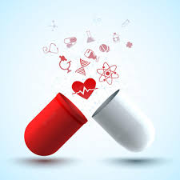


Pharmacology
By :Dr. Sarmad Mohammed Al-Hadithy

Slide 2
General of pharmacology
Pharmacology is a branch of medicine, biology, and pharmaceutical sciences concerned
with drug or medication action or as a science deals with all aspects of knowledge about drugs including
Source of drug
Physical and chemical properties
Biochemical and physiological effects
Pharmacokinetic and pharmacodynamics
Mechanism of action
Adverse effects.
Therapeutic and other uses.

Slide 3
General of pharmacology
Drug where a drug may be defined as any artificial, natural, or endogenous (from within the body) molecule or any substance (other than food) which exerts a biochemical or physiological effect on the cell, tissue, organ, or organism that is used to prevent, diagnose, treat, or relieve symptoms of a disease or abnormal condition.
Drug are obtained from six major sources:
Plant sources
Animal sources
Mineral/ Earth sources
Microbiological sources
Semi synthetic sources/ Synthetic sources
Recombinant DNA technology

Slide 4
General of pharmacology
Pharmacokinetics it is a branch of pharma., it deals with the study of at bsorption, distribution, metabolism and excretion (ADME) of drugs. In other words, studying the effect of body on drug,
including four major processes:
Absorption is transport of drug from site of administration into systemic circulation.
Distribution (movement of the drug from blood stream to its site of action).
Metabolism (conversion of drug from its inactive form to its active form or vice versa, takes place in liver by microsomal enzymes system P450).
Excretion or Elimination (removal of the drug and its metabolites from the body through kidneys, bile, lungs and skin).

Slide 5
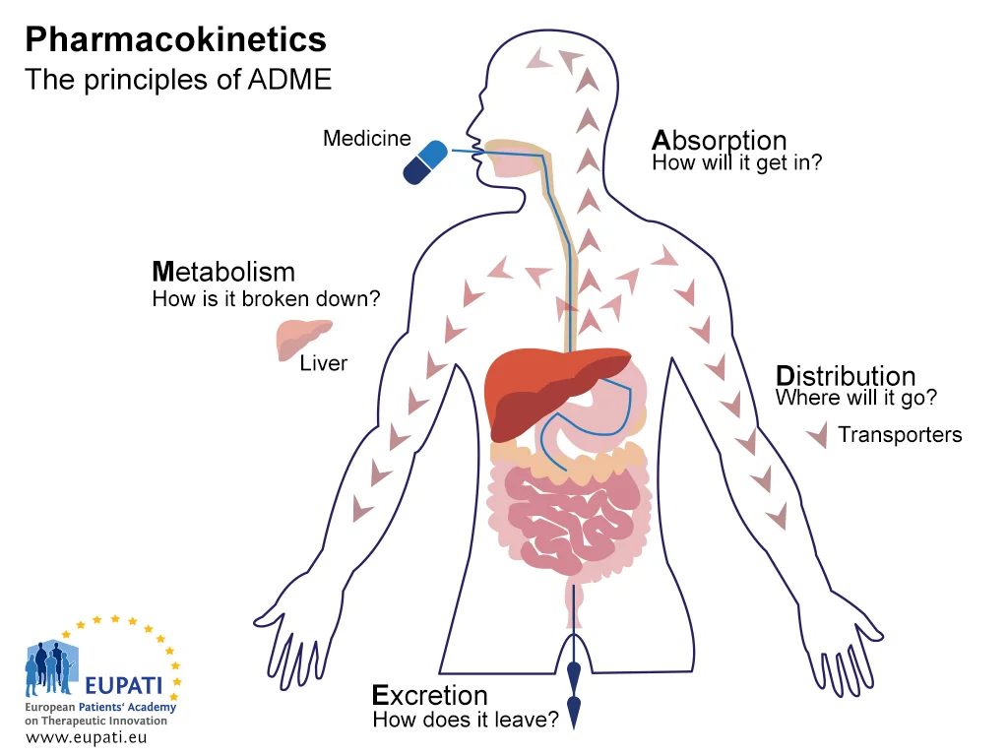
General of pharmacology

Slide 6
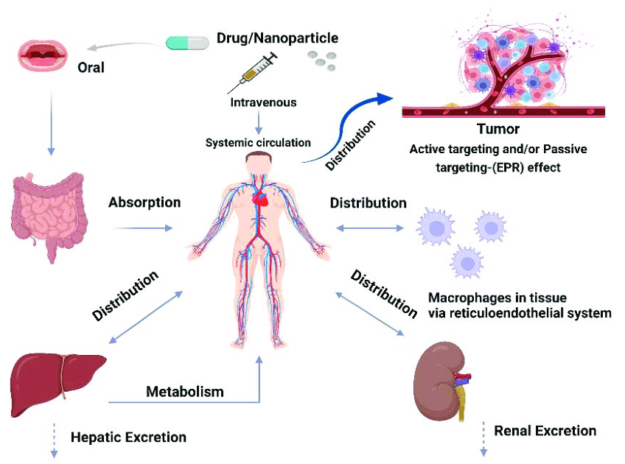
General of pharmacology

Slide 7
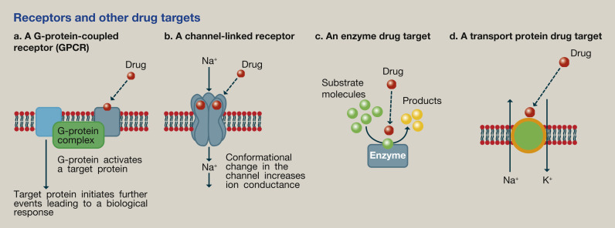
General of pharmacology
Pharmacodynamics: It deals with the study of biochemical and physiological effects of drugs and their mechanism of action. In other words, it means "What the drug does to the body".

Slide 8
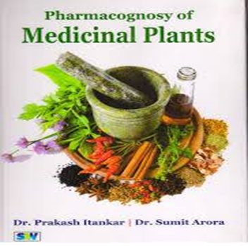

Pharmacognosy: It deals with the study of drugs derived from plant and animal sources (their sources, identification, constituents and detection of substituents or adulterants).

Slide 9
General of pharmacology
Pharmacometrics is a field of study of the methodology and application of models for disease and pharmacological measurement. It uses mathematical models of biology, pharmacology, disease, and physiology to describe and quantify interactions between xenobiotics and patients (human and non-human), including beneficial effects and adverse effects.
Pharmacy is the study and practice of finding, making, preparing, administering, reviewing, and monitoring of medicines with the goal of ensuring their safe, efficient, and affordable usage.

Slide 10
General of pharmacology
Toxicology is the study of the adverse effects of chemical, physical, or biological agents on living organisms and the ecosystem, including the prevention and amelioration of such adverse effects.
Pharmacological effect :is effect of a drug on cells, organs and systems refers to the specific biochemical interaction produced by a drug substance, which is called its mechanism of action.

Slide 11
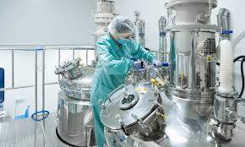
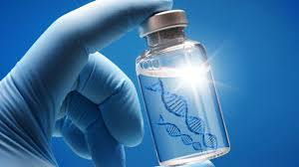
General of pharmacology
Therapeutics is a practical branch of medicine dealing with the application of all sciences in the treatment of diseases. It includes use of drugs, surgery, radiation, diets, exercise and management practices.
Bio pharmaceutics It deals with the development of new drug delivery systems and new dosage forms. It also provides information how these dosage forms can influence the pharmacodynamic and pharmacokinetic

Slide 12
General of pharmacology
Posology It deals with study of determination of drug dosage of remedies. It may also be defined as the study of drug dosage.
Chemotherapy is a drug treatment that uses powerful chemicals to kill fast-growing cells in your body.
Chemotherapy is most often used to treat cancer, since cancer cells grow and multiply much more quickly than most cells in the body.

Slide 13
General of pharmacology
Dose the amount of drug that necessary to elicit the desired therapeutic effect or response in the patient.
Dosage determination and regulation of doses.
Adverse effect An undesired effect of a drug or other type of treatment, such as surgery. Adverse effects can range from mild to severe and can be life-threatening.
Side effect A side effect is an undesired effect that occurs when the medication is administered regardless of the dose.

Slide 14
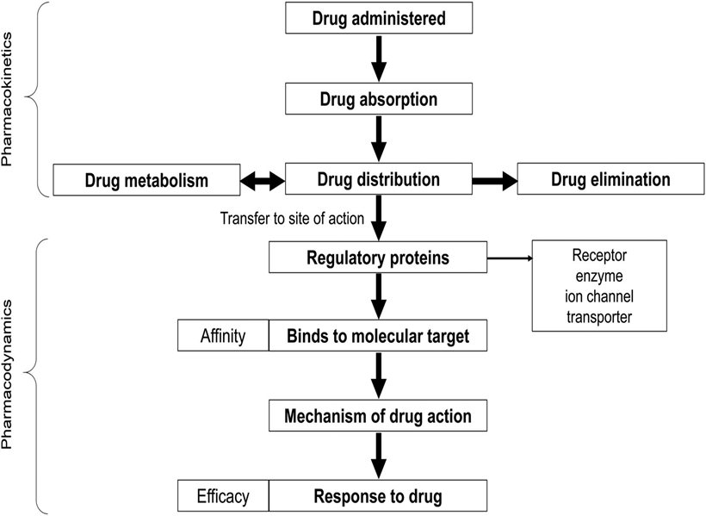

Slide 15


