Slide 1
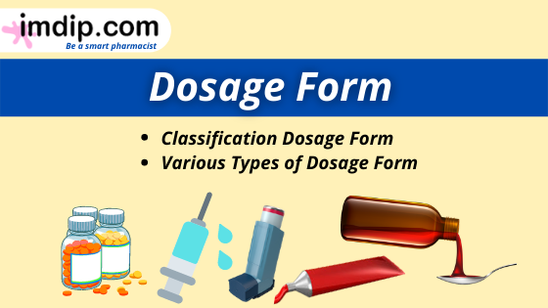
Drug form
MSc.Sarmad.Mohammed

Slide 2
Definition of Dosage form:
Dosage Form means the physical form or the vehicle by which drug molecules are delivered to sites of action within the body to get therapeutic value.
Example: Tablet is solid dosage form

Slide 3
Benefits of Dosage form:
A pharmaceutical dosage form is an entity OR form of drug that is administered to patients so that they receive an effective dose of a drug. Some common examples are tablets, capsules, suppositories, injections, suspensions, and transdermal patches. Besides providing the mechanism for the safe and convenient delivery of accurate dosage, pharmaceutical dosage forms are needed for the following additional reasons:
Some drug substances have a bitter, salty, or unpleasant taste or odor in this case capsules, coated tablets, flavored syrup are used to mask up this taste.
Dosage forms play an important role to target the drug at the desired site of action

Slide 4
Benefits of Dosage form:
To protect the drug substance from the destructive influence of atmospheric oxygen or humidity (coated tablets).
To protect the drug substance from the destructive influence of gastric acid after oral administration (enteric-coated tablets).
To provide liquid preparations of substances that are either insoluble or unstable in the desired vehicle (suspensions).
To provide rate-controlled drug action (various controlled-release tablets, capsules, and suspensions).
To provide site-specific and local drug delivery (e.g., rectal and vaginal suppositories)

Slide 5
Classification Dosage form:
Basically, there are 4 types of dosage forms.
Solid Dosage Form
Semi-solid Dosage Form
Liquid Dosage Form
Gaseous Dosage Form
According to the route of administration, there are
Oral Dosage Form
Topical Dosage Form
Rectal Dosage Form
Parenteral Dosage Form
Vaginal Dosage Form
Inhaled Dosage Form
Ophthalmic Dosage Form
Otic Dosage Form

Slide 6
Solid Dosage Form:
The solid dosage forms are one type of dosage form, It's solid in nature which contains one or more drugs for therapeutic effects and excipients like binding agents, sweetening agents, coloring agents, etc.
Example of solid dosage form:
Tablets, capsules, granules, sachets, powders, powder for inhalation, etc.

Slide 7
Liquid dosage forms
Liquid dosage forms are either solutions or suspensions of active drug in a liquid such as water, alcohol, or other solvent. Since liquid dosage forms for oral use bring the drug and vehicle into contact with the mouth and tongue, they often contain various flavours and sweeteners to mask unpleasant tastes. They usually also require sterilization or addition of preservatives to prevent contamination or degradation.

Slide 8
Semi-solid Dosage Form:
Semisolid dosage forms are that types of dosage forms that contain both solid and liquid. It is used for therapeutic, protective, or cosmetic functions. It may be applied to the skin, nasal, vaginal, or rectal cavity. Normally used for topical or external application.
Examples of semi-solid dosage form:
Ointments, pastes, cream, plasters, gels, and rigid foams.

Slide 9
Gaseous Dosage Form:
Gaseous dosage forms are gas in nature. In the form of gas, therapeutically active medicaments are present in it. It may be applied for internal as well as external purposes like skin, nose, mouth, etc.
Examples of semi-solid dosage forms: Sprays, Vaporizer, Aerosols, Nebulizer, Inhalers, etc

Slide 10
Oral Dosage Forms
Topical dosage forms are those dosage forms that are administered or used on the topical areas (like- skin, mucus membrane).
Examples like emulsions, ointments, creams, gels, pastes, dusting powders, transdermal patches, liniments, lotion, collodion, paints, pressurized dispensers (aerosol sprays), etc.

Slide 11
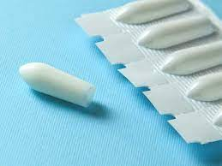
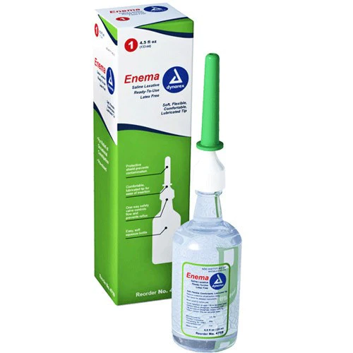
Rectal Dosage Form
Rectal dosage forms are those dosage forms that are administered through the rectum. Examples Like Suppository, Enema, etc.
Suppository
Enema

Slide 12
Parenteral Dosage Form
Parenteral dosage forms are those dosage forms that are administered through the vein, muscle, arteries, subcutaneous, etc.
Examples like intramuscular injection, intravenous injection, intraarterial injection, subcutaneous injection.

Slide 13

Vaginal Dosage Form
Vaginal dosage forms are those dosage forms that are administered through the vagina. Examples like pessary, vaginal ring, douche, intrauterine device
Vaginal douche

Slide 14

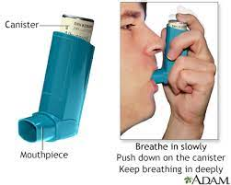
Inhaled Dosage Form
Inhaled dosage forms are those dosage forms that are administered through the nose or mouth. Examples like an inhaler, powder for inhalation, nebulizer, solution for inhalation, etc
inhaler
nebulizer

Slide 15
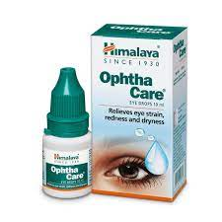
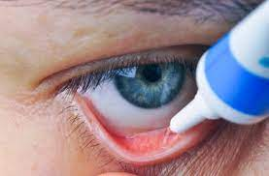
Ophthalmic Dosage Form
Ophthalmic dosage forms are those dosage forms that are administered through the eyes. Like eye drops, ophthalmic ointments, and gels.

Slide 16
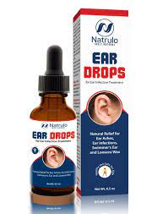
Otic Dosage Form
Otic dosage forms are those dosage forms that are administered through the ears. Like ear drops

Slide 17
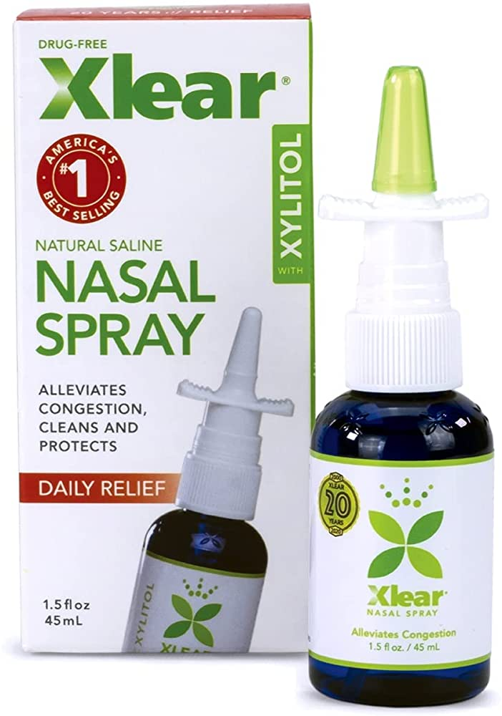
Nasal Dosage Form
These are those dosage forms that are applied on the nose trills. Examples like nasal drops and sprays.

Slide 18
Pharmaceutical Applications of suspensions:
Some drugs are insoluble or partially soluble, there is the application of suspension. Example- Prednisolone.
Some of the drugs are very bitter taste. Suspension helps to mask the sweet taste of the drug. Example- Chloramphenicol palmitate suspension.
Suspension prevents degradation or improves the stability of the drug. Example- Oxytetracycline suspension.

Slide 19
Pharmaceutical Applications of suspensions:
Parenteral suspensions are also applicable in order to control the rate of drug absorption, Example- penicillin procaine.
In the cosmetic industry, there are huge applications of suspension. Example- Lotions contain insoluble solid particles to spread a thin coating of medicament on the skin. Like- calamine lotion, etc.

Slide 20
Suspending agents:
Suspending agents are those substances, which help active pharmaceutical ingredients to stay suspended into the suspension.
Example: Methylcellulose, Carboxy methylcellulose (CMC), Hydroxy propyl methylcellulose (HPMC), Sodium alginate, etc

Slide 21
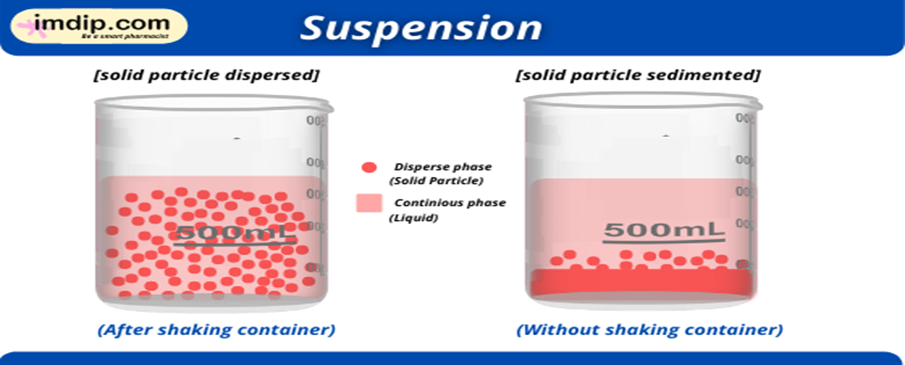
Suspending agents:

Slide 22
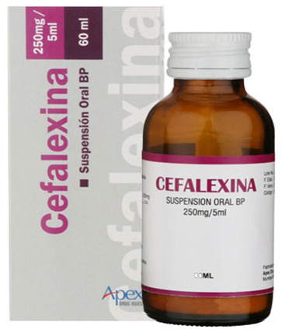
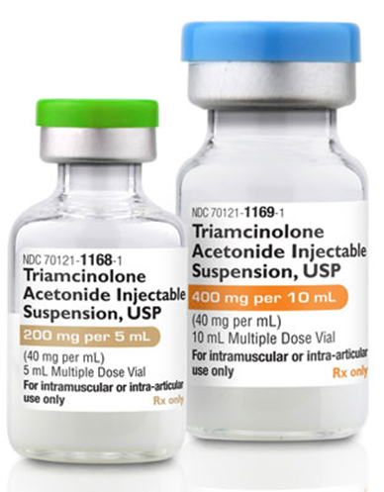
Classification of Suspensions:
1. Classification of suspension depending on the route of administration:
Oral suspension: Those suspensions which administered through the oral route. Example: Paracetamol suspension.
Parenteral suspension: Those suspensions administered through the intravenous and intramuscular routes. Example: Sodium benzylpenicillin suspension.

Slide 23
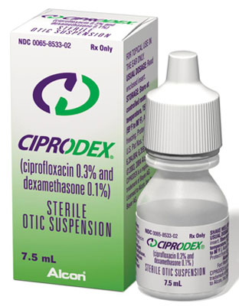
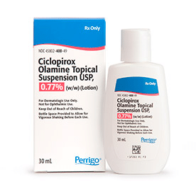
Classification of Suspensions:
Ophthalmic suspension: This type of suspension is used for the eyes. The particle size should very fine, non-irritant, sterile, and isotonic.
Topical suspension: Those suspensions for topical or external uses. Example: Calamine lotion

Slide 24
Advantages of a Suspension:
A suspension is a dosage form that can improve the chemical stability of certain drugs. Like Procaine penicillin G.
Suspension can improve the taste of various bitter tastes of the drug by masking them. Example Chloramphenicol
The drug in suspension exhibits a higher rate of bioavailability than other dosage forms.
Duration and onset of action can be controlled. For example Protamine Zinc-Insulin suspension.

Slide 25
Disadvantages of a Suspension:
Sedimentation of the particle is one of the disadvantages of this dosage form.
The formulation is quite difficult than other dosage forms.
100% uniform and accurate dose are not possible.

Slide 26
Additives or excipients used in the preparation of suspension:
Wetting Agents: Hydrophilic materials are wetted by water but hydrophobic materials are not wetted by water, it's wetted by non-polar liquids.
Surfactants: Example- Polysorbate 80
Hydrophilic colloids: Example- acacia, tragacanth, alginates, guar gum.
Solvents: Example- alcohol, glycerin, polyethylene glycol, and polypropylene glycol.
Buffers: Example- buffers are salts of weak acids such as carbonates, citrates, gluconates, phosphate

Slide 27
Additives or excipients used in the preparation of suspension:
Coloring Agents: Colouring agents are used in the suspension to improve the acceptance of consumers. Example- Brilliant blue, Indigo carmine(blue), Tartrazine (yellow), Titanium dioxide (white), Amaranth (red),
Sweetening Agents: Sweetening agents are used to overcoming the unpleasant taste of the formulation. Example- xylose, ribose, glucose, mannose.
Humectants: It absorbs moisture to prevent the degradation of active pharmaceutical ingredients by moisture. Example- Propylene glycol, glycerol.
Antioxidants: Example- ascorbic acid, erythorbic acid, glycerol, cytosine, acetylcysteine, etc
Preservatives: Preservatives are those ingredients used for the preservation or for the protection of the formulation from the attack of microorganisms. Example- Propylene glycol, Benzoic acid.

Slide 28


