Slide 1
Al- Maʹmon University College
Department of English
First Year
Phonetics
By: ASSIST. Lect. Husham Alyasiri

Slide 2

Branches of phonetics:
Articulatory phonetics: deals with the production of sounds by the speech organs.
Acoustic phonetics: deals with the physical properties of sounds by waves
Auditory phonetics: the hearing & perception of sounds as mediated by ear, auditory nerve & brain

Slide 3
The differences between letters and sounds
Sounds are spoken . Letters are written
Letters are used in writing . They are abstract symbols or marks making no noise on paper, while sounds are organized and noisy , distinguished by our ears. used in speech

Slide 4
IPA symbols for English consonants
Many IPA symbols represent the same sound that the corresponding English letters do -- [p], [b], [m], [f], [v], [t], [d], [l], [w] -- though even for these you have to be careful. Other symbols are a bit harder.

Slide 5
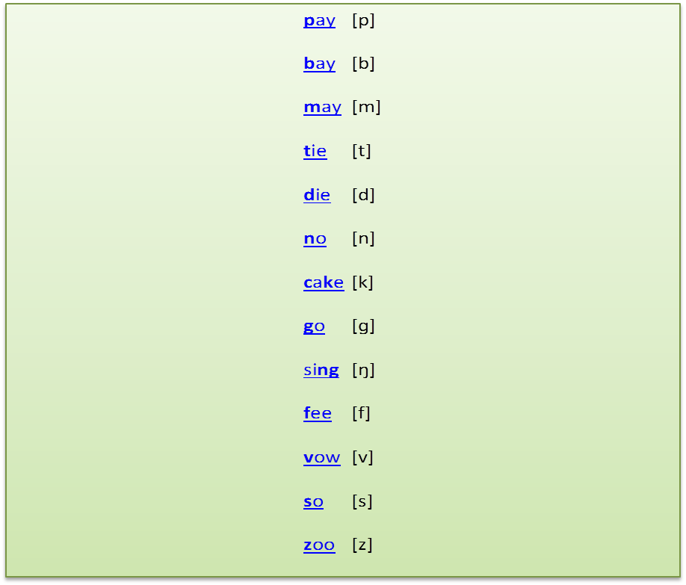

Slide 6
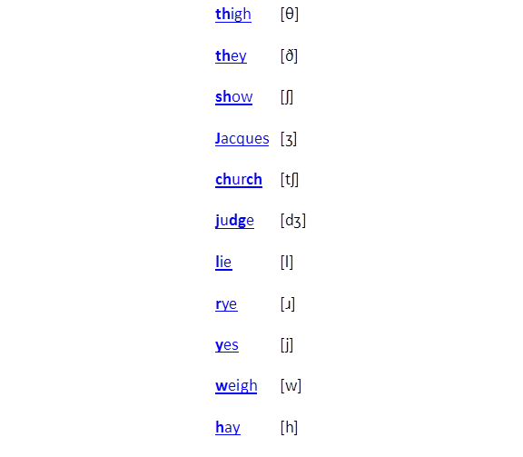

Slide 7


