Slide 1
Discrete Mathematics
Logic & Boolean Algebra

Slide 2
Mathematical Logic
Definition: Methods of reasoning, provides rules and techniques to determine whether an argument is valid
Theorem: a statement that can be shown to be true (under certain conditions)
Example: If x is an even integer, then x + 1 is an odd integer
This statement is true under the condition that x is an integer is true

Slide 3
Mathematical Logic
A statement, or a proposition, is a declarative sentence that is either true or false, but not both
Uppercase letters denote propositions
Examples:
P: 2 is an even number (true)
Q: 7 is an even number (false)
R: A is a vowel (true)
The following are not propositions:
P: My cat is beautiful
Q: My house is big

Slide 4
Mathematical Logic
Truth value
One of the values “truth” (T) or “falsity” (F) assigned to a statement
Negation
The negation of P, written , is the statement obtained by negating statement P
Example:
P: A is a consonant
: it is the case that A is not a consonant
Truth Table
P
T F
F T

Slide 5
Mathematical Logic
Conjunction
Let P and Q be statements.
The conjunction of P and Q, written P ^ Q , is the statement formed by joining statements P and Q using the word “and”
The statement P ^ Q is true if both p and q are true; otherwise P ^ Q is false
Truth Table for Conjunction:

Slide 6
Mathematical Logic
Disjunction
Let P and Q be statements. The disjunction of P and Q, written P v Q , is the statement formed by joining statements P and Q using the word “or”
The statement P v Q is true if at least one of the statements P and Q is true; otherwise P v Q is false
The symbol v is read “or”
Truth Table for Disjunction:

Slide 7
Mathematical Logic
Implication
Let P and Q be statements.The statement “if P then Q” is called an implication or condition.
The implication “if P then Q” is written P → Q
P is called the hypothesis, Q is called the conclusion
Truth Table for Implication:

Slide 8
Mathematical Logic
Implication
Let P: Today is Sunday and Q: I will wash the car.
P → Q :
If today is Sunday, then I will wash the car
The converse of this implication is written Q → P
If I wash the car, then today is Sunday
The inverse of this implication is
If today is not Sunday, then I will not wash the car
The contrapositive of this implication is
If I do not wash the car, then today is not Sunday

Slide 9
Mathematical Logic
Biimplication
Let P and Q be statements. The statement “P if and only if Q” is called the biimplication or biconditional of P and Q
The biconditional “P if and only if Q” is written P ↔ Q
“P if and only if Q”
Truth Table for the Biconditional:

Slide 10
Mathematical Logic
Precedence of logical connectives is:
highest
^ second highest
v third highest
→ fourth highest
↔ fifth highest

Slide 11
Mathematical Logic
Tautology
A statement formula A is said to be a tautology if the truth value of A is T for any assignment of the truth values T and F to the statement variables occurring in A
Contradiction
A statement formula A is said to be a contradiction if the truth value of A is F for any assignment of the truth values T and F to the statement variables occurring in A

Slide 12
Mathematical Logic
Logically Implies
A statement formula A is said to logically imply a statement formula B if the statement formula A → B is a tautology. If A logically implies B, then symbolically we write A → B
Logically Equivalent
A statement formula A is said to be logically equivalent to a statement formula B if the statement formula
A ↔ B is a tautology. If A is logically equivalent to B , then symbolically we write A B

Slide 13
Mathematical Logic

Slide 14
Inference and Substitution

Slide 16
Quantifiers and First Order Logic
Predicate or Propositional Function
Let x be a variable and D be a set; P(x) is a sentence
Then P(x) is called a predicate or propositional function with respect to the set D if for each value of x in D, P(x) is a statement; i.e., P(x) is true or false
Moreover, D is called the domain (universe) of discourse and x is called the free variable

Slide 17
Quantifiers and First Order Logic
Universal Quantifier
Let P(x) be a predicate and let D be the domain of the discourse. The universal quantification of P(x) is the statement:
For all x, P(x) or
For every x, P(x)
The symbol is read as “for all and every”
or
Two-place predicate:

Slide 18
Quantifiers and First Order Logic
Existential Quantifier
Let P(x) be a predicate and let D be the universe of discourse. The existential quantification of P(x) is the statement:
There exists x, P(x)
The symbol is read as “there exists”
or
Bound Variable
The variable appearing in: or

Slide 19
Quantifiers and First Order Logic
Negation of Predicates (DeMorgan’s Laws)
Example:
If P(x) is the statement “x has won a race” where the domain of discourse is all runners, then the universal quantification of P(x) is , i.e., every runner has won a race. The negation of this statement is “it is not the case that every runner has won a race. Therefore there exists at least one runner who has not won a race. Therefore:

Slide 20
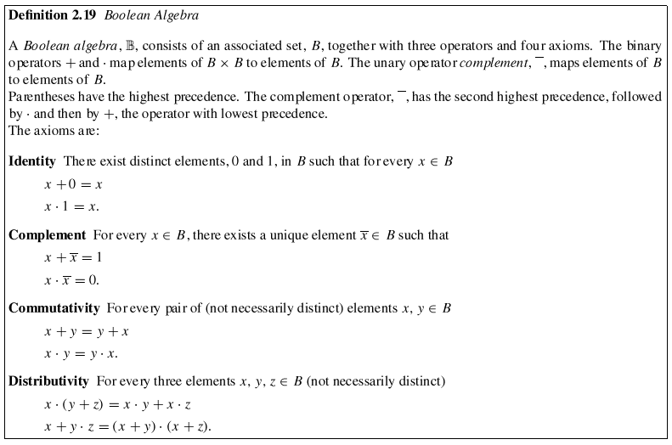

Slide 21
Two-Element Boolean Algebra
The Boolean Algebra on B= {0, 1} is defined as follows:
+ 0 1 · 0 1 ¯
0 0 1 0 0 0 0 1
1 1 1 1 0 1 1 0

Slide 22
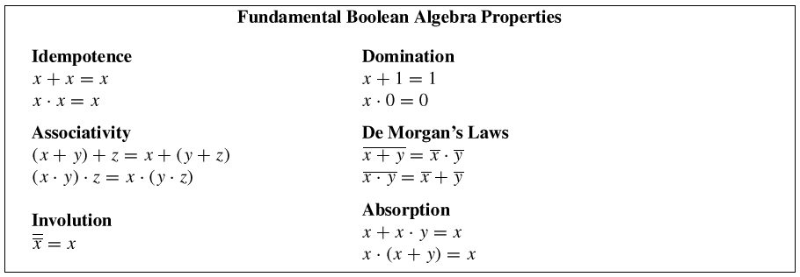
Duality and the Fundamental Boolean Algebra Properties
Duality
The dual of any Boolean theorem is also a theorem.
Parentheses must be used to preserve operator precedence.

Slide 23
Logic and CS
Logic is basis of ALU (Boolean Algebra)
Logic is crucial to IF statements
AND
OR
NOT
Implementation of quantifiers
Looping
Database Query Languages
Relational Algebra
Relational Calculus
SQL

