Slide 1
lec. 3
Medical Helminthology
By Dr. Rawaa hayder

Slide 2
Trematodes
Trematodes are unsegmented helminths, which are flat and broad, resembling the leaf of a tree or a flatfish (hence the name Fluke, from the Anglo-saxon word 'floc‘ meaning 'flatfish’).
The name Trematode comes from their having large prominent suckers with a hole in the middle (Greek trema: hole, eidos: appearance).

Slide 3
Trematodes
FLUKES
Phylum: Platyhelminthes
Class: Trematoda
*see Table 13.2.
Classification Based on Habitat
Based on habitat, trematodes can be classified as
(Table 13.2)
i. Blood flukes
ii. Liver flukes
iii. Intestinal flukes
iv. Lung flukes

Slide 4
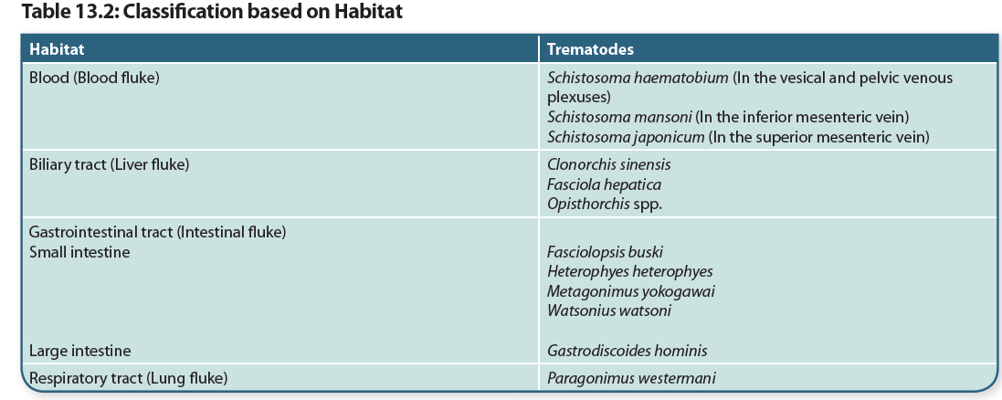

Slide 5
Flukes: General Characteristics
Vary in size from the species just visible to the naked eye, like Heterophyes to the large fleshy flukes, like Fasciola and Fasciolopsis.
A conspicuous feature of flukes is the presence of 2 muscular cup-shaped suckers (hence called distomata)— the oral sucker surrounding the mouth at the anterior end and the ventral sucker or acetabulum in the middle, ventrally.

Slide 6
The body is covered by an integument which often bears spines, papillae, or tubercles.
They have no body cavity, circulatory and respiratory organs.
The alimentary system consists of the mouth surrounded by the oral sucker, a muscular pharynx and the esophagus, which bifurcates anterior to the acetabulum to form 2 blind caeca, that reunite in some species. The alimentary canal, therefore appears like an inverted Y. The anus is absent (Fig. 13.1).
The excretory system consists of flame cells and collecting tubules, which lead to a median bladder opening posteriorly (Fig. 13.1).

Slide 7
There is a rudimentary nervous system consisting of paired ganglion cells.
The reproductive system is well-developed. Flukes are hermaphroditic (monoecious) except for schistosomes, in which the sexes are separate (dioecious).
The hermaphroditic flukes have both male and female structures, so that self fertilization takes place, though in many species cross-fertilization also occurs.
Trematodes are oviparous and lay eggs, which are operculated, except in the case of schistosomes.

Slide 8
Life Cycle
Medically important members of the class Trematoda belong to the subclass Digenea, as they are digenetic, i.e. require 2 hosts to complete their life cycle.
Egg Miracidium sporocyst
(Operculated) Redia
Cercaria
Adult Metacercaria

Slide 10
Blood flukes: General Characteristics
Schistosomes
In the schistosomes, the sexes are separate (dioecious), but the male and female live in close apposition (in copula).
The male worm is broader than the female and its lateral borders are rolled ventrally into a cylindrical shape, producing a long groove or trough called the gynecophoric canal, in which the female is held. It appears as though the body of the male is split longitudinally to produce this canal; hence the name schistosome (Greek schisto: split and soma: body) (Fig. 13.2).

Slide 11
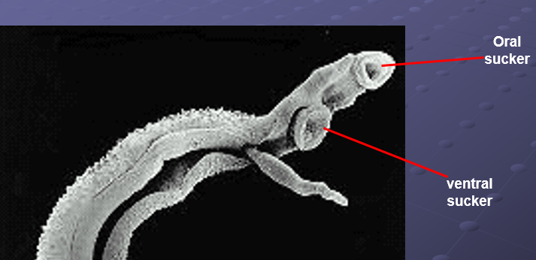

Slide 12
Schistosomes are trematodes, which lead to Schistosomiasis (bilharziasis).
Schistosomiasis is a water-borne disease constituting an important public health problem and affecting millions of persons in Africa, Asia, and Latin America. It is estimated that over 100 milion people are infected with S. haematobium, S. mansoni, and S. japonicum each. Two other species of Schistosoma parasitizing humans are S. mekongi and S. intercalatum.
Schistosomes were formerly called Bilharzia after Theodor Bilharz who in 1851, first observed the worm in the mesenteric veins of an Egyptian in Cairo.
All schistosomes live in venous plexuses in the body of the definitive host, the location varying with the species.

Slide 13
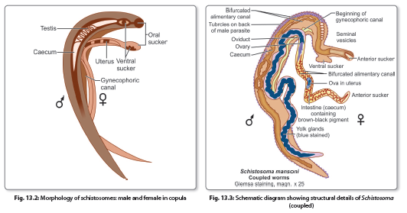

Slide 14
Features distinguishing schistosomes from other Trematodes
••They are diecious.
••They lack a muscular pharynx.
••Their intestinal caeca reunite after bifurcation to form a single canal.
••They produce non-operculated eggs.
••They have no redia stage in larval development.
••The cercariae have forked tails and infect by penetrating the unbroken skin of definitive hosts.

Slide 15
Schistosoma spp which infect human
المنشقه الدمويه او المنشقه المثانيه Schistosoma haematobium
المنشقه المانسونيه Schistosoma mansoni
المنشقه اليابانيه
Schistosoma japonicum

Slide 16
Schistosoma haematobium
Common name :Bilharzia haematobium
Final host + Habitat :Veins of the vesical and pelvic plexuses of man
Intermediate host: Snails ( Bulinus)
Disease: Urinary bilhariziasis
Infective stage: Forked tail cercaria
Mode of infection : Cercaria come into contact with persons bathing in the water, they penetrate through their unbroken skin. Skin penetration is facilitated by lytic substances secreted by penetration glands present in the cercaria.
Diagnosis : Egg with terminal spine shed with Urine.

Slide 17
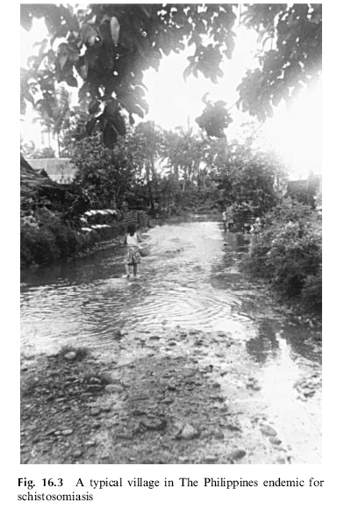

Slide 18
Pathogenicity and Clinical Features
Clinical illness caused by schistosomes can be classified depending on the stages in the evolution of the infection, as follows:
Skin penetration and incubation period
Egg deposition and extrusion
Tissue proliferation and repair.
The clinical features during the incubation period may be local cercarial dermatitis or general anaphylactic or toxic symptoms. include fever, headache, malaise, and urticaria.
Cercarial dermatitis consists of transient itching and petechial lesions at the site of entry of the cercariae (swimmer’s itch).
Clinical features during oviposition include painless terminal hematuria (endemic hematuria) Hematuria is initially microscopic, but becomes gross, if infection is heavy.
This is accompanied by leucocytosis, eosinophilia, enlarged tender liver, and a palpable spleen. This condition is more common in infection with S. japonicum (Katayama fever).

Slide 19
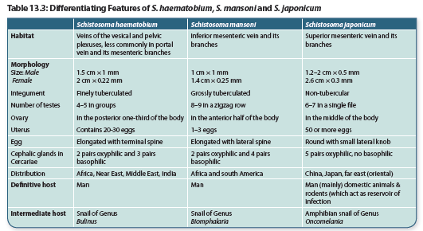

Slide 20
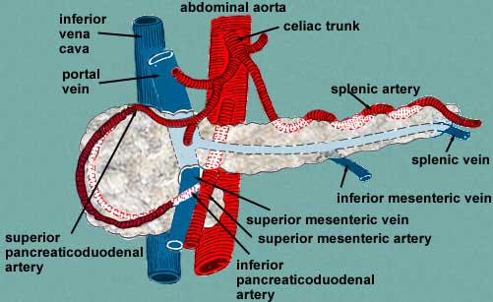
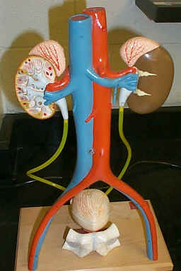
الأورده المساريقيه العلياS. jabanicum
superior mesenteric vein
في الأورده المعديه المساريقيه gastric mesenteric veins
s. mansoni
الأورده المساريقيه السفلى inferior mesenteric vein وفي الضفائر الباسوريه hemorrhoidal plexus
S.haematobium
urinary veins الالوردة البولية
الأورده المثانيةvesicle veins
الضفائر الحوضيه Pelvic plexus

Slide 21
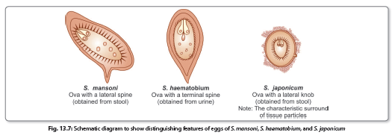
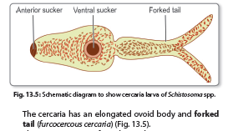
Schistosoma infective and diagnostic stages

Slide 22
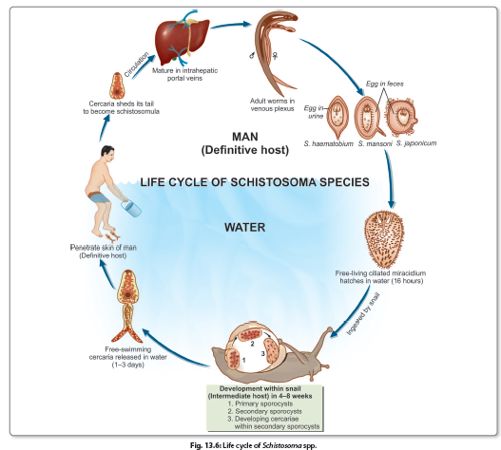
Life cycle of schistosoma spp.

Slide 23
LIVER FLUKES
Scientific name: Fasciola hepatica
Common name Sheep liver fluke
Habitat: The parasite resides in the liver and biliary passages of the definitive host.
تعيش بالغات هذه الديدان في القنوات الصفراويه للاغنام و الماعز و الأبقار وقد تصيب الأنسان احياناً.
Disease: Liver rot
Infective stage: Metacercaria
1st intermediate host: Lymnea
2nd intermediate host: aquatic vegetation
(water cress)
Diagnosis: operculated ova are found in feces

Slide 24
F. hepatica ( leaf like shape termatoda) was the first trematode that was discovered more than 600 years ago in 1379 by Jehan de Brie.
It is the largest and most common liver fluke found in humans, but its primary host is the sheep and to a less extent, cattle.

Slide 25
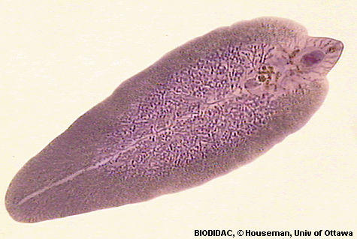
F. hepatica morphology
Adult Worm
It is a large leaf-shaped fleshy fluke, 30 mm long and 15 mm broad, grey or brown
in color.
Like all other trematodes, it is hermaphrodite.

Slide 26
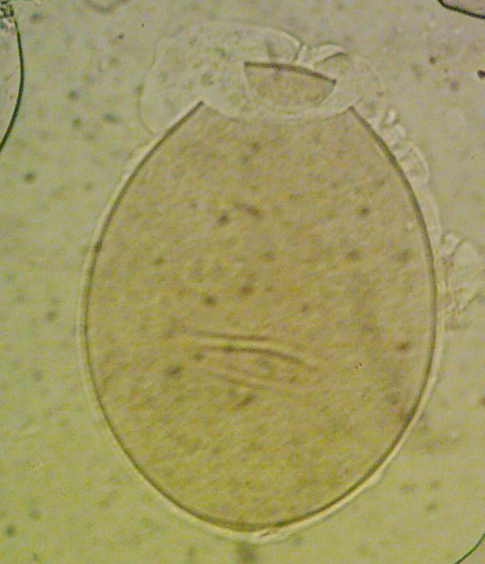
F. hepatica morphology
Egg
The eggs are large, ovoid, operculated
bile-stained.
Eggs contain an immature larva,
the miracidium
Eggs do not float in saturated solution of common salt
Eggs of F. hepatica and Fasciolopsis buski cannot be differentiated.
Eggs are unembryonated when freshly passed.

Slide 28
Pathogenicity
Fascioliasis
In traversing the liver tissue, it causes parenchymal injury. As humans are not its primary host, it causes more severe inflammatory
response. Some larvae penetrate right through the liver and diaphragm ending up in the lung.
In acute phase during the migration of the larva, patients present with fever, right upper quadrant pain, eosinophilia, and tender hepatomegaly. The symptoms subside as parasites reach their final destination.
Diagnosis
Stool Microscopy
Demonstration of eggs in feces or aspirated bile from duodenum is the best method of diagnosis.
Eggs of F. hepatica and F. buski are indistinguishable.

Slide 29
Thank You

