Slide 1
lec. 4
Medical Helminthology
by Dr. Rawaa hayder

Slide 2
General Characteristics Nematoda(Nema:thread)
Unlike trematodes and cestodes, all of which are parasitic, most nematodes are free-living forms found in soil and water.
They are Unsegmented, cylindrical, or filariform in shape, bilaterally symmetrical with a secondary triradiate symmetry at the anterior end.
Nematodes are diecious, sex are separated.The adults vary greatly in size, from about a millimeter (Strongyloides stercoralis) to a meter (Dracunculis medinensis) in length. Male is generally smaller than female and its posterior end is curved or coiled ventrally.

Slide 3
3. Their body is covered with a tough outer cuticle, which may be smooth, striated, bossed, or spiny. The middle layer is hypodermis and the inner layer is the somatic muscular layer. They move by sinuous flexion of the body.
4. The body cavity is a pseudocele, in which all the viscera are suspended.
5.The digestive system is complete, consisting of a anteriorly placed mouth then ended through the anus. In the male, the rectum and the ejaculatory duct open into the cloaca.

Slide 4
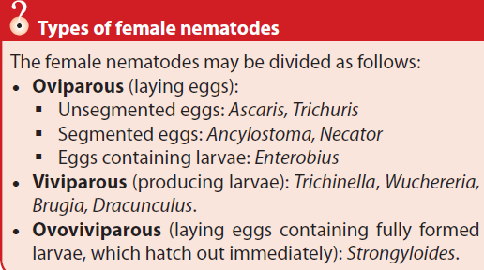

Slide 5
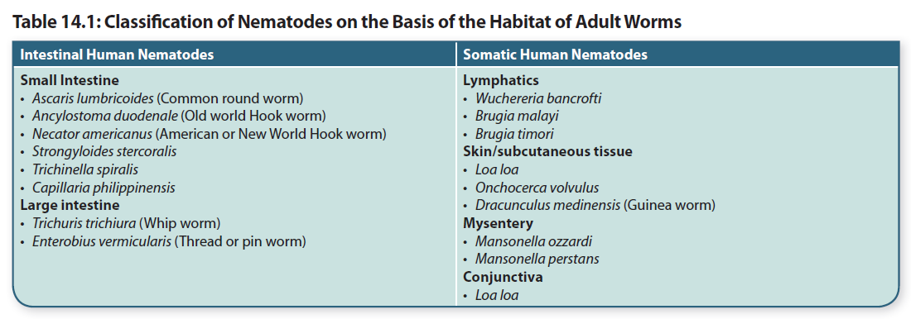

Slide 7
Enterobius vermicularis (oxyuris vermicularis )
Common name: Pinworm, Seatworm, Threadworm
Disease : Entrobiasis
Infective stage : Egg with filariform larva
Lab diagnosis : 1-finding the adult parasite in the stool ( or D shaped egg) 2-GSE is not useful for detection of E.vermicularis3-anal swab : a cellophane – tape method

Slide 8
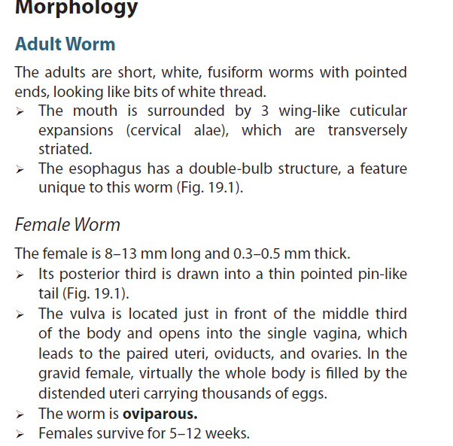
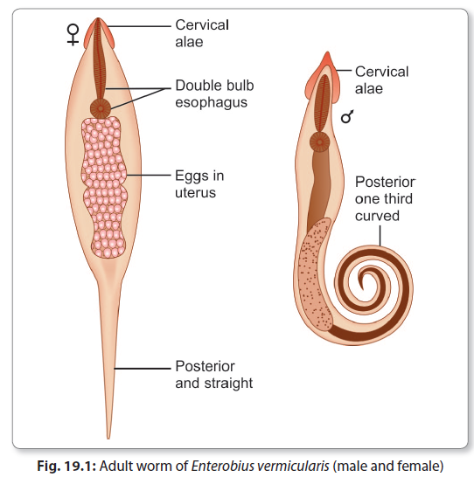

Slide 9
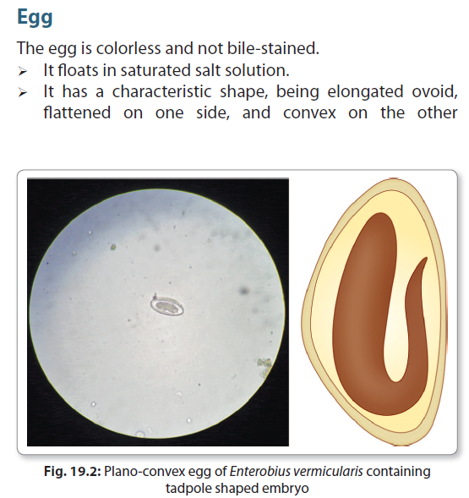

Slide 10
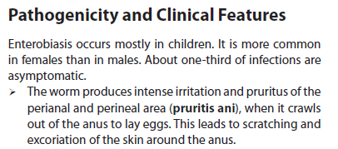

Slide 11
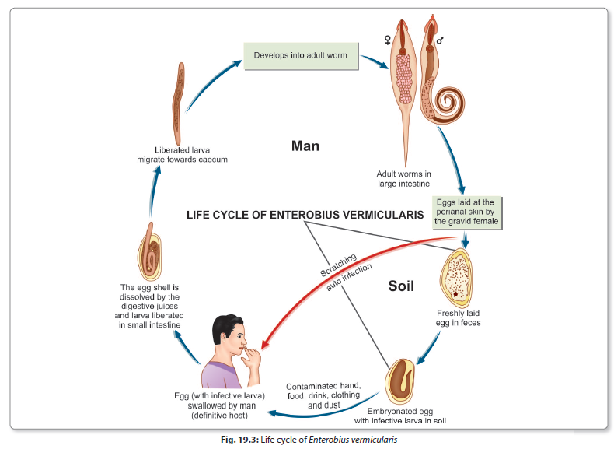

Slide 14
Ascaris lumbricoides
Common n: Giant round worm , abdominal snake
Habitat: small intestine of the man specially the ileum
Disease: Ascarisiasis
Infective stage: eggs containing infective second stage larvae.
Lab diagnosis: A - General stool examination (G.S.E)
1 – macroscopically based on the identification of the worms passed in the stool .2 – microscopically based on finding the characteristic Ascaris ova after applying the concentration method to the stool sample (sedimentation for unfertilized , flotation for fertilized) .
B – make X – ray if suspect there is intestinal obstruction due to large number of Ascaris in the small intestine specially in the children .

Slide 15
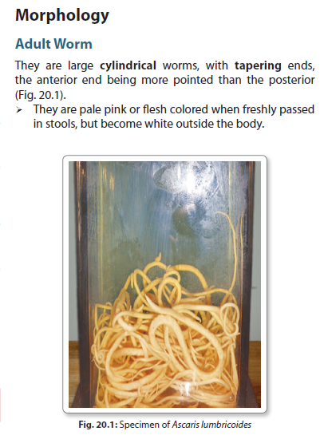
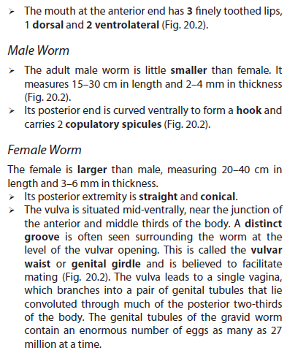

Slide 16
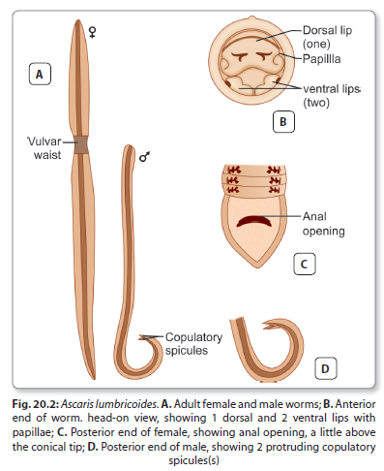

Slide 17
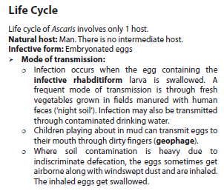

Slide 18
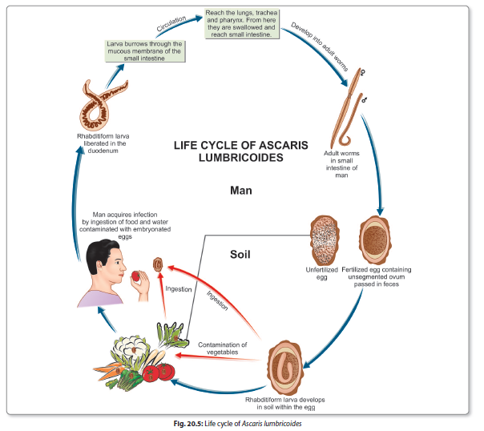

Slide 20
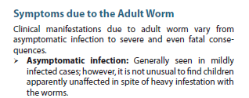
Ascariasis may contribute to protein-energy malnutrition and vitamin A deficiency. Patients have loss of appetite and are often listless. Abnormalities of the jejunal mucosa are often present, including broadening and shortening of villi, elongation of crypts, and round cell infiltration of lamina propria. These changes are reversed when the worms are eliminated.

Slide 21
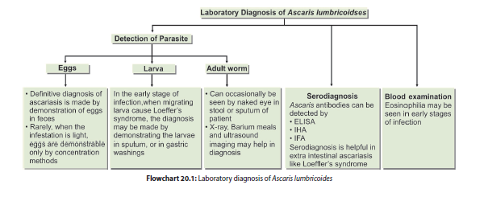

Slide 22
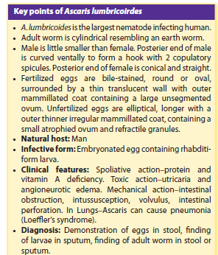

Slide 23
Thank You

