Slide 1
Helminthology
Lec. 5
Nematohelminthes
By Dr. Rawaa hayder

Slide 2
Trichuris trichiura
Common name :whip worm
Habitat: lives in the large intestine. The adult worms are found attached to the wall of the caecum
Infective stage: ova containing the infective larva
Disease :Trichuriasis, whip worm infection ,trichocephaliasis.
Mode of Transmission: Infection occurs in humans when the mature embryonated eggs containing the infective larvae are swallowed in contaminated food or water.
Lab diagnosis : General stool examination (G.S.E)
_ Macroscopic examination : bloody diarrhea in the advance cases
_ Microscopic examination : found the characteristic barrel-shape ova with two polar plug .
In heavy infection, sigmoidoscopy may show white bodies of worm hanging from the inflamed mucosa, the so called coconut cake rectum.

Slide 3
Morphology
Adult Worm
The male worm is 30–45 mm long, while the female is slightly larger, about 40–50 mm.
*The worm is _ flesh-colored. In shape, it resembles a whip, with the anterior threefifth
thin and thread-like and the posterior two- fifth thick and fleshy, appearing like
the handle of a whip.

Slide 4
Egg
The egg has a characteristic appearance.
*It is brown in color being bile-stained.
*It has a triple shell, the outermost layer of which is stained brown.
*It is barrel-shaped and about 50 μm long and 25 μm wide in the middle, with a
projecting mucus plug at each pole containing an unsegmented ovum
The plugs are colorless.
*The egg _ floats in saturated salt solution.
*When freshly passed, the egg contains an unsegmented ovum. At this stage, it is not
infective for humans.
*The fertilized female lays about 5,000 eggs per day.

Slide 5
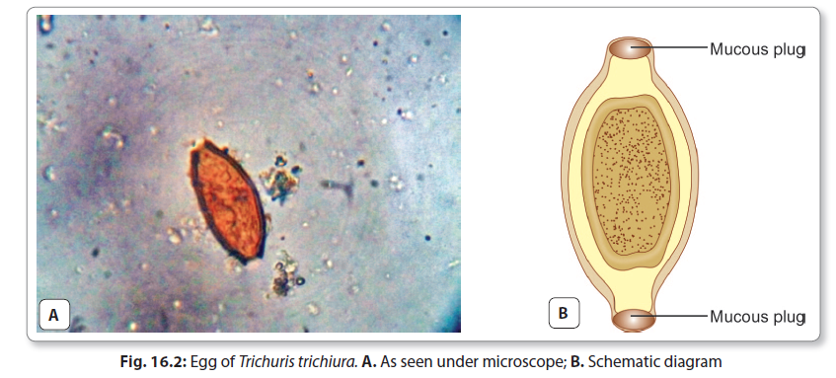
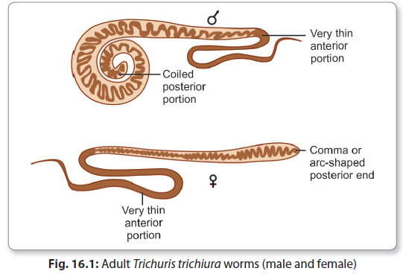

Slide 6
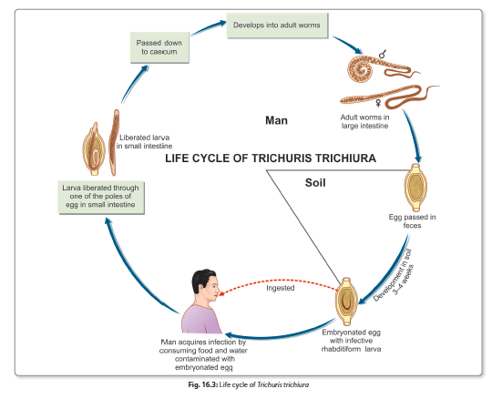

Slide 7
Pathogenicity and Clinical Features
asymptomatic, except when the worm load is heavy. Disease may result either due to mechanical effects or allergic reaction.
*It has been suggested that mechanical blockage of the appendiceal lumen by masses of whipworms may cause acute appendicitis. In heavy infection, the worm may be
abundant on the colonic mucosa, even up to the rectum. Mucus diarrhea, chronic dysentery and abdominal pain, and weight loss are frequently seen in such cases. Some patients, particularly young children, may develop rectal prolapse.

Slide 8
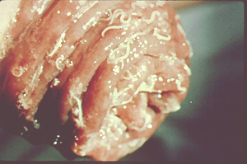
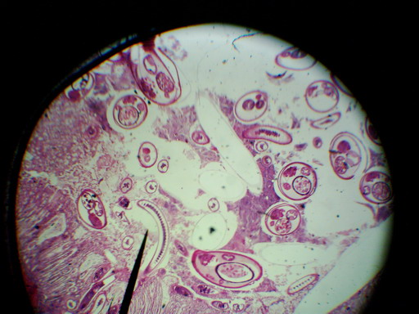
C.S in Rectum Show heavy infection of Trichuris trichiura
Prolapse of rectum due to infection of Trichuris trichiura

Slide 11
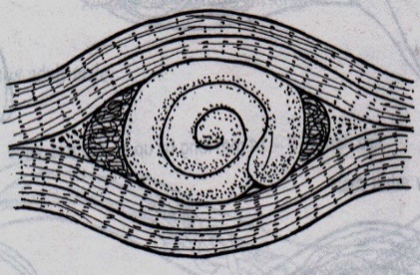
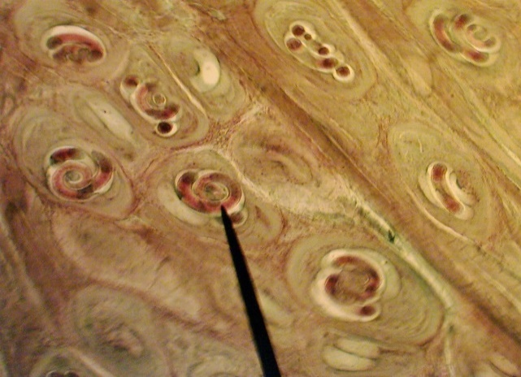
Trichinella spiralis
Common name: Trichina worm
Location: Adults live in small intestine in Pig , as optimum host and human as alternate host. Larval stages live in the striated muscle in
same hosts, (skeletal muscle).
Length: male 1.6 mm – female up to 2.4 mm.
Disease: Trichenelliasis or Trichinosis
Host: Mucosa of small intestine pig ,
Bear , rat, Man
Infective stage: Nurse cell (encysted larvae)
Diagnosis: Nurse cell (encysted larvae)

Slide 12
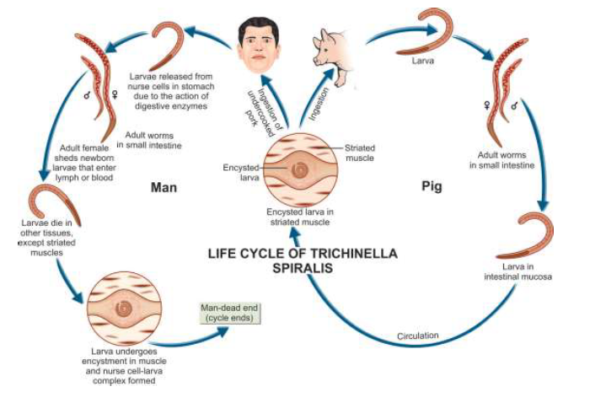

Slide 13
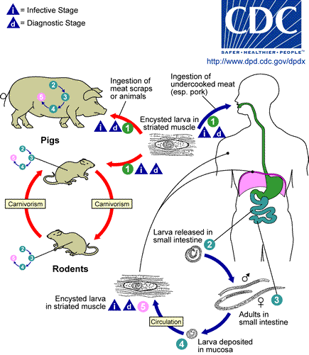

Slide 16
Strongyloids stercoralis
Life modes: free living or parasitic phase
Location: Adults found in the human intestine in the mucosa of the
duodenum and jejunum.
➢ Only the female worms are seen in the intestine. It was believed that they are parthenogenetic and can produce offspring without being fertilized
Length: The female worm is thin,, about 2.5 mm long and, the male is shorter and broader..
Disease:
larvae wander in the dermis of the perianal region for sometime, causing a radiating perianal creeping eruption, a form of cutaneous larva migrans
The clinical disease may be classified as cutaneous, pulmonary and intestinal
Infective stage: Rhabditiform larva
Mode of infection: Skin penetration + Autoinfection

Slide 17
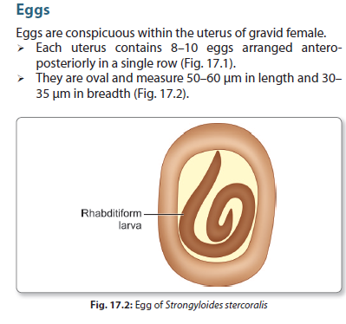
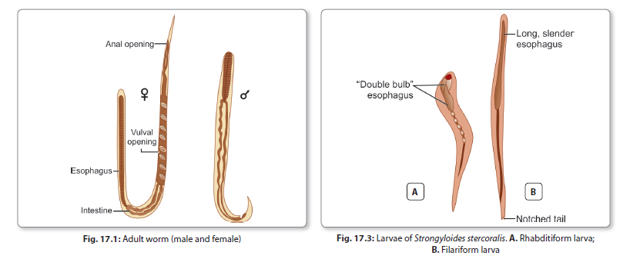

Slide 18
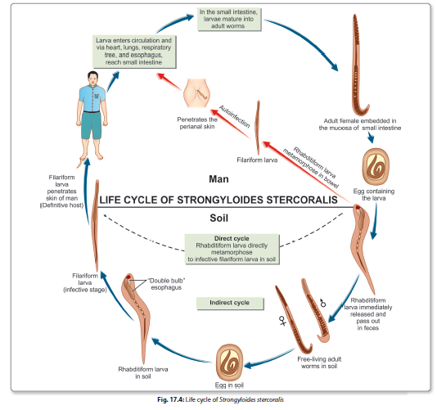

Slide 19
Pathogenesis and Clinical Features
Strongyloidosis is generally asymptomatic, But it may sometimes cause clinica
manifestations, which may be severe and even fatal, The clinical disease may be classified as cutaneous, pulmonary and intestinal

Slide 20
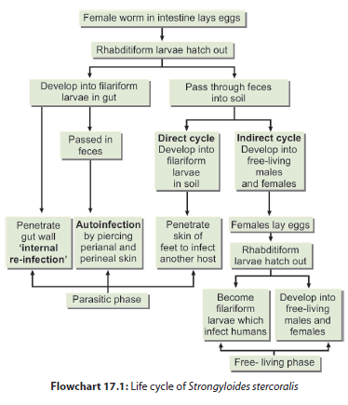

Slide 21
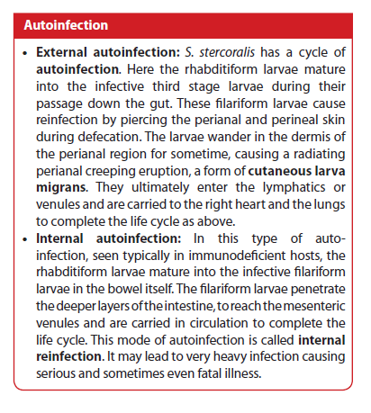

Slide 22
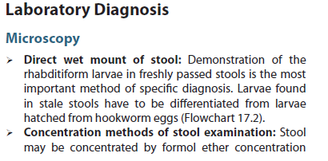

Slide 23
Thank You

