Slide 1
Cholinergic Agonists
Presented by DR . Hasan Falah

Slide 2
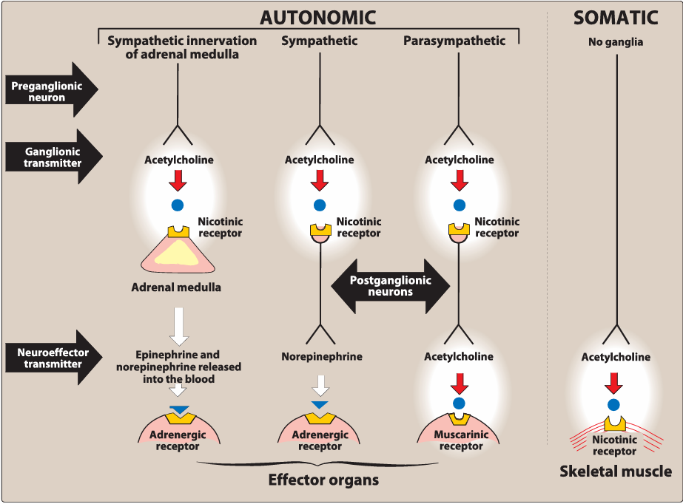
THE CHOLINERGIC NEURON
The preganglionic fibers terminating in the adrenal medulla, the autonomic ganglia (both parasympathetic and sympathetic), and the postganglionic fibers of the parasympathetic division use ACh as a neurotransmitter
The postganglionic sympathetic division of sweat glands also uses ACh.

Slide 3
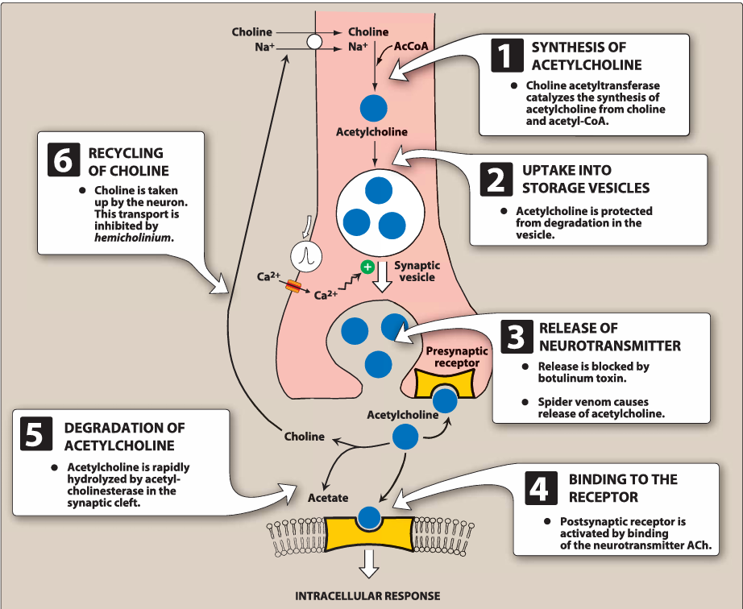
A. Neurotransmlsslon at cholinergic neurons

Slide 4
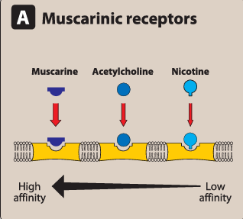
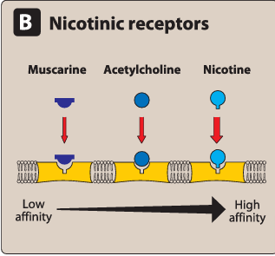
CHOLINERGIC RECEPTORS {CHOLINOCEPTORS)
Two families of cholinoceptors, designated muscarinic and nicotinic receptors, can be distinguished from each other on the basis of their different affinities for agents that mimic the action of Ach

Slide 5
Muscarinic Receptors
1. Classification & Ligand Specificity:
Muscarinic receptors are G-protein–coupled receptors (metabotropic).
They respond to acetylcholine (ACh) and muscarine (from poisonous mushrooms).
They have low affinity for nicotine (unlike nicotinic receptors).
2. Subtypes:
There are five subtypes (M1–M5), but only M1, M2, and M3 are well-characterized.
3. Locations:
Found in autonomic effector organs: heart, smooth muscle, brain, and glands.
  M1: gastric parietal cells and neurons
  M2: heart and smooth muscle
  M3: bladder, glands, smooth muscle

Slide 6
Nicotinic receptor
1. Classification & Ligand Specificity:
Ionotropic receptors (ligand-gated ion channels).
Bind acetylcholine (ACh) and nicotine, but have low affinity for muscarine.
2. Structure & Function:
Activation causes Na⁺ influx → depolarization of the effector cell.
3. Nicotine Action:
Low doses: stimulate the receptor
High doses: block the receptor

Slide 7
4. Locations & Types: Found in:
  Central nervous system (CNS)
  Adrenal medulla
  Autonomic ganglia
  Neuromuscular junction (NMJ)
Subtypes:
  NM: at neuromuscular junction
  NN: in autonomic ganglia and other areas
5. Selective Blockers:
Mecamylamine: blocks ganglionic (NN) receptors
Atracurium: blocks NMJ (NM) receptors

Slide 8
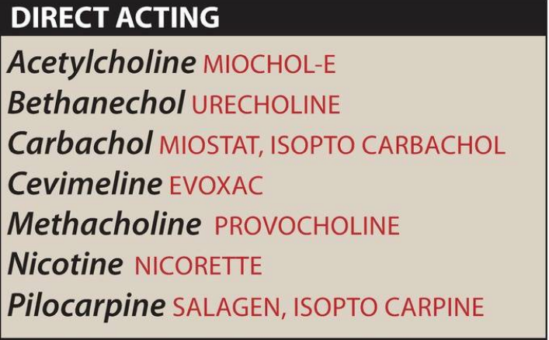
DIRECT-ACTING CHOLINERGIC AGONISTS
Acetylcholine :it lacks therapeutic importance because of its multiplicity of actions (leading to diffuse effects) and its rapid inactivation by the cholinesterases.
ACTION :
1. Decrease in heart rate and cardiac output
2. In the gastrointestinal (GI) tract, acetylcholine increases salivary secretion, increases gastric acid secretion, and stimulates intestinal secretions and motility
It also enhances bronchiolar secretions and causes bronchoconstriction
marked constriction of the pupil
ACh increases the tone of the detrusor muscle, causing urination.

Slide 9
B. Bethanechol
1. Structure & Properties:
Carbamoyl ester structurally related to ACh.
No nicotinic activity (due to a methyl group).
Strong muscarinic activity. Duration of action: ~1 hour.
2. Actions:
Stimulates muscarinic receptors → ↑ intestinal motility & tone.
Contracts detrusor muscle and relaxes sphincter → promotes urination.

Slide 10
3. Therapeutic Uses:
Treats atonic bladder (especially postpartum/postoperative, nonobstructive).
Used for neurogenic bladder atony and megacolon.
4. Adverse Effects:
May cause cholinergic overstimulation:
  Sweating, salivation, flushing
  ↓ BP (with reflex tachycardia), nausea, abdominal cramps
  Diarrhea, bronchospasm
Atropine sulfate can be used to counteract severe effects.

Slide 11
C. Carbachol (Carbamylcholine)
1. Properties:
Ester of carbamic acid, poor substrate for AChE.
Acts on both muscarinic and nicotinic receptors.
2. Actions:
Affects cardiovascular and GI systems by stimulating ganglia.
Can stimulate and then depress these systems.
In the eye: causes miosis and spasm of accommodation ( preventing focusing).
3. Therapeutic Uses:
Rarely used systemically due to high potency and nonselectivity.
Used intraocularly to:
  Induce miosis during eye surgery
  Lower intraocular pressure in glaucoma
4. Adverse Effects: Minimal, when used in the eye, due to poor systemic absorption).

Slide 12
D. Pilocarpine
1. Properties:
Selective for muscarinic receptors, but with low potency.
2. Actions:
In the eye: causes rapid miosis, ciliary muscle contraction, and spasm of accommodation.
Strong stimulant of secretions: sweat, tears, and saliva.
3. Therapeutic Uses:
Emergency treatment of glaucoma (open-angle and angle-closure):
Reverses mydriasis (e.g., caused by atropine)
Treats xerostomia (dry mouth) due to: 1. Radiation therapy 2.Sjogren syndrome (along with cevimeline)
4. Adverse Effects:
Blurred vision, night blindness, brow ache
Poisoning: Profuse sweating, salivation (similar to mushroom toxicity from Inocybe)
Treated with parenteral atropine (must cross BBB)

Slide 13
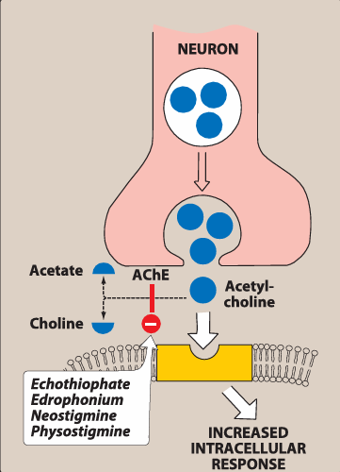
V. INDIRECT-ACTING CHOLINERGIC AGONISTS: ANTICHOLINESTERASE AGENTS (REVERSIBLE)
AChE is the enzyme that degrades acetylcholine (ACh) into choline and acetate, terminating its action.
Located pre- and postsynaptically in the nerve terminal.
Inhibitors of AChE (anticholinesterases) increase ACh in the synapse → enhance cholinergic activity.
Affect muscarinic, nicotinic, NMJ, and CNS receptors.
Reversible AChE inhibitors are classified as short-acting or intermediate-acting.

Slide 14
A. Edrophonium
Short-acting (10–20 min), quaternary amine, acts peripherally.
Binds reversibly to AChE.
Uses: Diagnosis of myasthenia gravis, reversal of nondepolarizing NM blockers.
Adverse: Risk of cholinergic crisis; antidote = atropine.
Use is now limited.

Slide 15
B. Physostigmine
Intermediate-acting (30 min–2 hrs), tertiary amine → crosses CNS.
Forms reversible carbamoyl-AChE complex.
Actions: Stimulates muscarinic, nicotinic, NMJ, and CNS.
Uses: Antidote for anticholinergic toxicity (e.g., atropine), reversal of NM blockers.
Adverse: High doses → convulsions, bradycardia, muscle paralysis (rare at therapeutic dose).

Slide 16
C. Neostigmine
Intermediate-acting (30 min–2 hrs), quaternary amine → no CNS effects.
Stronger action on skeletal muscle than physostigmine.
Uses: Stimulates bladder & GI, treats myasthenia gravis, reverses NM blockers.
Adverse: Typical cholinergic effects (salivation, flushing, ↓BP, diarrhea), no CNS toxicity.
Contraindicated in bladder or intestinal obstruction.

Slide 17
D. Pyridostigmine
Intermediate-acting (3–6 hrs), longer-lasting than neostigmine.
Used for long-term management of myasthenia gravis.
Adverse effects similar to neostigmine.

Slide 18
Tacrine, donepezil, rivastigmine, and galantamine
Use to delay the progression of Alzheimer disease
Adverse: Primarily GI upset (nausea, vomiting, diarrhea)

Slide 19
INDIRECT-ACTING CHOLINERGIC AGONISTS: ANTICHOLINESTERASE AGENTS (IRREVERSIBLE)
Overview:
Organophosphates bind irreversibly to acetylcholinesterase (AChE), leading to long-lasting increases in ACh at all cholinergic sites.
Many are toxic nerve agents (military use); others like parathion and malathion are insecticides.

Slide 20
A. Echothiophate
1. Mechanism of Action:
Organophosphate compound that covalently binds to the active site of AChE.
2. Actions:
Causes generalized cholinergic stimulation:
  Miosis (pupil constriction)
  Muscle paralysis → breathing difficulties
  Convulsions
High-dose atropine can reverse many peripheral and some central effects.
3. Therapeutic Use:
Rarely used today.
Used topically in open-angle glaucoma to lower intraocular pressure by enhancing aqueous humor outflow.
Side effects (notably cataracts) limit its use.

Slide 21


