Slide 1
Cholinergic Antagonists
PRESENTED BY DR . HASAN FALAH

Slide 2
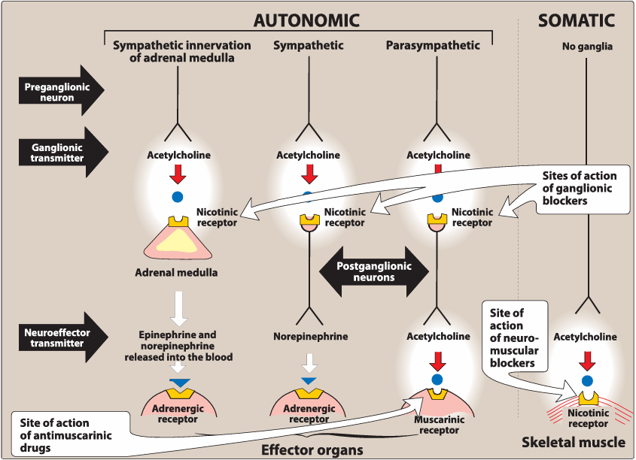
Antimuscarinic agents
Antimuscarinic agents (anticholinergic drugs), such as atropine and scopolamine, block muscarinic receptors, inhibiting muscarinic functions.
They also block certain cholinergic sympathetic neurons (e.g., those supplying salivary and sweat glands) but do not affect nicotinic receptors, so they have little or no effect on skeletal NMJs or autonomic ganglia.

Slide 3
atropin
1. Therapeutic Uses
Ophthalmic: Mydriasis + cycloplegia for refraction measurement (rare now; replaced by shorter-acting agents).
Antispasmodic: Relaxes GI tract.
Cardiovascular: Treats bradycardia.
Antisecretory: Reduces respiratory secretions pre-surgery.
Antidote: Organophosphate, nerve gas, anticholinesterase overdose, certain mushroom poisoning; requires large, prolonged doses.
2. Pharmacokinetics
Well absorbed, partly metabolized in liver, excreted in urine; half-life ~4 hrs.
3. Adverse Effects
Peripheral: Dry mouth, blurred vision, “sandy eyes,” tachycardia, urinary retention, constipation.
CNS: Restlessness, confusion, hallucinations, delirium → possible depression, circulatory/respiratory collapse, death.
Management of toxicity: Low doses of physostigmine.
Warning: Children are especially sensitive, with risk of rapid hyperthermia.

Slide 4
Scopolamine
1. Actions
Highly effective for motion sickness.
Blocks short-term memory.
Causes sedation at normal doses; excitement at higher doses.
May produce euphoria → potential for abuse.
2. Therapeutic Uses
Prevention of motion sickness (more effective prophylactically than after onset).
Postoperative nausea/vomiting.
Available as topical patch lasting up to 3 days.
3. Pharmacokinetics & Adverse Effects
Similar to atropine but with longer half-life.

Slide 5
Aclidinium, Glycopyrrolate, Ipratropium, and Tiotropium
Classification:
Ipratropium: Short-acting muscarinic antagonist (SAMA).
Glycopyrrolate, tiotropium, aclidinium: Long-acting muscarinic antagonists (LAMAs).
Uses: Bronchodilators for maintenance treatment of bronchospasm in COPD.
Ipratropium & tiotropium also for asthma (acute & chronic management, respectively).
Administration: Inhalation route.
Properties: Positively charged → minimal systemic or CNS absorption → effects confined to the lungs.

Slide 6
Tropicamide & Cyclopentolate
Use: Ophthalmic solutions for mydriasis and cycloplegia.
Duration:
  Tropicamide: ~6 hours.
  Cyclopentolate: ~24 hours.
Shorter action than atropine.
Benztropine & Trihexyphenidyl
Use: Adjunct therapy in Parkinson’s disease and antipsychotic-induced extrapyramidal symptoms.

Slide 7
Oxybutynin & Other Agents for Overactive Bladder
Drugs: Oxybutynin, darifenacin, fesoterodine, solifenacin, tolterodine, trospium.
Mechanism: Competitive M3 receptor antagonism in the bladder → ↓ intravesical pressure, ↑ capacity, ↓ contractions.
Uses: Overactive bladder, urinary incontinence; oxybutynin also for neurogenic bladder.
Pharmacokinetics:
All oral; most long half-life → once-daily dosing.
IR oxybutynin & tolterodine require multiple daily doses; ER forms allow once daily.
Oxybutynin also as transdermal patch & topical gel.
Adverse Effects: Dry mouth, constipation, blurred vision; ER forms & patch have fewer effects. Trospium preferred in dementia due to minimal CNS effects.

Slide 8
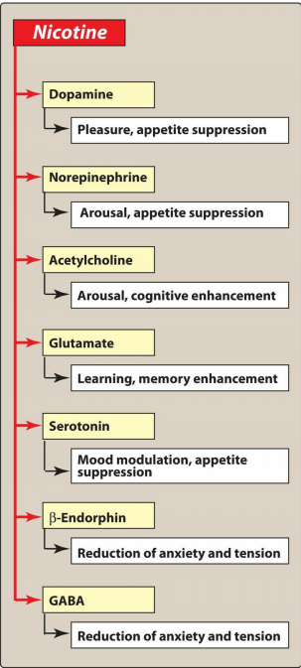
Ganglionic Blockers
These drugs show no selectivity toward the parasympathetic or sympathetic ganglia and are not effective as neuromuscular antagonists.
ganglionic blockade is rarely used therapeutically
Nicotine
Component of cigarette smoke; toxic with no therapeutic value.
Mechanism: Depolarizes autonomic ganglia → initial stimulation, then paralysis.
Effects: Complex due to ↑ neurotransmitter release from both sympathetic and parasympathetic ganglia.

Slide 9
Neuromuscular Blocking Agents
NMBs block cholinergic transmission at nicotinic receptors on skeletal muscle, preventing contraction. They are chemically similar to ACh and act as antagonists (nondepolarizing) or agonists (depolarizing).
Uses: Facilitate rapid intubation (RSI), provide muscle relaxation during surgery, and aid mechanical ventilation in ICU.
Note: Not a substitute for anesthesia.

Slide 10
A. Nondepolarizing (Competitive) Blockers
Cisatracurium, mivacurium, pancuronium, rocuronium, vecuronium.
MOA:
  Low doses: Compete with ACh at nicotinic receptors → prevent depolarization; reversed by cholinesterase inhibitors (e.g., neostigmine).
  High doses: Block ion channels at motor end plate → stronger blockade, less reversible.
Paralysis order: Face/eye → limbs → trunk → intercostals → diaphragm (recovery in reverse order).
Pharmacokinetics: IV only; poor membrane penetration; eliminated by urine, bile
Adverse effects: Minimal; drug-specific.
Interactions:
  ↑ Blockade: Halogenated anesthetics, aminoglycosides, calcium channel blockers.
  Reversal: Cholinesterase inhibitors (may cause depolarizing block if excessive).
  Sugammadex: Rapidly reverses rocuronium & vecuronium.

Slide 11
Depolarizing Agents
MOA: Binds nicotinic receptor → sustained depolarization →
  Phase I: Fasciculations (brief twitches).
  Phase II: Desensitization → flaccid paralysis.
Rapid onset & short duration (due to plasma cholinesterase metabolism; prolonged in enzyme deficiency).
Uses: Rapid intubation, electroconvulsive therapy.
Adverse Effects:
  Malignant hyperthermia (life-threatening in susceptible patients).
  Prolonged apnea in plasma cholinesterase deficiency or electrolyte imbalance.
  Hyperkalemia (dangerous in burns, trauma, renal failure).

Slide 12


