Slide 1
Drug-Receptor Interactions and Pharmacodynamics
PRESENTED BY DR. HASAN FALAH

Slide 2
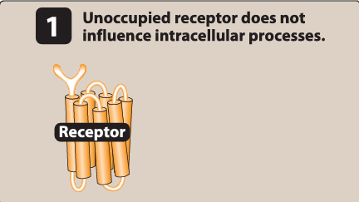
Pharmacodynamics
describes the actions of a drug on the body.
Most drugs exert their effects , both beneficial and harmful, by interacting with receptor
Receptors: is, specialized target (macromolecules) present on the cell surface or within the cell
The drug–receptor complex initiates alterations in biochemical and/or molecular activity of a cell by a process called signal transduction

Slide 3
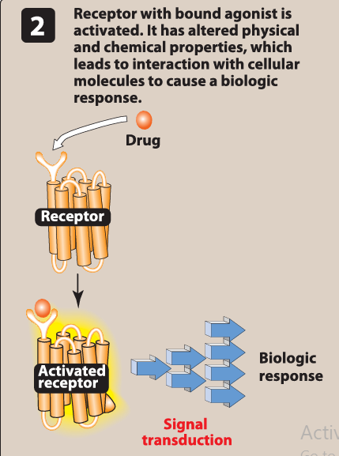
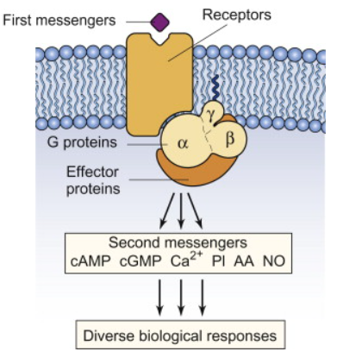
Signal Transduction
Drugs act as signals, and receptors act as signal detectors. A drug is termed an "agonist ' if it binds to a site on a receptor protein and activates it to initiate a series of reactions that ultimately result in a specific intracellular response.
"Second messenger'' or effector molecules are part of the cascade of events that translates agonist binding into a cellular response.

Slide 4
The drug-receptor complex
Cells have many different types of receptors, each of which is specific for a particular agonist and produces a unique response
****it is important to know that not all drugs exert effects by interacting with a receptor. Antacids, for instance, chemically neutralize excess gastric acid, thereby reducing stomach upset.

Slide 5
B.Receptor states
Receptors exist in two reversible states: inactive (R) and active (R*), usually favoring the inactive state.
Agonists shift the equilibrium toward the active state (R*), producing a biological effect.
Antagonists bind the receptor but keep it in the inactive state (R), preventing activation.
Partial agonists activate receptors but less effectively than full agonists, creating a smaller shift to R*.

Slide 6
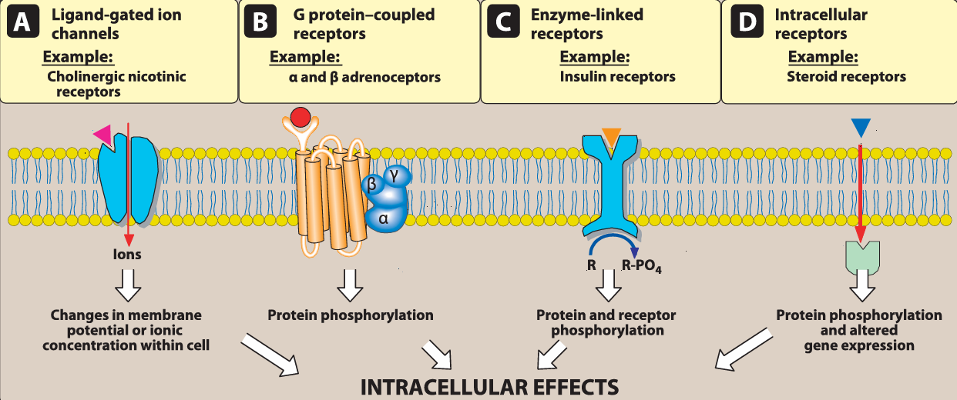
Major Receptor Families
A receptor is any biological molecule a drug binds to and produces a measurable response. While enzymes, nucleic acids, and proteins can serve as receptors, the main drug targets are membrane-bound receptors that convert external signals into internal cellular responses. These are classified into four major families:

Slide 7
1. Ligand-Gated Ion Channels
Found on the cell membrane.
Open in response to ligand (agonist) binding, allowing ions (e.g., Na⁺, K⁺, Cl⁻) to pass.
Response is fast, lasting milliseconds.
Example:
  Nicotinic receptors → Na⁺ in / K⁺ out → nerve signals and muscle contraction.
  GABA-A receptors → Cl⁻ influx → neuronal inhibition.
  Voltage-gated ion channels (like Na⁺ channels) can also be drug targets (e.g., local anesthetics).

Slide 8
2. G Protein-Coupled Receptors
Located on the cell membrane.
Activation triggers G protein signaling (α, β, γ subunits).
Causes the production of second messengers like:
  cAMP (via adenylyl cyclase)
  IP₃ and DAG (via phospholipase C)
Responses last seconds to minutes.
Involved in many physiological processes.

Slide 9
3. Enzyme-Linked Receptors
Transmembrane receptors with intrinsic enzyme activity (often tyrosine kinase).
Activation leads to phosphorylation of specific proteins, triggering signal cascades.
Example: Insulin and growth factor receptors.
Effects last minutes to hours

Slide 10
4. Intracellular Receptors
Located inside the cell (in cytoplasm or nucleus).
Ligands (e.g., steroids) must be lipid-soluble to cross the membrane.
Main targets are transcription factors, influencing gene expression.
Effects appear hours to days later.
Other intracellular targets include:
Tubulin (target of paclitaxel)
Enzymes (e.g., dihydrofolate reductase by trimethoprim)
Ribosomes (e.g., macrolides bind 50S subunit).

Slide 11
Characteristics of Signal Transduction
Signal transduction involves two key features: signal amplification and regulation mechanisms to prevent overstimulation.

Slide 12
1. Signal Amplification
Common in G protein-coupled and enzyme-linked receptors.
A single ligand-receptor interaction can activate many G proteins, which persist longer than the ligand itself.
This leads to a cascade effect that amplifies the signal.
Spare receptors exist when maximal response is achieved without full receptor occupancy.
Example:
  Insulin receptors: ~99% are spare → large reserve.
  β-adrenoceptors in heart: only 5–10% are spare → minimal reserve, especially in heart failure.

Slide 13
2. Desensitization & Down-Regulation
Desensitization (tachyphylaxis): Repeated agonist use → receptors become less responsive (often due to phosphorylation).
Down-regulation: Receptors are internalized, reducing receptor availability.
Refractory period: Ion channels may need time to recover after activation before responding again.
Up-regulation: Repeated antagonist use → more receptors added to the membrane, increasing cell sensitivity to agonists.

Slide 14
Dose-Response Relationships
Agonist drugs mimic the body's natural ligands, producing effects by binding to receptors. The intensity of a drug’s effect depends on:
Receptor sensitivity
Drug concentration at the receptor, which is influenced by dose and pharmacokinetics (absorption, distribution, metabolism, elimination)

Slide 15
A. Graded Dose-Response Relationship
As drug dose increases, the effect increases until maximum effect is reached.
1. Potency
Definition: The amount of drug needed to produce a specific effect.
Measured by: EC₅₀ (dose that produces 50% of max response).
Example: Candesartan is more potent than irbesartan due to a lower required dose.
2. Efficacy
Definition: The maximum effect a drug can produce (Eₘₐₓ).
More important clinically than potency.
Full agonists have higher efficacy than partial agonists. Antagonists have zero efficacy.

Slide 16
B. Drug Concentration vs. Receptor Binding
Follows the law of mass action:
Drug + Receptor ⇌ Drug–Receptor Complex → Effect
Equation:
[DR][RT]=[D]Kd+[D]\frac{[DR]}{[R_T]} = \frac{[D]}{K_d + [D]}[RT​][DR]​=Kd​+[D][D]​
[D]: Free drug concentration
[DR]: Drug–receptor complex
[R_T]: Total receptors
Kd: Dissociation constant (lower Kd = higher affinity)
As drug concentration increases, receptor occupancy and effect approach a maximum.

Slide 17
C. Drug Binding and Pharmacologic Effect
Effect is proportional to receptor occupancy.
Maximal effect occurs when all receptors are occupied.
Mathematical relationship:
[E]Emax=[D]Kd+[D]\frac{[E]}{E_{max}} = \frac{[D]}{K_d + [D]}Emax​[E]​=Kd​+[D][D]​
Affinity (Kd) and potency are related:
  Drugs with high affinity (low Kd) generally have higher potency.
Drugs may bind multiple receptor types → both therapeutic and adverse effects.
To study drug specificity, correlation curves of receptor affinity vs. drug effect are used.

Slide 18
Intrinsic Activity and Drug-Receptor Interactions
Drugs differ not only in their ability to bind receptors (affinity) but also in their ability to activate those receptors. This activating potential is called intrinsic activity, which affects the drug's maximum effect (Emax).
A. Full Agonists
Fully activate receptors, producing maximum biological response.
Example: Phenylephrine acts like norepinephrine at α₁-receptors to increase blood pressure.

Slide 19
B. Partial Agonists
Bind receptors but produce less than maximal response, even at full receptor occupancy.
May compete with full agonists and reduce their effect (act as partial antagonists).
Example: Aripiprazole (used in schizophrenia) can stimulate or inhibit dopamine pathways depending on the brain region.
C. Inverse Agonists
Bind to receptors that are spontaneously active and stabilize the inactive (R) form, reducing receptor activity below baseline.
Produce the opposite effect of full agonists.

Slide 20
D. Antagonists
Bind receptors with high affinity but have zero intrinsic activity.
Block the effects of agonists by preventing receptor activation.
1. Competitive Antagonists
Reversibly bind the same site as the agonist.
Effect can be overcome by increasing agonist concentration.
Shift the dose-response curve right (↑EC₅₀), but Emax stays the same.
Example: Terazosin competes with norepinephrine at α₁-receptors.
2. Irreversible Antagonists
Bind covalently to receptors and permanently reduce receptor availability.
Cannot be overcome by more agonist.
Reduce Emax, but EC₅₀ stays the same.

Slide 21
3. Allosteric Antagonists
Bind to a different (allosteric) site, not the active site.
Prevent receptor activation.
Reduce Emax without changing EC₅₀.
Example: Picrotoxin blocks GABA-A receptor function.
4. Functional (Physiologic) Antagonists
Act on different receptors but produce opposite physiological effects.
Example: Epinephrine relaxes bronchial smooth muscle via β₂-receptors, opposing histamine-induced constriction via H₁-receptors.

Slide 22
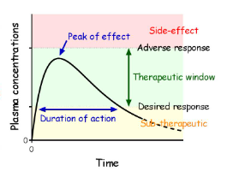
Therapeutic index
The therapeutic index (TI) of a drug is the ratio of the dose that produces toxicity in half the population (TD50) to the dose that produces a clinically desired or effective response (ED50) in half the population

Slide 23


