Slide 1
Hypertension & Pharmacologic Management
Presented by DR. Hasan Falah

Slide 2
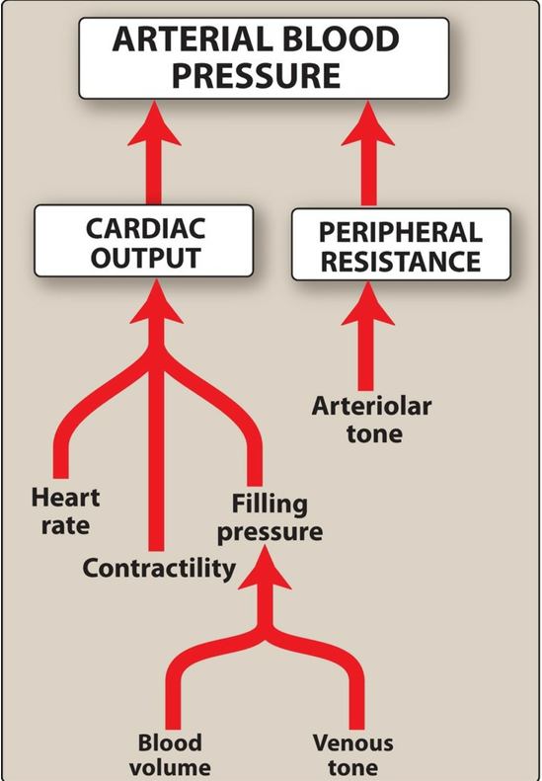
Overview & Classification
Elevated BP: SBP > 120 mm Hg & DBP < 80 mm Hg.
Hypertension: SBP ≥ 130 mm Hg or DBP ≥ 80 mm Hg on ≥ 2 occasions.
Caused by ↑ peripheral vascular resistance from arteriolar smooth muscle tone.
Often asymptomatic but increases risk of heart disease, stroke, CKD, and heart failure.
Four categories of hypertension; treatment goals prioritize BP targets (<130/80 mm Hg) over category.

Slide 3
Etiology & Risk Factors
90%: Essential hypertension (no identifiable cause).
Higher risk with family history, aging, lower education/income, non-Hispanic Black ethnicity, diabetes, obesity, disability.
Environmental risks: stress, high sodium diet, smoking.

Slide 4
Physiologic Control of BP
BP = Cardiac Output × Peripheral Resistance.
Controlled by:Baroreceptor reflex – rapid adjustments via autonomic output.
Renin–Angiotensin–Aldosterone System (RAAS) – long-term control via volume and vasoconstriction (angiotensin II, aldosterone).

Slide 5
Treatment Strategies
First-line: Thiazide diuretic, ACE inhibitor, ARB, or calcium channel blocker (CCB).
Add a second drug if BP >20/10 mm Hg above target or monotherapy insufficient.
Combination therapy improves BP control and adherence.Individualize based on comorbidities .

Slide 6
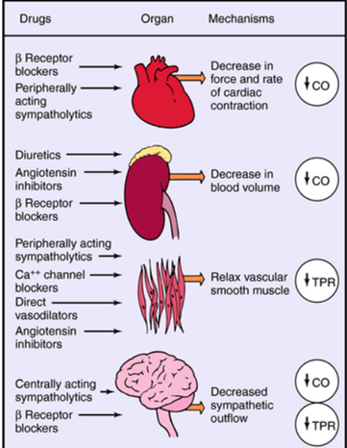
Classification of Antihypertensive Drugs
• Diuretics
• ACE Inhibitors
• Angiotensin II Receptor Blockers (ARBs)
• Calcium Channel Blockers (CCBs)
• Beta-Blockers
• Others: Alpha-Blockers, Vasodilators,
Central Agents.

Slide 7
1. Diuretics
Thiazides (HCTZ, chlorthalidone): ↓ ECF volume → ↓ CO; long-term ↓ PR. Ineffective if GFR < 30 mL/min (except metolazone).
Risks: hypokalemia, hyperuricemia.
Loop diuretics: For poor renal function or edema; cause hypokalemia, ↑ urine calcium.
Potassium-sparing: Amiloride, triamterene (Na⁺ channel blockers), spironolactone/eplerenone (aldosterone antagonists). Reduce K⁺ loss; aldosterone antagonists also ↓ cardiac remodeling.

Slide 8
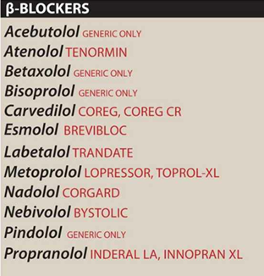
2. β-Adrenoceptor Blockers
↓ CO, inhibit renin, ↓ sympathetic outflow.
Cardioselective (β₁): metoprolol, atenolol; nonselective: propranolol; vasodilatory β₁-selective: nebivolol.
Used in hypertension with CAD, arrhythmias, MI, HF.
Avoid in asthma (nonselective), acute HF.
Adverse: bradycardia, fatigue, sexual dysfunction, lipid changes; taper to avoid rebound.

Slide 9
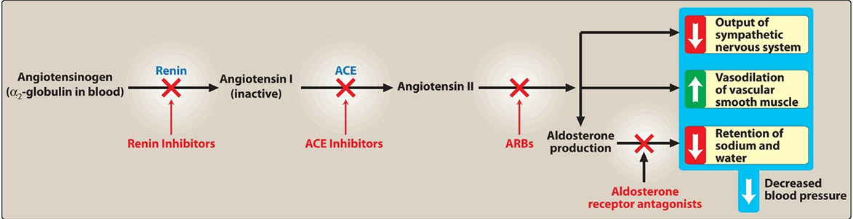
3. ACE Inhibitors (captopril, enalapril, lisinopril)
↓ Ang II, ↑ bradykinin → vasodilation, ↓ aldosterone.
Benefits in CKD, HF, post-MI, diabetes.
Adverse: cough, hyperkalemia, angioedema, fetal toxicity.

Slide 10
4. ARBs (losartan, irbesartan)
Block AT₁ receptors; similar effects as ACEIs but no ↑ bradykinin → less cough/angioedema.
Same indications and fetal risk; avoid combining with ACEIs.
5. Renin Inhibitor (aliskiren)
Directly inhibits renin; similar cautions as ACEIs/ARBs.

Slide 11
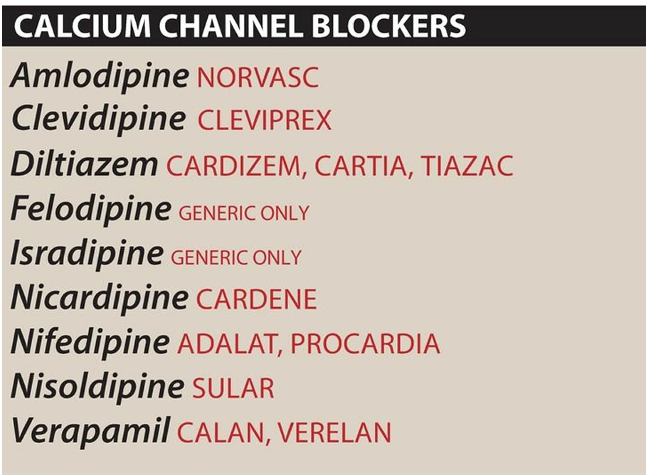
6. Calcium Channel Blockers
• Prevent calcium entry into vascular smooth muscle cells → vasodilation.
• Dihydropyridines (e.g., Amlodipine) for BP.
• Diphenylalkylamines (e.g., Verapamil) for arrhythmias.
Benzothiazepines (e.g., diltiazem)
• Side Effects: edema, headache, dizziness, constipation (verapamil), gingival hyperplasia..

Slide 12
7. α-Adrenoceptor Blockers (prazosin, doxazosin, terazosin)
Vasodilation of arteries/veins; risk of postural hypotension; not first-line.
8. α/β Blockers (labetalol, carvedilol)
Carvedilol for HF; labetalol for hypertensive emergencies & pregnancy hypertension.
9. Centrally Acting Drugs
Clonidine: α₂ agonist; for resistant HTN; risk of sedation, rebound hypertension.
Methyldopa: safe in pregnancy; causes sedation.

Slide 13
10. Vasodilators (hydralazine, minoxidil)
Arteriolar smooth muscle relaxation; cause reflex tachycardia, Na⁺/water retention → combine with β-blocker + diuretic.
Hydralazine safe in pregnancy; minoxidil causes hypertrichosis.
Special Situations
Hypertensive Emergency: BP >180/120 mm Hg with organ damage → IV drugs (nicardipine, nitroprusside, labetalol, hydralazine, etc.).
Resistant Hypertension: Uncontrolled despite ≥3 drugs (incl. diuretic). Causes: poor adherence, high salt intake, interfering drugs, secondary causes.

Slide 14


