Slide 1
Examination of the Respiratory System
Dr. Mariam Al-Ashbal
MSC of the community medicine

Slide 2
Examination of the respiratory system
Inspection
Palpation
Percussion
Auscultation

Slide 3

Inspection
https://youtu.be/jmYeEPWqvc4?si=GqnxtMlfzBSfgUMA

Slide 4
Inspection
Initial patient assessment: This involves noting if the patient looks well or unwell, their level of alertness, colour, and nutritional/hydration status.
Respiratory assessment: Observe if the patient is breathing comfortably, measure their respiratory rate, and check for the use of accessory muscles. Listen for abnormal breathing sounds, such as wheezing, stridor, or hoarseness, and note any cough or sputum.
Equipment and medical devices: Look for any equipment attached to or surrounding the patient, including respiratory medications, IV lines, oxygen delivery systems, chest drains, and urinary catheters.
Physical signs and environment: Check for visible wounds, scars, or deformities of the chest wall, and specific signs like dorsal guttering of the hand or Horner syndrome
Measuring respiratory rate: The video emphasises measuring the respiratory rate for at least 15 seconds.

Slide 5
Palpation
https://youtu.be/MxBGzJsJKN8?si=s6yPtM5RW9Kq08k4

Slide 6
Palpation
Before performing a systemic examination, palpate any part of the chest where the patient reports pain or swelling.
Position of the Apex beat and Trachea
In normal subjects, the trachea is in the midline and can
be palpated in the suprasternal notch
The apex beat (the lowest and outermost point of definite cardiac pulsations) can usually be palpated in the 5th intercostal space within the midclavicular line

Slide 7
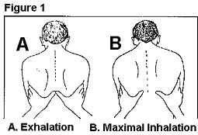
Palpation
Expansion of the chest: Symmetrical or asymmetrical chest expansion can be assessed by palpation
Vocal fremitus: Vocal fremitus is the vibration detected by palpation with the palm of the hand on the chest when the patient is asked to repeat “ninety-nine”.
In a normal healthy adult, the vibrations felt in the corresponding areas on the two sides of the chest are equal in intensity

Slide 8
Percussion and Auscultation
https://youtu.be/E3FW11Mbb0I?si=T1cA5Ml8jPrHL6ZH

Slide 9
Percussion
  Action: Gently tap on the chest wall.
  Finding: This technique helps assess the density of underlying tissue. Different sounds (e.g., resonant, dull, hyper-resonant) can indicate various lung conditions.

Slide 10
Auscultation
Action: Use a stethoscope to listen to lung sounds.
Patient Instruction: Ask the patient to take deep breaths in and out through their mouth.
Finding: Listening for normal breath sounds and identifying any adventitious sounds (like crackles, wheezes, or diminished sounds) can help diagnose respiratory issues.

Slide 11
Auscultation
Breath sounds: There are two types of breath sounds:
Vesicular breath sounds
Bronchial breath sounds

Slide 12
Vesicular breath sounds
These originate in the larger airways and are produced by the passage of air in and out of normal lung tissue. In good health, they can be heard all over the chest
The inspiration is longer than expiration
The inspiratory sound is intense and louder than the expiratory sound
It is a low-pitched rustling sound
There is no gap between inspiration and expiration
Vesicular breathing with prolonged expiration example: airway obstruction (asthma)

Slide 13
Bronchial breath sounds
These are produced by air passage in the trachea and larger bronchi. In good health, they can be heard only over the trachea
In disease, bronchial breathing may be heard over the area of the lung that is affected (lung collapse, fibrosis or when there is a cavity)
The expiration is as long as or longer than the inspiration
The pitch sound of the expiration is louder than the inspiratory sounds
There is a gap between inspiration and expiration

Slide 14
Airway assessment
Mallampati score
Wilson Risk score

Slide 15
Airway Assessment video
https://www.youtube.com/watch?v=Dqn5tRtha_I

Slide 16
Mallampati score
The Mallampati score (or classification) is a bedside airway assessment used by clinicians to predict the ease of endotracheal intubation, based on the visibility of structures in the oropharynx. It classifies patients from Class 1 (easiest) to Class 4 (most difficult) based on visibility of the soft palate, uvula, and fauces.
Mallampati Classes (Modified)
Class 1: Soft palate, uvula, fauces, and tonsillar pillars are visible.
Class 2: Soft palate, uvula, and fauces are visible.
Class 3: Soft palate and base of uvula are visible.
Class 4: Only the hard palate is visible; the soft palate, uvula, and pharynx are not visible.

Slide 17
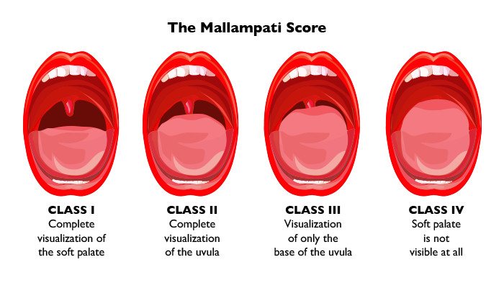
Mallampati score

Slide 18
Wilson risk score
Wilson Score for Difficult Intubation (0–10 points)
Purpose:
A pre-anaesthetic, five-factor assessment used to predict difficult intubation.
Score > 2 → Increased probability of difficulty
Score > 8 → High risk

Slide 19
Components (Each scored 0–2 points)
1. Weight
0 points: < 90 kg
1 point: 90–110 kg
2 points: > 110 kg
2. Head & Neck Movement
0 points: > 90°
1 point: ~ 90°
2 points: < 90°

Slide 20
Components (Each scored 0–2 points)
3. Jaw Movement (Mouth Opening + Subluxation)
0 points:
  Interincisal Gap (IG) > 5 cm
  Normal mandibular subluxation
1 point:
  IG 4–5 cm
  Reduced subluxation
2 points:
  IG < 4 cm
  Severely limited subluxation

Slide 21
Components (Each scored 0–2 points)
4. Receding Mandible
0 points: Normal
1 point: Moderate recession
2 points: Severe recession
5. Buck Teeth (Protruding Incisors)
0 points: Normal
1 point: Moderate
2 points: Severe

Slide 22
Wilson risk score
Interpretation of Total Score
0–2: Easy intubation
3–7: Moderately difficult intubation
8–10: Difficult intubation (high risk)
Key Notes
Maximum score = 10
Higher score = greater difficulty
Commonly used alongside other airway assessments (e.g., Mallampati) for better prediction

Slide 23
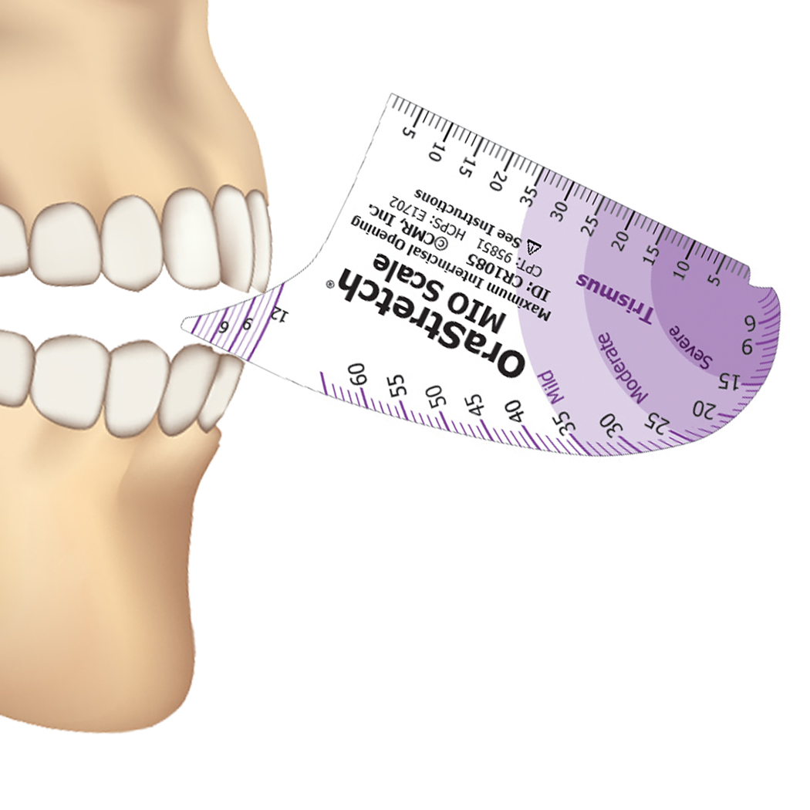
The interincisal gap is the distance (in cm) between the upper and lower central incisors when the mouth is opened as wide as possible.

Slide 24
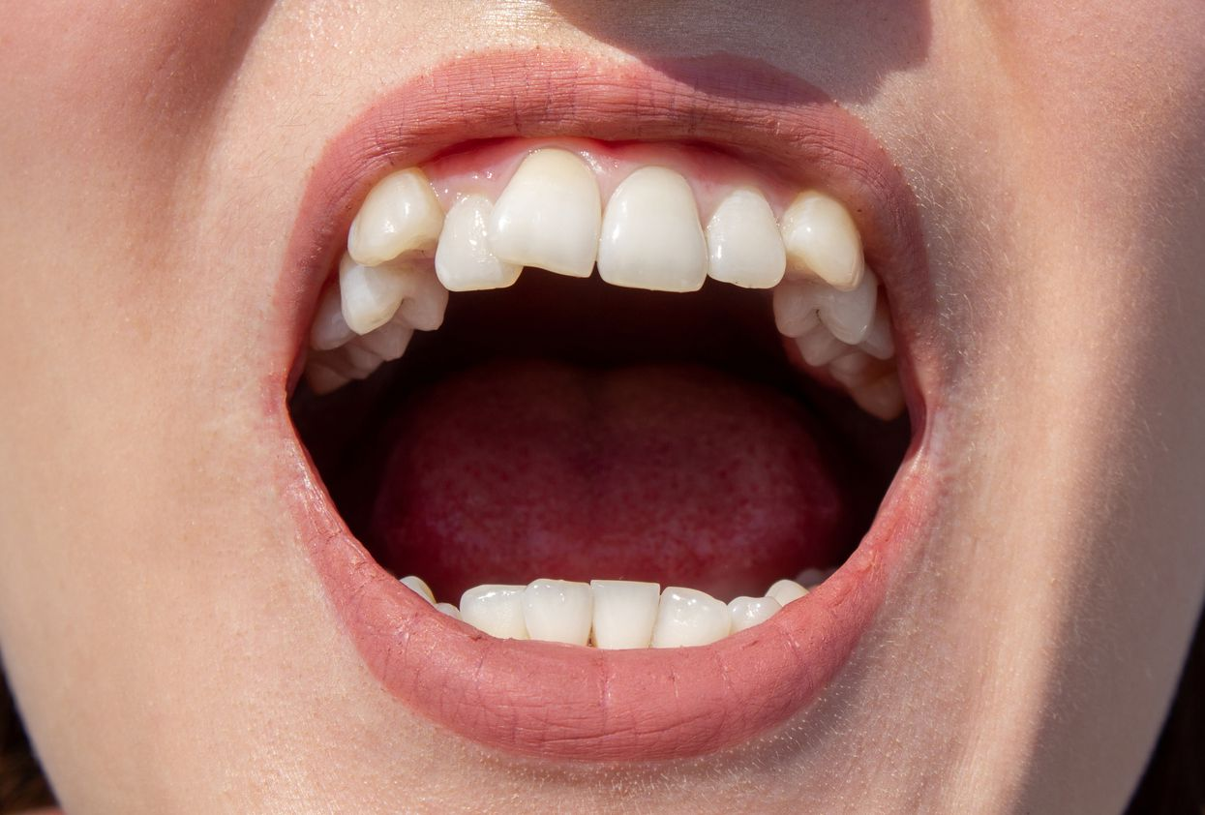
Buck Teeth

Slide 25
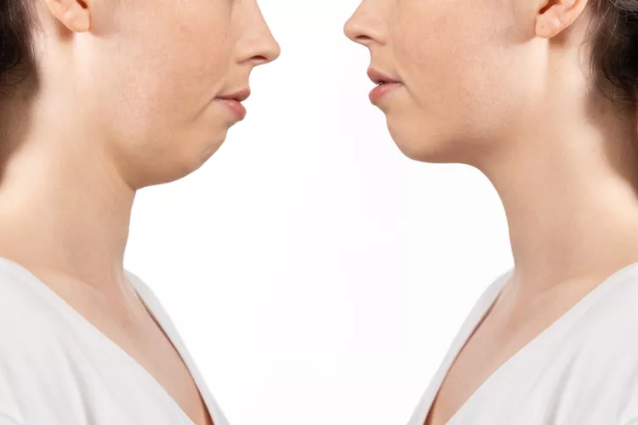
Receding Mandible

