Slide 1
Hepatitis B virus
Dr. Ahmed Shihab

Slide 2
Definition:
Hepatitis: Inflammation of the liver
Hepatitis can be caused by:
1-Viral infection
2-Medication
3-Alcohol
4-Autoimmune disease
Viral hepatitis can present as either an acute or a chronic illness.
Acute hepatitis is defined as an infection lasting for less than 6 months,
Whereas chronic hepatitis is an infection for more than 6 months
Today, we focus on Viral Hepatitis (HAV, HBV, and HCV)
Hepatitis B Virus (HBV) is a DNA virus transmitted through percutaneous/mucosal transmission from infected blood or body fluids
And Mother-to-child transmission during childbirth.

Slide 3
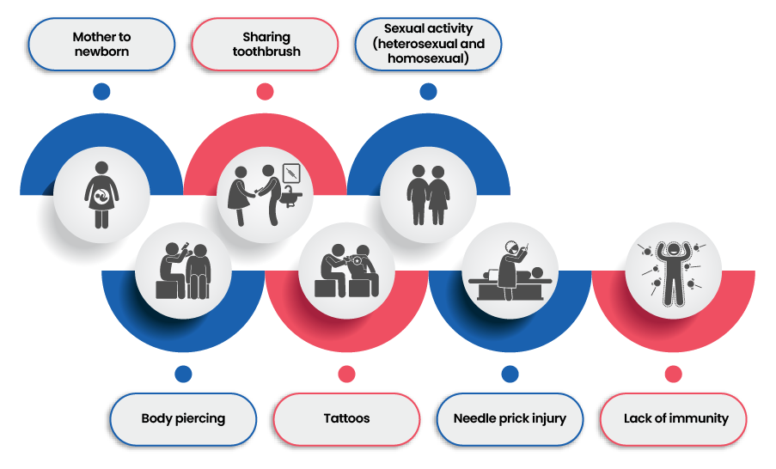
Transmission rout of HBV:
1-Parenteral: intravenous drug abuse, needlestick, transfusion, ear or body piercing
2-Bodily fluids: such as (saliva)
3-Sexual contact
4-Perinatal: mother to child at birth
*) Virus survives at least 7 days outside of the body
*) Incubation period: 60-150 days
Associated with both acute and chronic disease. The natural history of HBV is age-dependent. The risk of developing a chronic infection after an acute infection is 90% in neonates, 30% in children younger than 5 years, and 2%–6% in adults.
*) Chronic infection with HBV increases the risk of hepatocellular carcinoma.

Slide 4
Symptoms of HBV could include:
Commonly asymptomatic
(30% may have no symptoms)
HBV Acute infection:
1-nausea, vomiting.
2-diarrhea.
3-myalgia.
4-fever.
5-abdominal pain.
6-jaundice.
Symptoms of chronic HBV :
*) Commonly asymptomatic
1-Ascites
2-Encephalopathy
3-Jaundice
4-Peripheral edema
5-Splenomegaly
*) May take years to manifest into compensated or decompensated cirrhosis

Slide 5
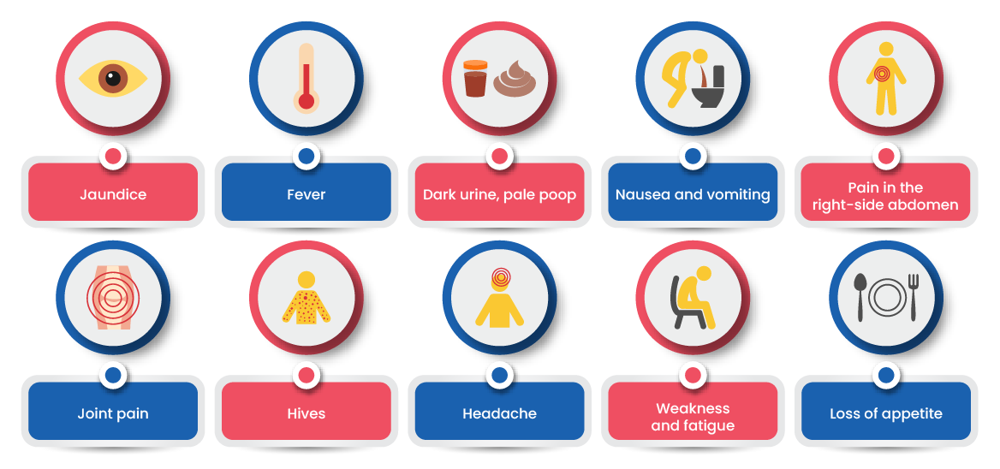
Symptoms of HBV could include:

Slide 6
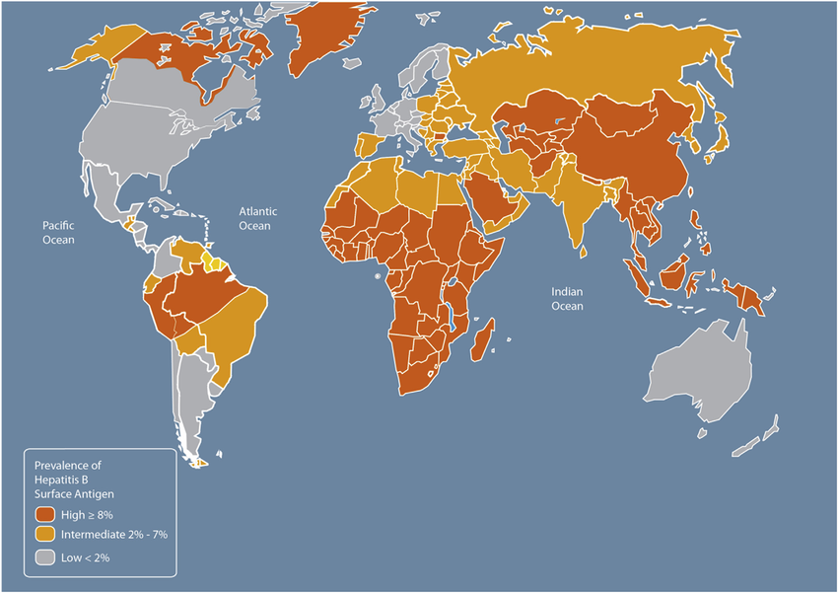
Risk factors for hepatitis B virus:
1-Direct contact with an infected person
2-Mother-to-child transmission during childbirth.
3-Occupational exposure to blood or blood-contaminated body fluids.
4-Hemodialysis.
*) Consequences of untreated hepatitis
1- Cirrhosis
2- Hepatocellular carcinoma
3- 5-year survival with compensated cirrhosis is around 85%, while for decompensated cirrhosis, it is around 14-35%
Prevalence of HBV by country. Footnote: Source: Adapted from Centers for Disease Control and Prevention. CDC Health Information for International Travel 2014. New York: Oxford University Press, 2014.

Slide 7
Diagnosis:
By symptoms Combinations of serologic markers must be reviewed to distinguish acute from chronic infections.

Slide 8
Clinical Definitions of HBV

Slide 9
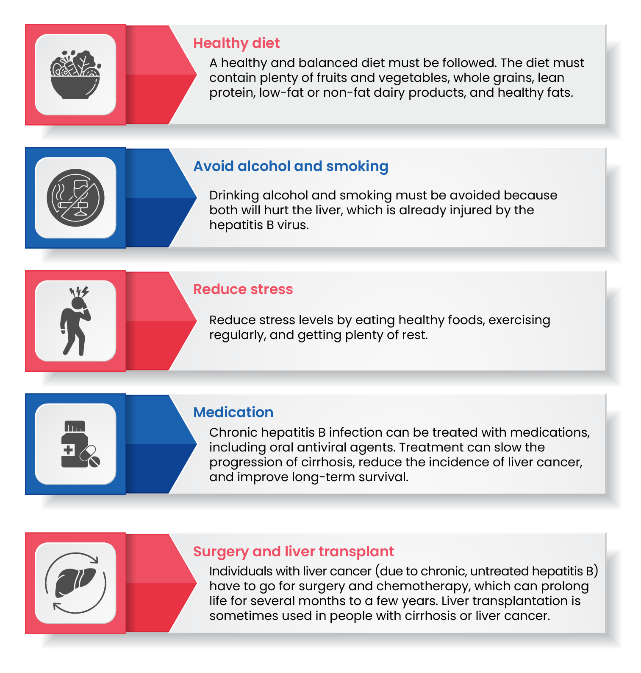
Management:
Acute infection: supportive measures
Chronic infection: antiviral therapy
(course of treatment takes 1 year)

Slide 10
Prevention:
*) Vaccination (preexposure); indicated in the following groups:
1-All infants, children, and adults aged 19–59 years
2-Adults 60 years and older with hepatitis risk factors, including:
A-Individuals at risk of infection by sexual exposure
B-Individuals at risk of infection by percutaneous or mucosal exposure to blood (injection drug use; occupational risk of exposure to blood or blood-contaminated body fluids; patients receiving hemodialysis; patients with diabetes)
C-Others (international travelers to countries where hepatitis B is common; individuals with hepatitis C, chronic liver disease, or HIV infection; incarcerated individuals)

Slide 11
Prevention:
*) Postexposure prophylaxis
*) Exposure can result in the need for HBV vaccine or immune globulin.
(1) Children born to HBsAg-positive mothers should receive the first dose of the three-dose vaccine series plus HBV immune globulin within 12 hours of birth.
(2) Children born to mothers with unknown HBsAg status (but suspected) should receive the first dose of the three-dose vaccine series within 12 hours of birth; testing should be performed on the child, and if positive, HBV immune globulin should be administered within 1 week.
(3) Sexual contact or household contact with an infected person: Should receive HBV immune globulin plus vaccine series if the exposed person is previously unvaccinated
(4) Sexual contact or household contact with an HBV carrier: Should receive vaccine series if the exposed person was previously unvaccinated

Slide 12
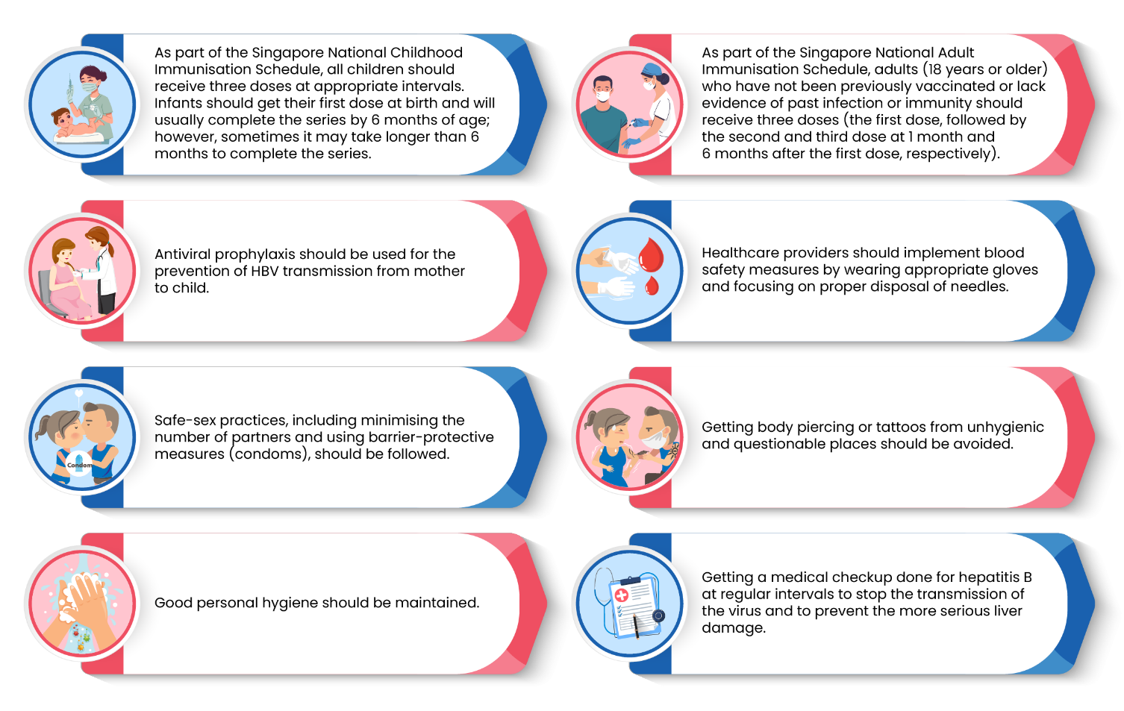
Summary:

Slide 13
Reference:
1-ACCP Pharmacotherapy 2024
2-Applied therapeutics 12th ed 2023
3-Infectious Disease ACCP 2025

Slide 14
“Prevention is not only better than cure—sometimes, it is the only cure.”
Thank you…

