Slide 1
Hepatitis A virus
Dr. Ahmed Shihab

Slide 2
Definition:
Hepatitis: Inflammation of the liver
Hepatitis can be caused by:
1-Viral infection .
2-Medication.
3-Alcohol.
4-Autoimmune disease.
Viral hepatitis can present as either an acute or a chronic illness.
Acute hepatitis is defined as an infection lasting for less than 6 months,
Whereas chronic hepatitis is an infection for more than 6 months
Today, we focus on Viral Hepatitis (HAV, HBV, and HCV)
Hepatitis A Virus (HAV) is an enveloped RNA virus that is associated with the development of self-limited hepatitis transmitted mainly via the fecal–oral route.

Slide 3
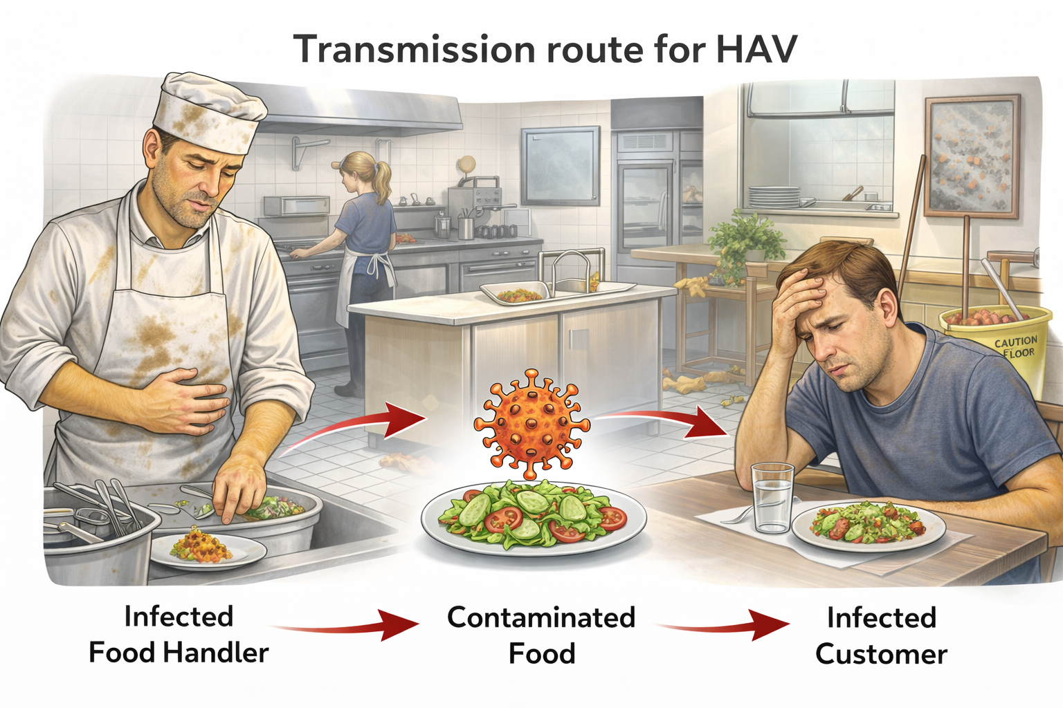
Transmission rout of HAV:
Occurs mainly through the fecal–oral route.
1-Areas of poor sanitation; also, flooding leading to increased spread
2-Foodborne: shellfish, water, milk, vegetables
3-Person-to-person contact: sexual, day care, intravenous drug use, household, restaurant workers
After exposure an Incubation period14–50 days occurs
Symptoms usually last less than 2 months
HAV is associated with very low mortality (less than 1%) and is not associated with the development of chronic hepatitis. Fulminant hepatitis can occur in some instances.

Slide 4
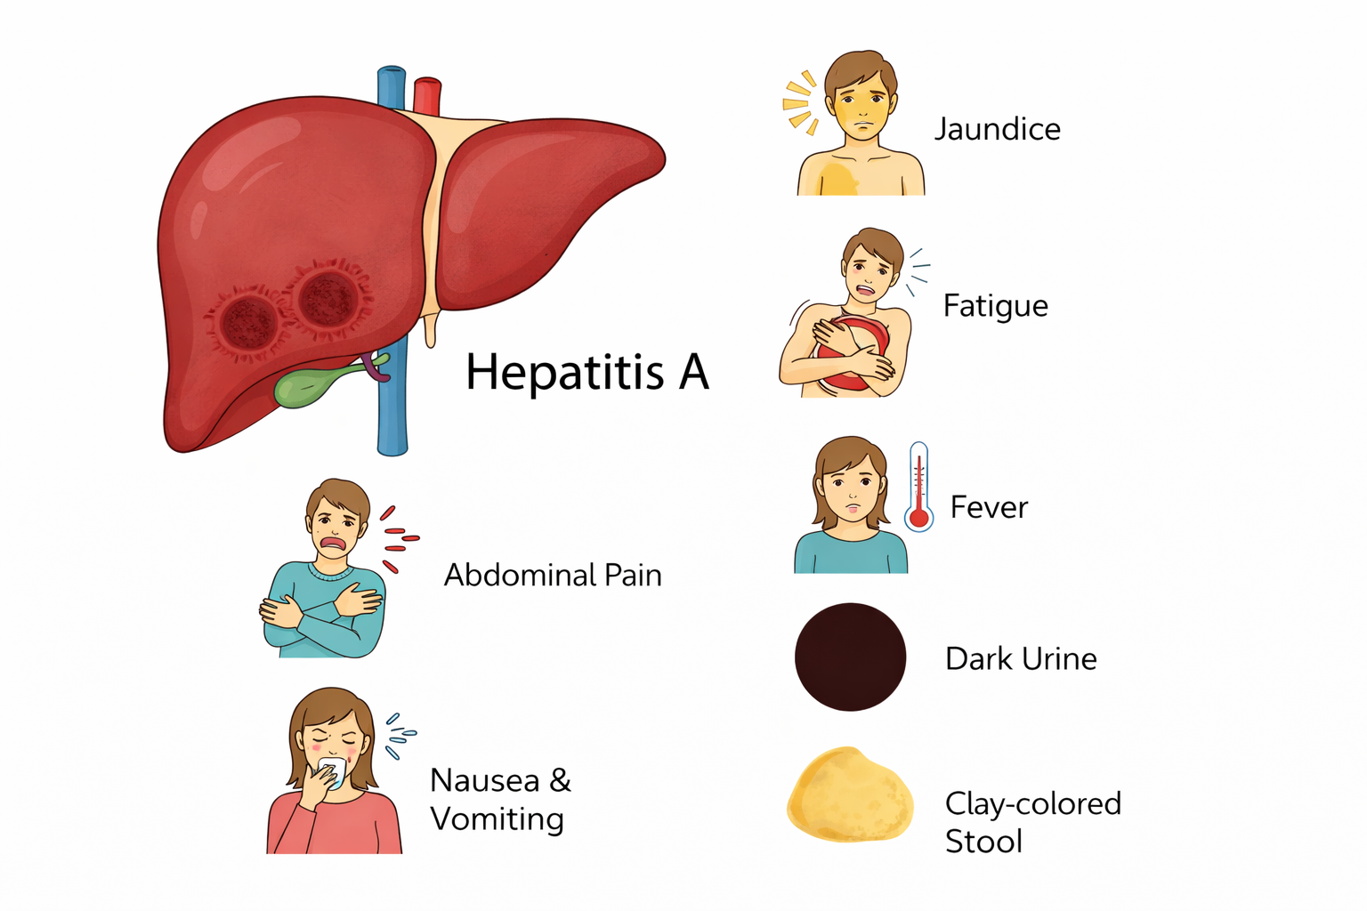
Symptoms of HAV could include:
1-nausea, vomiting.
2-diarrhea.
3-myalgia.
4-fever.
5-abdominal pain, and jaundice.
6-pale stools.
7-dark urine.
8-loss of appetite.
Much more severe in adults vs. children

Slide 5
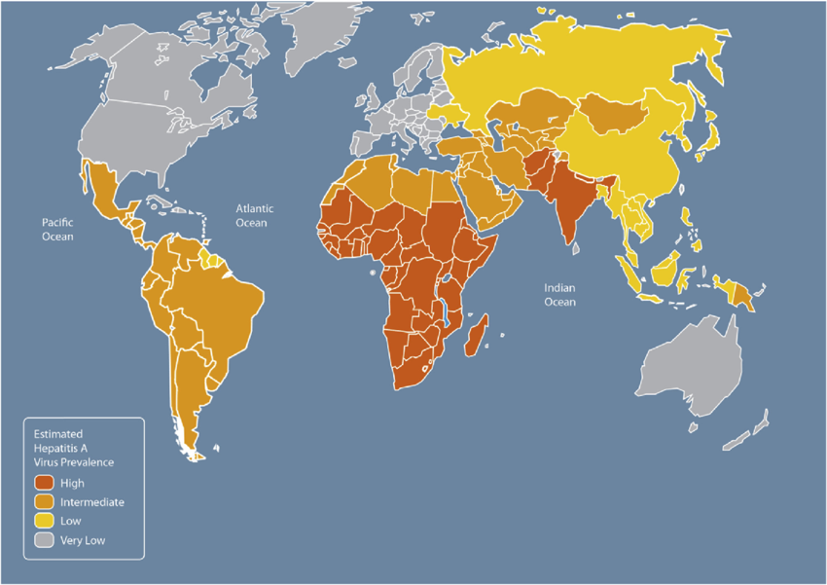
Risk factors for hepatitis A virus:
1-Travel to or live in an area with poor sanitation or lacking safe water.
2-Recreational drug use.
3-Direct contact with an infected person
Diagnosis of HAV:
-Clinical signs and symptoms
-Recent possible exposures
-Laboratory data
Prevalence of HAV by country. Footnote: Source: Adapted from Centers for Disease Control and Prevention. CDC Health Information for International Travel 2014. New York: Oxford University Press; 2014

Slide 6
Management:
1-Self-limiting disease
2-Avoidance of acetaminophen
3-Supportive care
A-Antiemetics
B-Fluids to replete volume loss from vomiting and diarrhea
*) Fluid replacement is the most important thing to address, and to avoid anything that can be
harmful to the liver

Slide 7
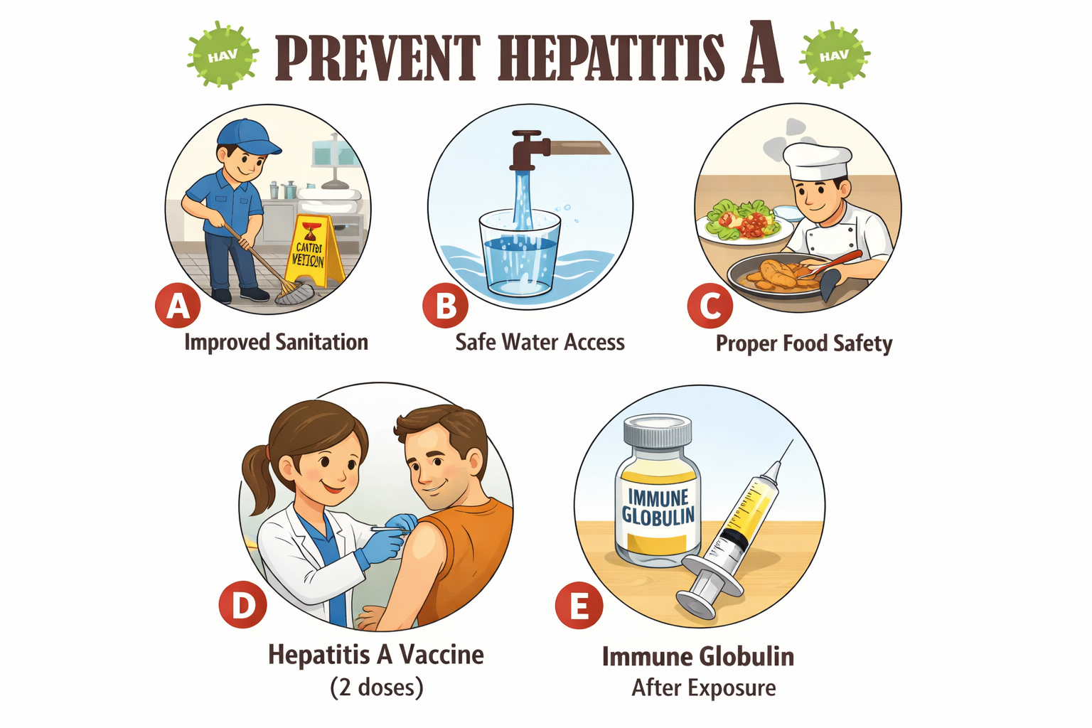
Prevention:
1-Improved sanitary conditions
2-Safe access to water
3-Ensuring that appropriate food safety procedures are followed
4-Vaccination is going to be the most beneficial prevention technique (2 doses given at least 6 months apart)
5-Immune globulin – if exposure has occurred and no vaccination has been given

Slide 8
Who should be immunized against HAV?
1-All children ≥1 year of age
2-Persons with travel to areas with intermediate to high rates of infection
3-Illegal and injection drug users
4-Homeless
5-Persons with clotting-factor disorders
6-Persons working with HAV-infected primates or with HAV in a research laboratory
7-Persons with chronic liver disease, including HBV- and HCV-infected
8-Persons exposed as a result of an outbreak
9-Persons who require post-exposure prophylaxis
*) Populations requiring preexposure prophylaxis with HAV immune globulin
1-Children younger than 1 year (vaccine not approved for this age group)
2-Travelers to endemic countries

Slide 9
Reference:
1-ACCP Pharmacotherapy 2024
2-Applied therapeutics 12th ed 2023
3-Infectious Disease ACCP 2025

Slide 10
“The best treatment for hepatitis A is prevention, and prevention begins with knowledge, hygiene, and vaccination.”
Thank you…

