Slide 1
Arthropod-Borne Viral Disease (Arboviruses)
Dr. Ahmed Shihab Ahmed

Slide 2
Introduction:
Arthropod-borne viral diseases:
are infections transmitted to humans through the bite of infected arthropods such as mosquitoes, ticks, and sandflies.
Public health importance:
Cause outbreaks and epidemics
Common in tropical and subtropical regions
Prevention depends largely on vector control

Slide 3
Arboviruses:
Arboviruses are viruses transmitted by blood-feeding arthropods.
Key characteristics:
Require a vector for transmission
Replicate in both vector and host
Often maintained in animal reservoirs
Humans may be incidental hosts

Slide 4
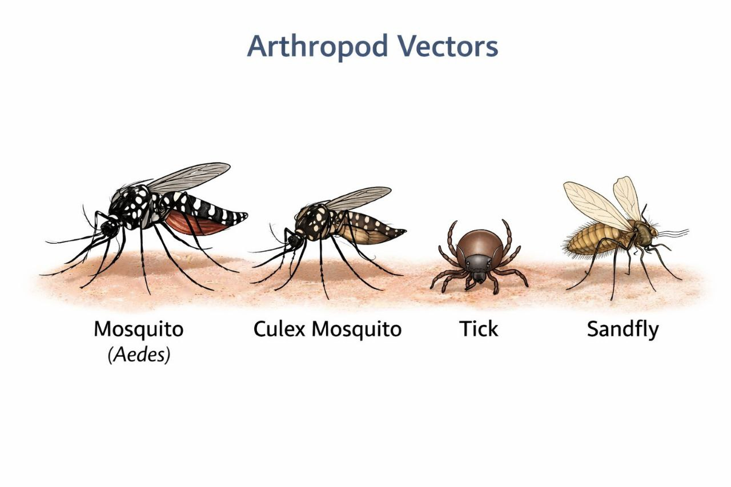
Common Vectors:
Major vectors include:
Mosquitoes (Aedes, Culex)
Ticks
Sandflies
*) Mosquitoes are responsible for most arboviral infections worldwide.

Slide 5
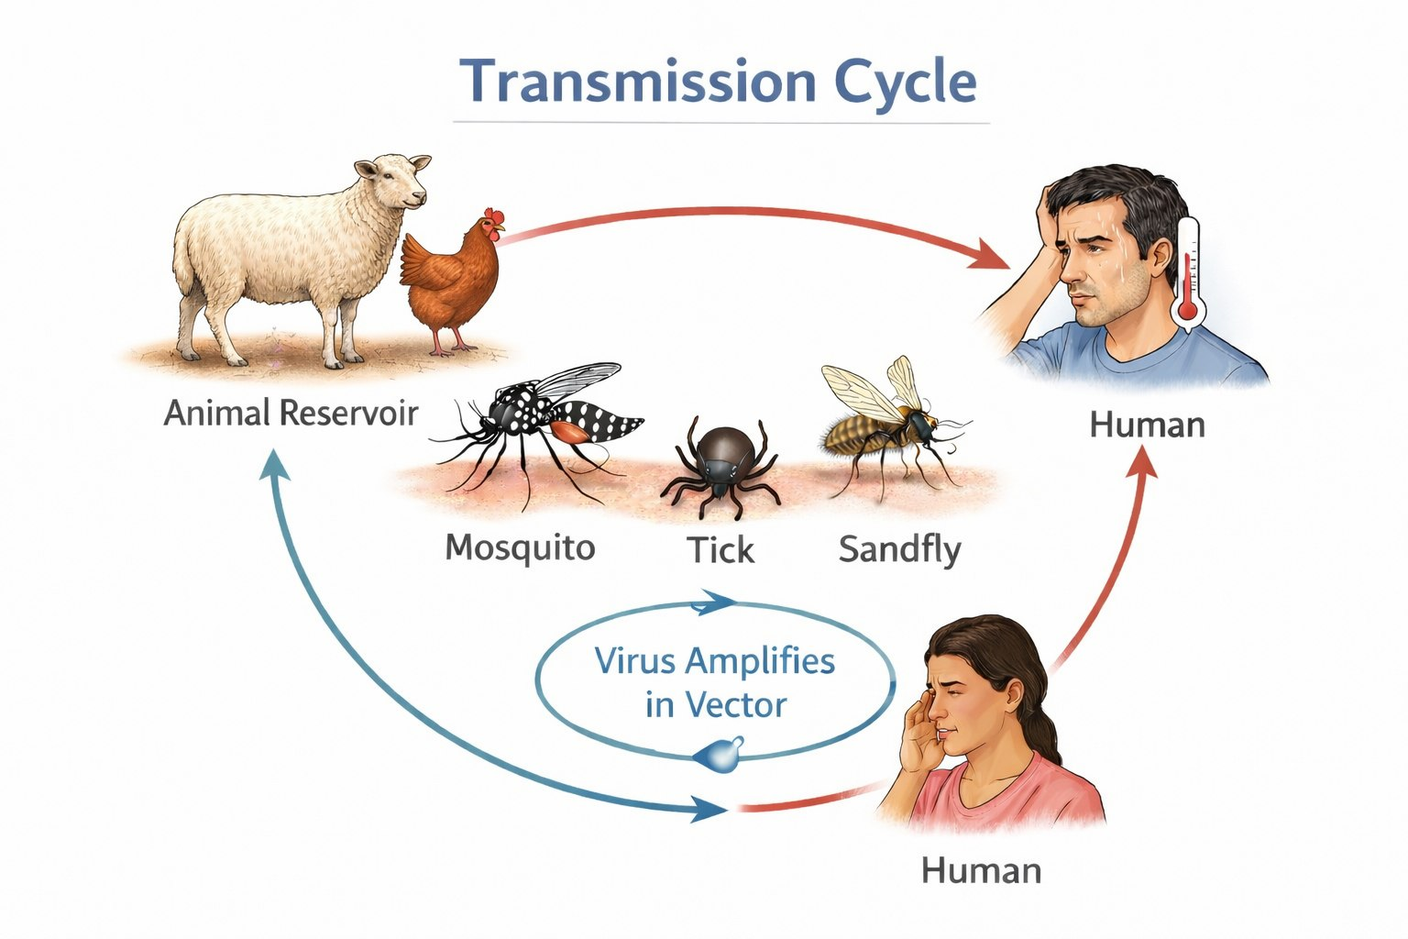
Transmission Cycle:
Typical transmission cycle:
1-Virus infects animal or human host
2-Arthropod feeds on infected host
3-Virus multiplies in the vector
4-Vector transmits virus to another host
Factors affecting transmission:
Climate
Rainfall
Sanitation
Vector population

Slide 6
Major Arboviral Diseases:
Mosquito-borne:
Dengue fever
Chikungunya
Zika virus infection
West Nile fever
Tick-borne:
Crimean-Congo hemorrhagic fever
Distribution varies geographically.
These diseases are important in public health due to outbreaks and complications.

Slide 7
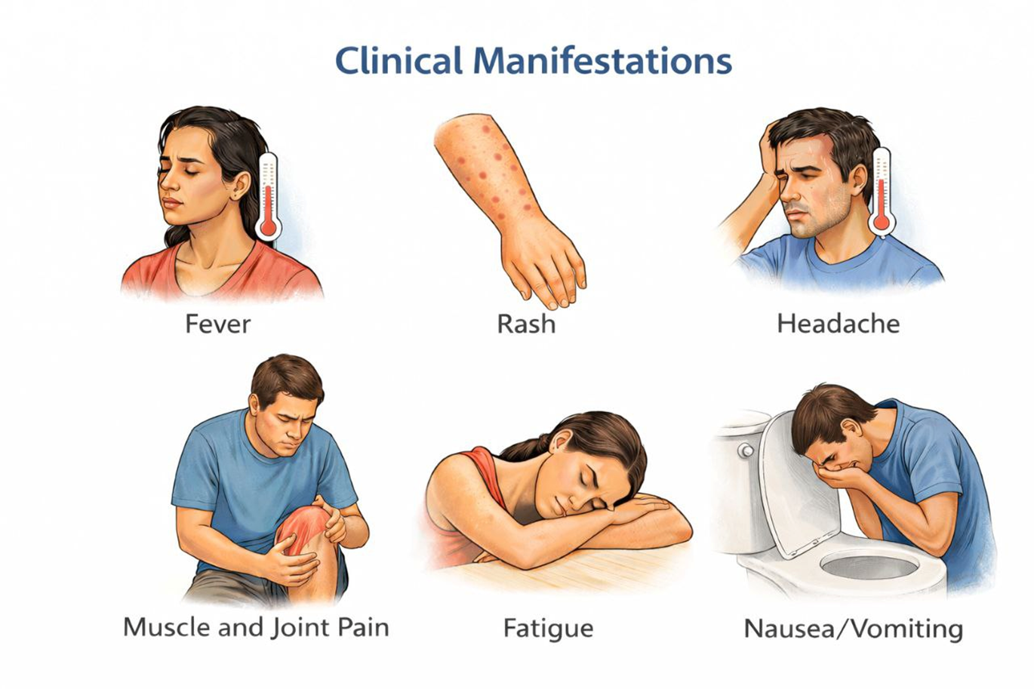
Clinical Manifestations:
Common symptoms include:
Fever
Headache
Muscle and joint pain
Rash
Fatigue
Nausea or vomiting
Symptoms are often non-specific in early stages.

Slide 8
Severe Complications:
Some infections may lead to:
Hemorrhage
Encephalitis
Shock
Organ failure
Severe disease occurs in a minority of patients but may be life-threatening.

Slide 9
Diagnosis:
Diagnosis is based on:
Clinical suspicion
Exposure history
Laboratory confirmation
Laboratory tests:
PCR
Serology (IgM antibodies)

Slide 10
Treatment:
There is no specific antiviral therapy for most arboviral infections.
Management is mainly supportive:
1-Fluid replacement
2-Antipyretics
3-Monitoring complications
*)Avoid unnecessary antibiotics unless bacterial infection is suspected.
*)Prevention remains the most effective strategy.

Slide 11
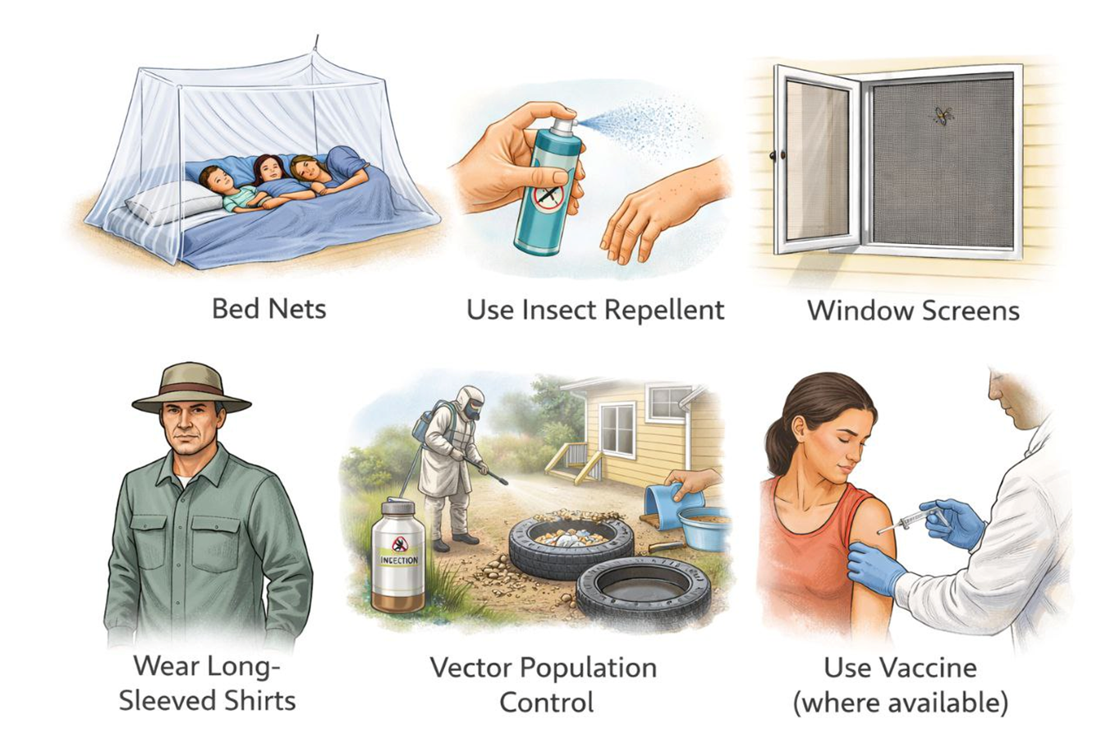
Prevention and Control:
Prevention strategies include:
Use of bed nets
Insect repellents
Wearing protective clothing
Window screens
Vector population control
Environmental management
Vaccination where available

Slide 12
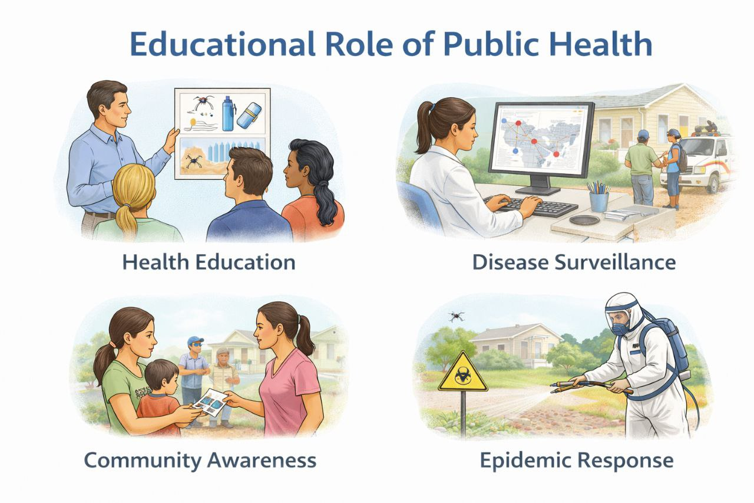
Role of Community Health:
Community health professionals are responsible for:
Health education
Disease surveillance
Early case detection
Reporting outbreaks
Promoting vector control programs
Community participation is essential for disease control.

Slide 13
Why Arboviral Diseases Are Increasing Important:
1-Climate change
2-Urbanization
3-Increased travel
4-Poor sanitation
5-Expansion of vector habitats

Slide 14
Summary:
Arboviral diseases are transmitted by arthropods, mainly mosquitoes and ticks.
They are common in many regions and represent a significant public health issue.
Prevention and vector control remain the most effective methods of reducing disease burden.

Slide 15
“The greatest victories in medicine are not in treatment, but in prevention.”

