Slide 1
Hepatitis C virus
Dr. Ahmed Shihab

Slide 2
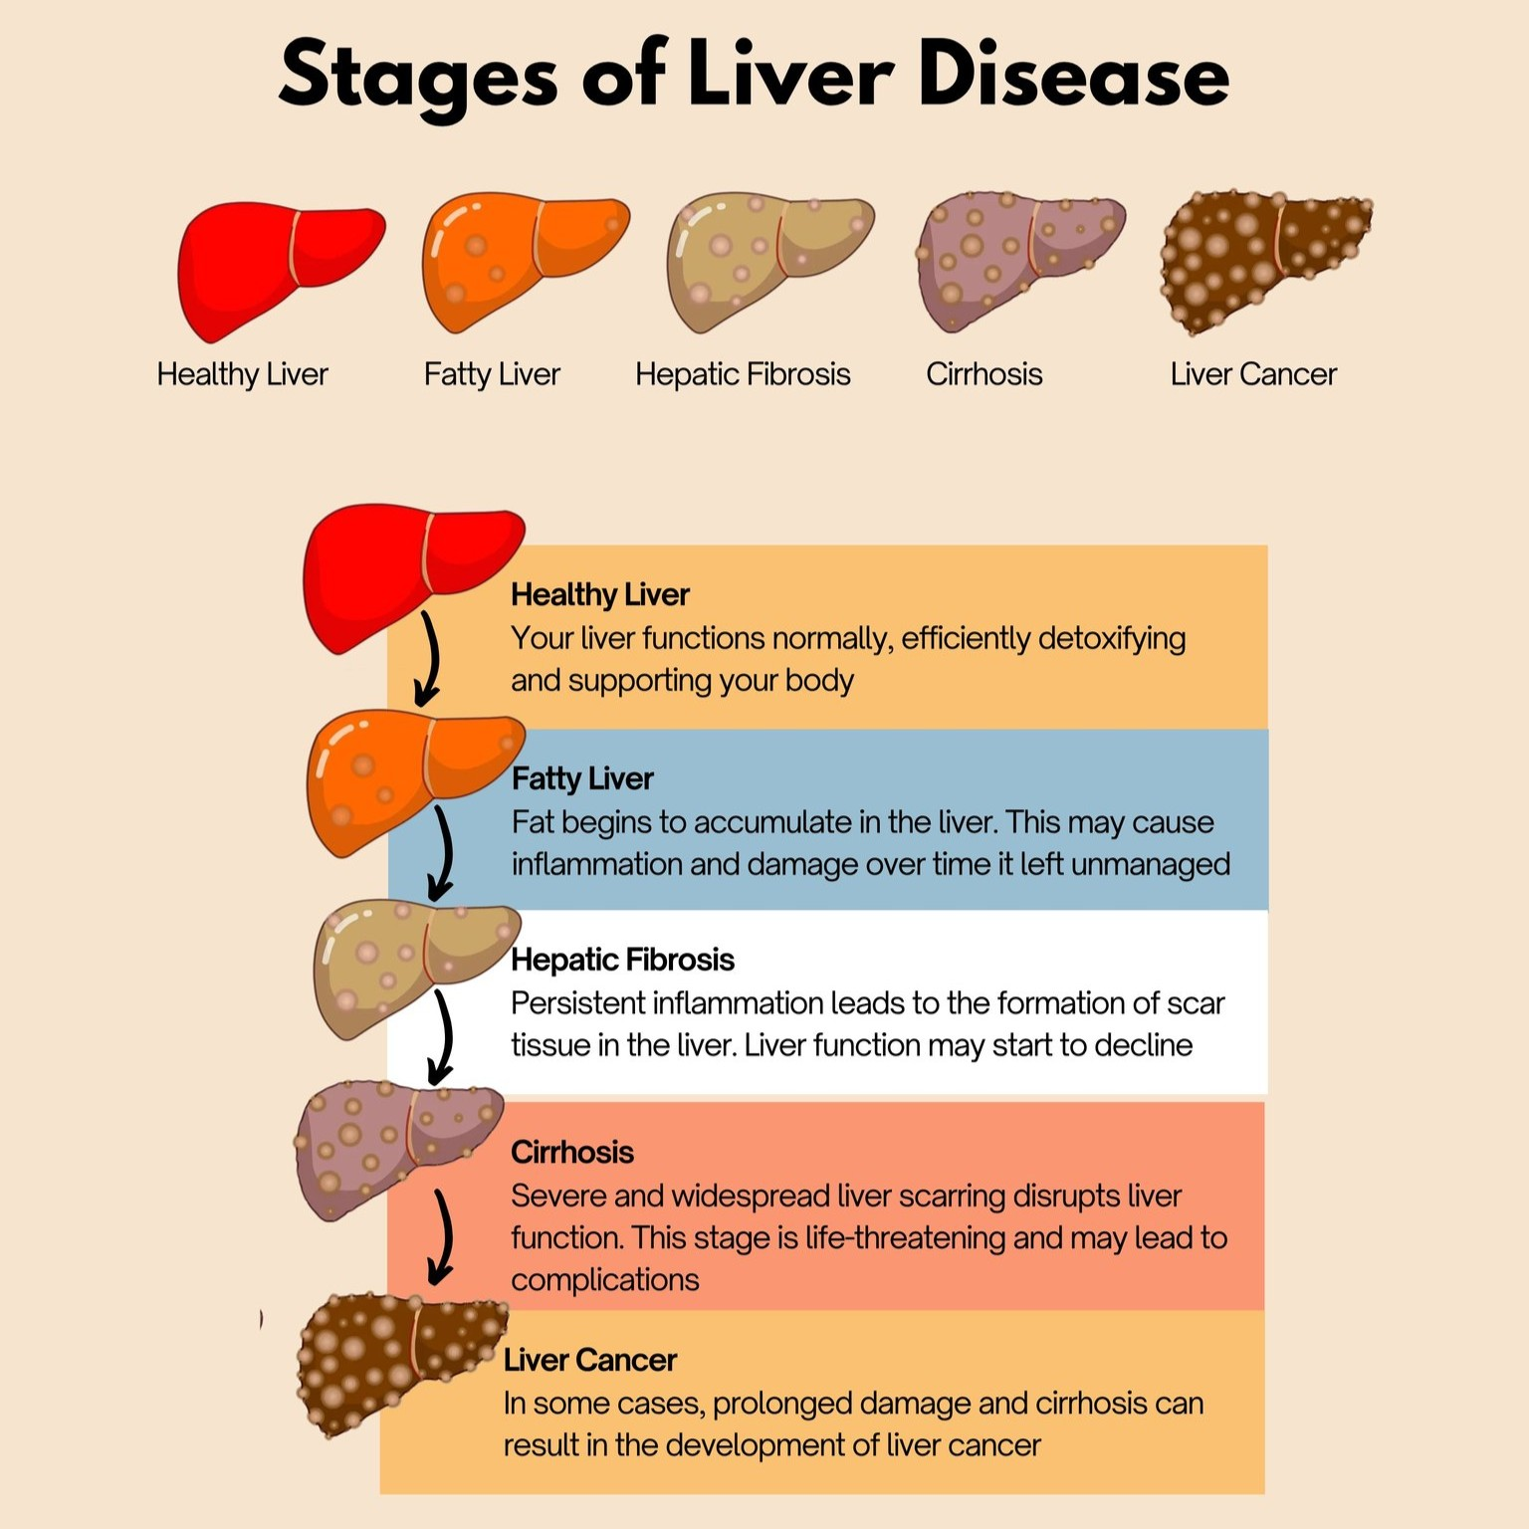
Definition:
Hepatitis C Virus (HCV):
Is a single-stranded RNA virus with six genotypes. It is the leading cause of liver disease and liver transplantation in the United States and a common cause of hepatocellular carcinoma. Transmission is mainly bloodborne (transfusion, intravenous drug abuse).

Slide 3
Transmission rout of HCV:
Percutaneous transmission
1. Injection drug use
2. Received donated blood, blood products, or organs prior to 1992
3. Needlestick injuries
4. Born to an HCV-infected mother
5. Sex with an HCV-infected person
6. Sharing personal items with infected blood

Slide 4
Recommended testing for HCV:
1-One time screening for all adults aged 18 years and older
2-Pregnant women during each pregnancy
3-People who have ongoing risk factors (e.g., persons who inject drugs, share needles or other preparatory equipment, or who have selected medical conditions, including receiving maintenance hemodialysis) should be tested routinely
*) Associated with acute and chronic infection; after acute infection, most patients (60%–85%) develop chronic infection

Slide 5
Symptoms of HCV could include:
Acute symptoms:
Commonly asymptomatic, but may experience mild symptoms
*) Symptoms present 4–12 weeks after exposure
1-fatigue.
2-abdominal pain.
3-poor appetite.
4-jaundice.
Chronic infection:
Commonly asymptomatic
1-Typically insidious over several decades, but can progress to cirrhosis and HCC
2-HBV and HIV co-infection can accelerate the progression of liver injury and are often associated with poor outcomes; alcohol use also accelerates the progression of liver injury.

Slide 6
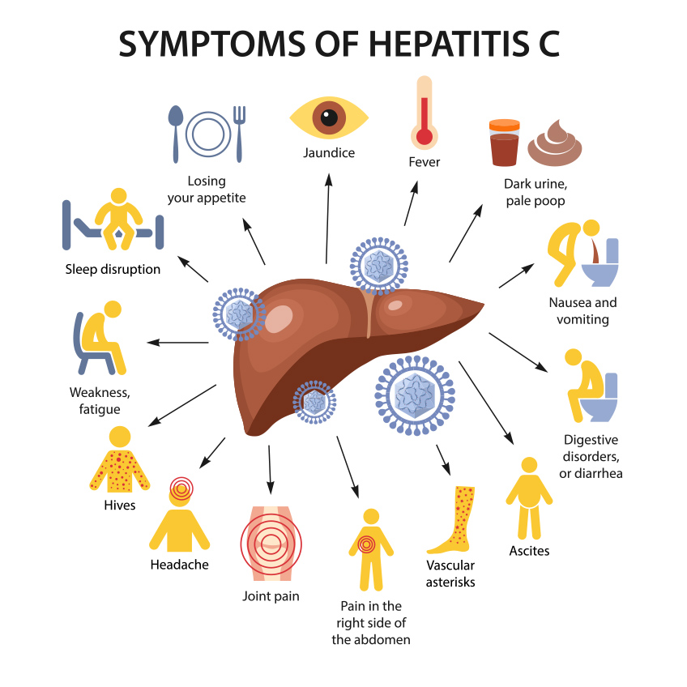
Symptoms of HCV could include:

Slide 7
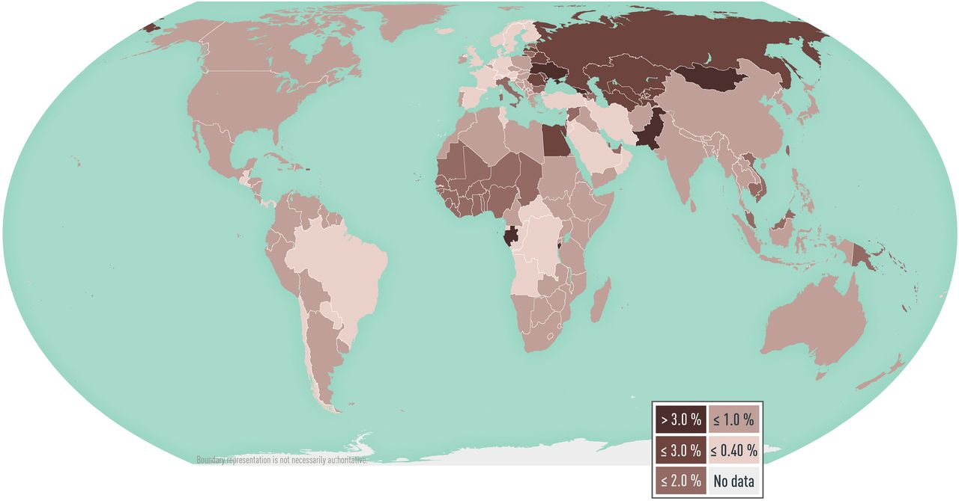
Risk factors for hepatitis C virus:
1-HIV infection
2-Current or former injection drug use (including historical and one-time use)
3-Patients who ever received maintenance hemodialysis
4-Prior recipients of transfusions or organ transplants (received clotting factor concentrates produced before 1987, received a transfusion of blood or blood components before July 1992, received an organ transplant before July 1992, or notified that they received blood from a donor who later tested positive for HCV infection)
5-Health care, emergency medical, and public safety personnel after needle sticks, sharps, or mucosal exposures to HCV-positive blood
6-Children born to mothers with HCV infection
Global prevalence of the hepatitis C virus

Slide 8
Diagnosis:
1-Clinical signs and symptoms.
2-Risk Factor consideration.
3-Laboratory (Serum anti-HCV antibodies).
4-Liver biopsy, imaging, or noninvasive markers to evaluate liver fibrosis.

Slide 9
Management:
15-25% of those with HCV clear the virus without treatment.
*) Preexposure or postexposure prophylaxis is not recommended.
Treatment:
With the availability of direct-acting antivirals (DAAs), treatment is recommended for all patients with chronic HCV infection. Exceptions include those with a short life expectancy that cannot be lengthened with HCV therapy, liver transplantation, or other therapy

Slide 10
Prevention:
No vaccine or immune globulin available
A-Risk factor modification
1-Intravenous drug abuse
2-Sexual contact
3-Avoid blood exposure: Occupational (universal precautions) or other contact (e.g., sharing toothbrushes or razors or receiving a tattoo)
4-The HAV and HBV vaccines to prevent further progression of liver disease
5-HCV-positive individuals are to refrain from donating blood, organs, tissues,

Slide 11
Reference:
1-ACCP Pharmacotherapy 2024
2-Applied therapeutics 12th ed 2023
3-Infectious Disease ACCP 2025

Slide 12
“Prevention is not only better than cure—sometimes, it is the only cure.”
Thank you…

