Slide 1
Medical Terminology
Prof.Dr. Mohammad Alfaham
M.Sc; Ph.d

Slide 2
Medical terminology is the language used in healthcare system to describe anatomy, structures, conditions, diagnoses, procedures, treatments, and much more.
Medical Terminology: Prefix = Beginning and is the descriptive part of the word; Root = Middle and is the subject of the word; Suffix = Ending and provides meaning to the word

Slide 4
word root is the main part of medical word
Examples:
Dent means tooth
Dermat means skin
Cardi means heart
Gastr means stomach
combining forms
Is the combination of word root and a vowel
To make the pronunciation of word roots easier it is necessary to use a vowel after the root
The combining vowel is usually an (o) but others may be used
Ex gastr + o = gasro
cardi + o = cardio

Slide 6
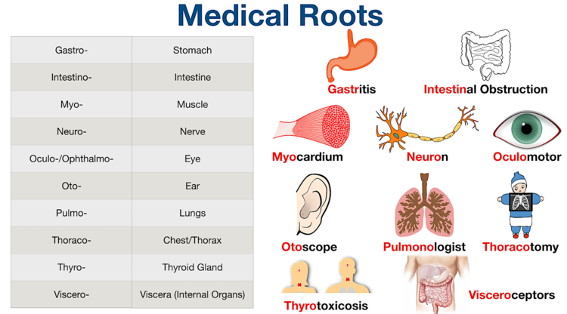

Slide 7
Suffix
Is a term added to the end of a word root or combinig form to have a meaning
To make pronunciation easier vowel is used between a word root and suffix that begins with a constant letter
Ex hepat + o + megaly = hepatomegaly
If suffix begins with a vowel letter, then a combining vowel is (not) used between the word root and its suffix
Ex arthr + itis
hemat + oma

Slide 8
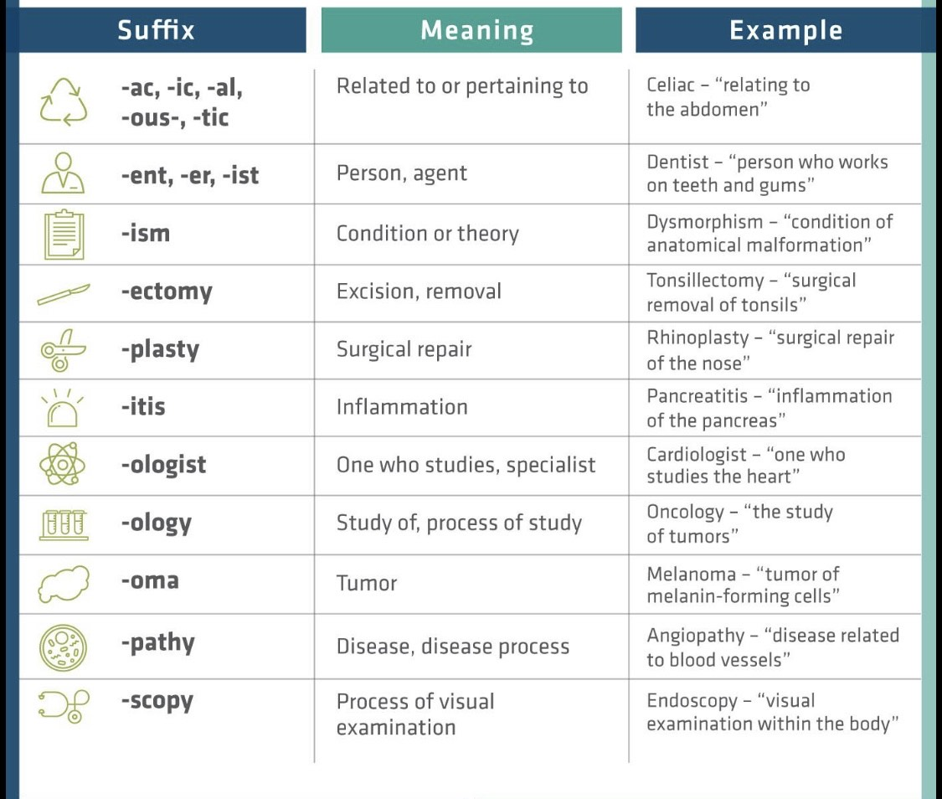

Slide 9
prefix
Placed before award root to change its meaning
Ex hyper (high) -- hypo (low) (hypertension – hypotension)
Pre (before ) --- post (after) (pre – operative – post operative)

Slide 10
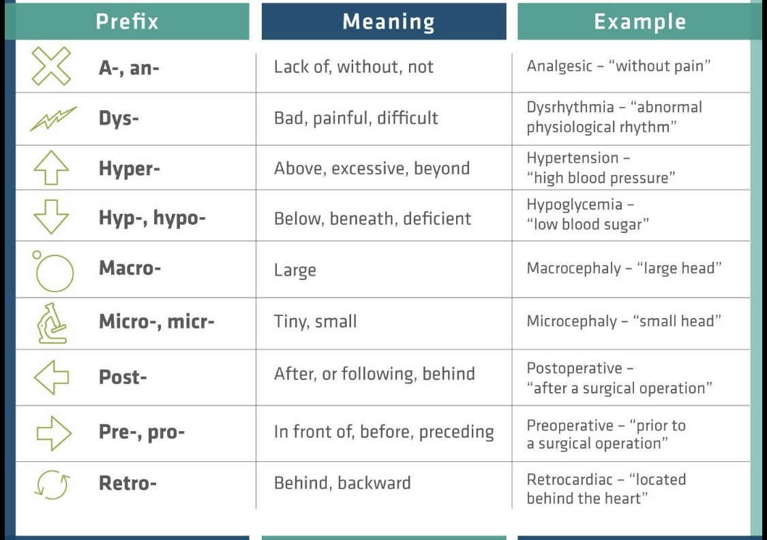

Slide 11
Common medical term
Benign: Not cancerous
Malignant: Cancerous
Anti-inflammatory: Reduces swelling, pain, and soreness (such as ibuprofen or naproxen)
Body Mass Index (BMI): Body fat measurement based on height and weight
Biopsy: A tissue sample for testing purposes
Hypotension: Low blood pressure
Hypertension: High blood pressure
Lesion: Wound, sore, or cut
Noninvasive: Doesn’t require entering the body with instruments; usually simple
In remission: Disease is not getting worse; not to be confused with being cured

Slide 12
12. Membrane: Thin layer of pliable tissue that serves as a covering or lining or connection between two structures
13. Acute: Sudden but usually short (e.g., acute illness)
14. Chronic: non severe , persisting for long time
15. Angina: Pain in the chest related to the heart that comes and goes
16. Gastroesophageal Reflux Disease (GERD): Heartburn
17. Cellulitis: Inflamed or infected tissue beneath the skin
18. Epidermis: Outermost layer of skin
19. Neutrophils: Most common type of white blood cell (WBC)
20. Edema: Swelling
21. Embolism: Blood clot
22. Sutures: Stitches
23. Polyp: Mass or growth of thin tissue
24. fracture: Broken bone
25. Myocardial infarction: Also known as a heart attack, where the heart is deprived of blood due to arterial blockage

Slide 13
26. Fever: elevated body temperature
27. Diabetes: a disease cause high level of blood sugar
28. Hypoglycemia: decrease of blood sugar in blood
29. Hyperglycemia: increase of blood sugar in blood
30. Anemia: a condition of low red blood cell count
31. Hemoglobin : A protein inside red blood cells that carries oxygen from the lungs to tissues and organs in the body and carries carbon dioxide back to the lungs. Testing for the amount of hemoglobin in the blood is usually part of a complete blood cell (CBC) test.
32. Hepatitis : inflammation of the liver
33. Pancreatitis : inflammation of pancreas
34. Gastroenteritis : inflammation GIT usually associated with vomiting and diarrhea
35. Tachycardia : high pulse rate
36. Bradycardia : low pulse rate
37. Hyperkalemia ( k) : high potassium level in blood

Slide 14
38. Hypokalemia ( k): low potassium level in blood
39. Hypernatremia ( Na): high sodium level in blood
40. Hyponatremia ( Na): low sodium level in blood
41. Electrocardiogram(ECG)/Echocardiogram(ECHO): Two tests that use electrical impulses and sound waves respectively to look at a heart
42. Biologist : biology specialist
43. Cardiologist : cardiology specialist (heat diseases )
44. Pathologist : pathology specilaist
45. Viral : caused by virus
46. Bacterial : caused by bacteria
47. Tuberculosis (TB) : communicable disease caused by tubercle bacillus characterized by fever , cough and difficulty in brathing
48. jaundice : yellowish dicoloration of skin and body tissue

Slide 15
Thank you

