Slide 1
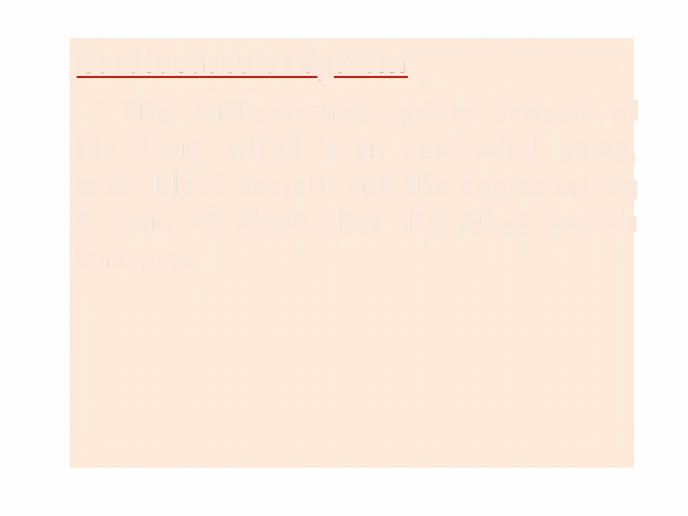
Cardiovascular System
The
cardiovascular system
consists
of
the heart,
which
is
an
and
anatomical
pump,
with
blood
vessels,
the
the
approximately
5 liters
of
blood
that
blood
vessels
transport.

Slide 2
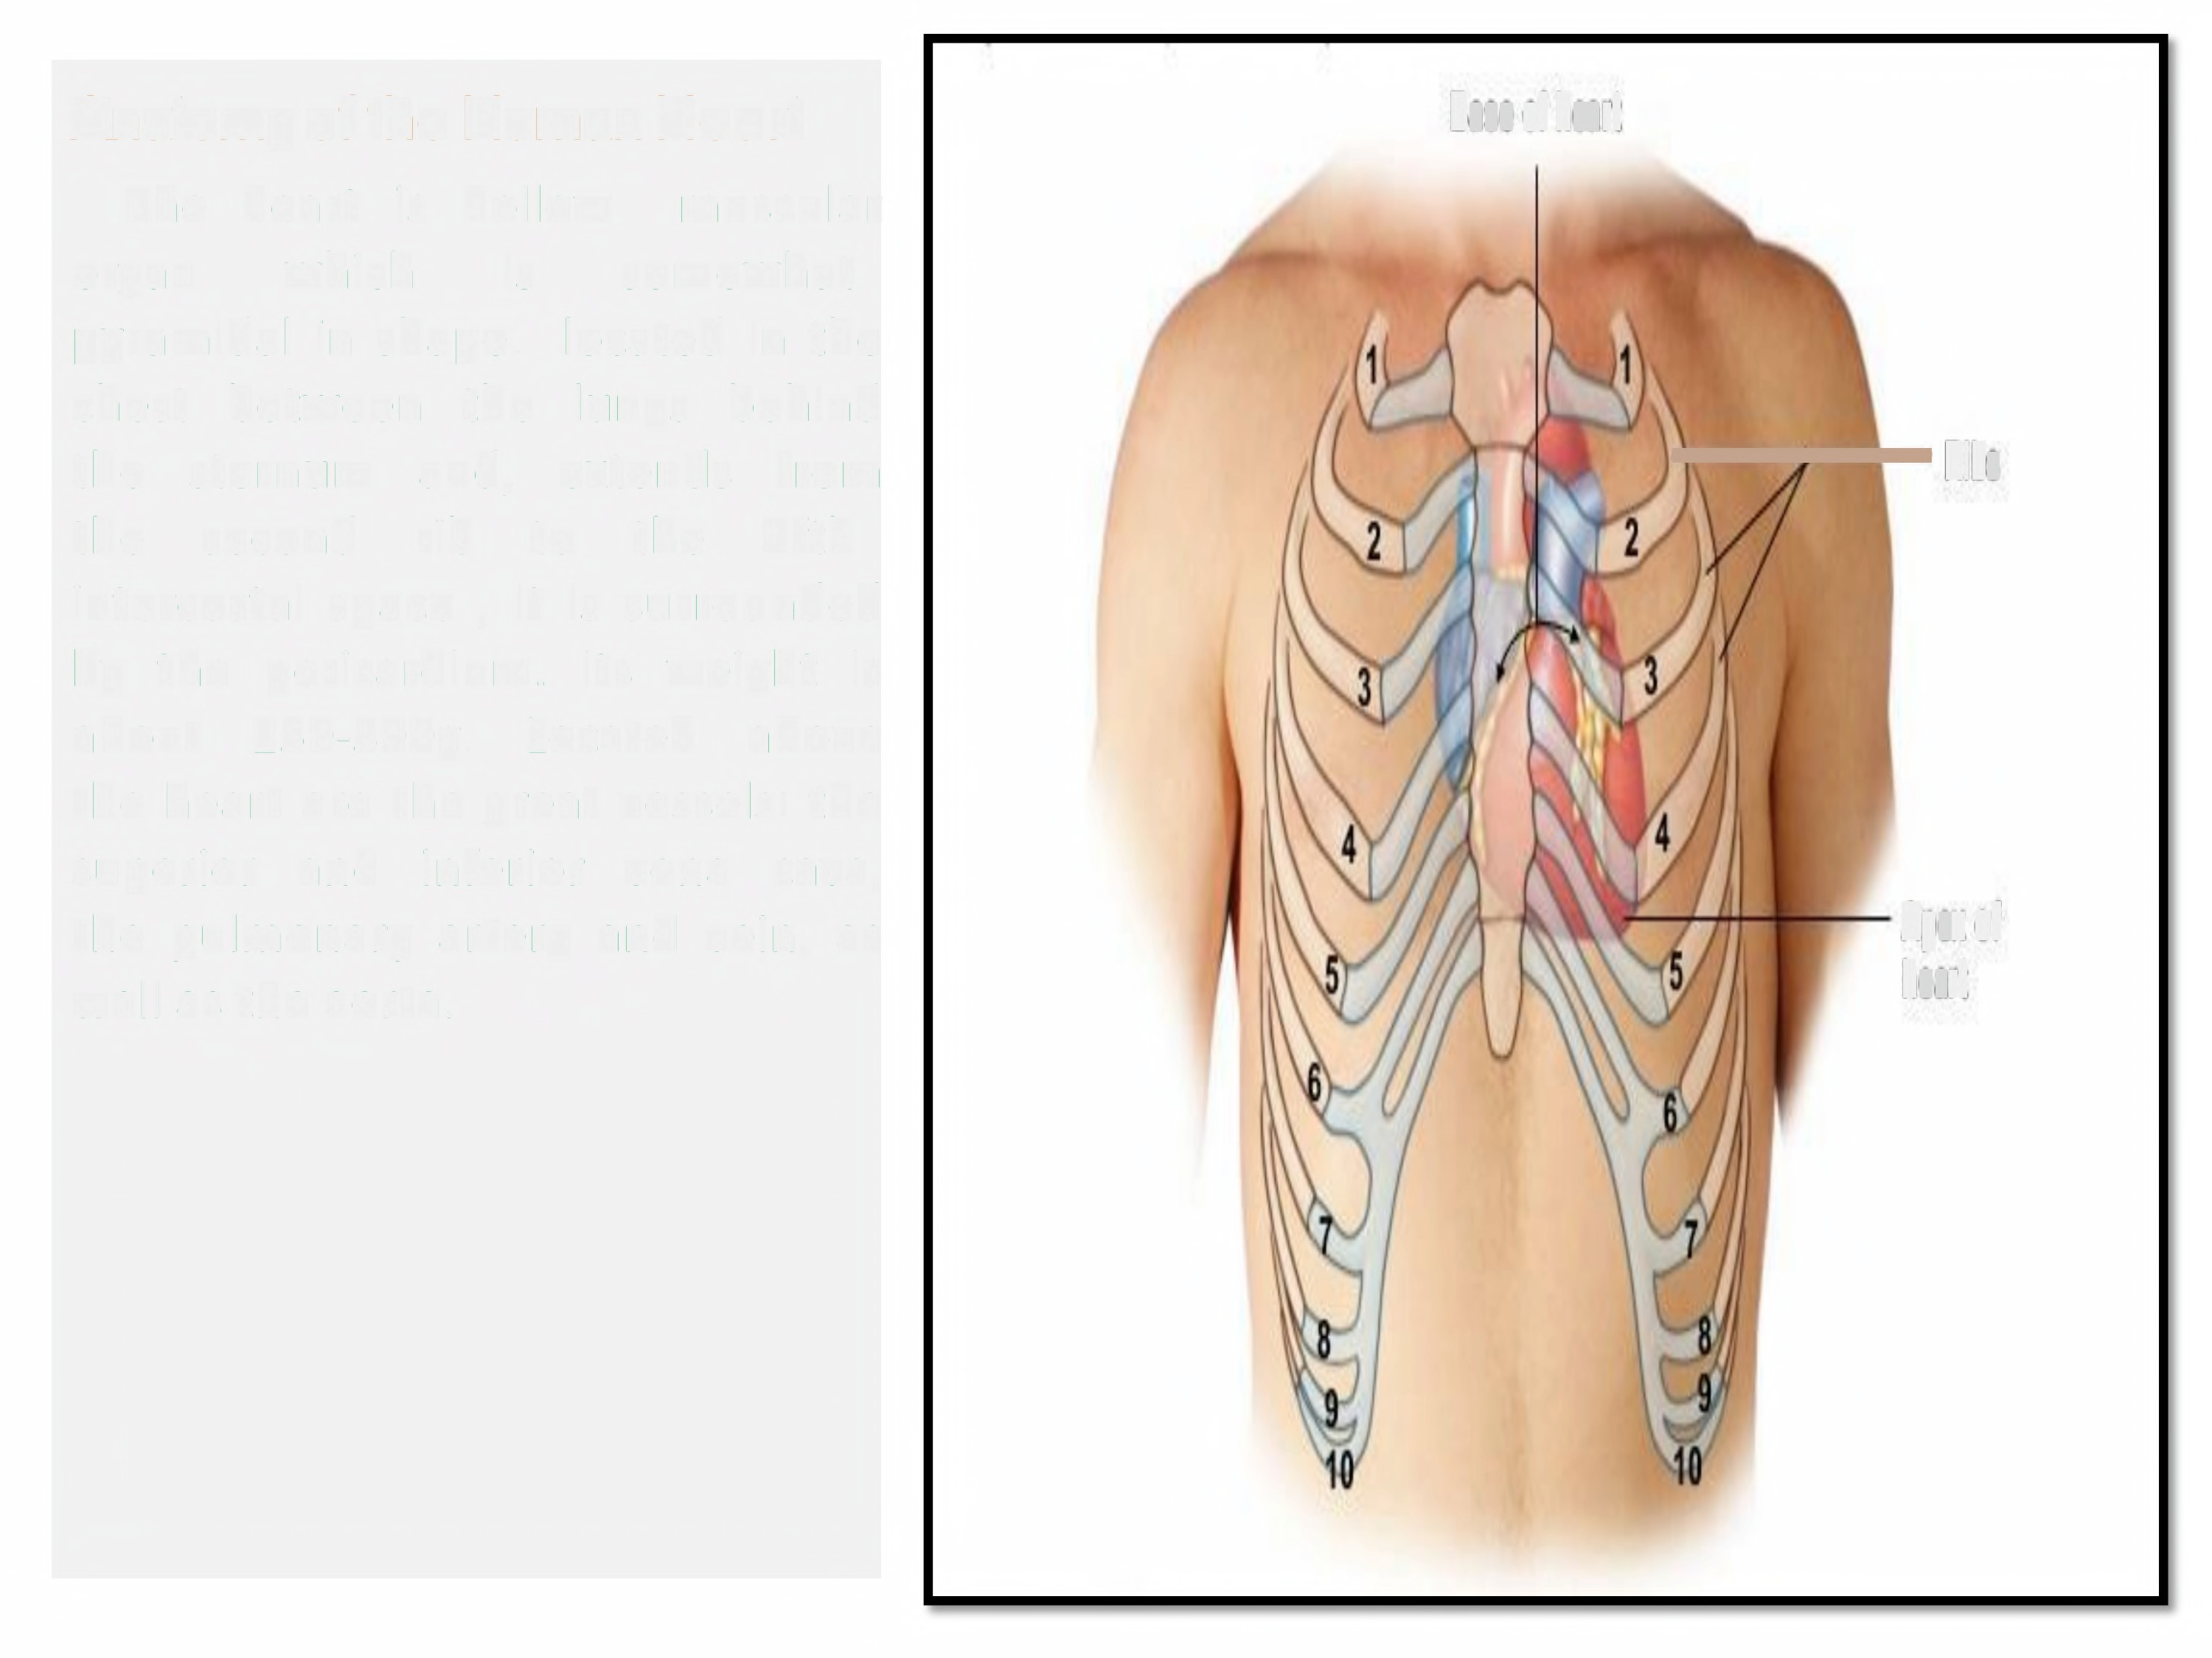
Anatomy of the
Human Heart
Base of heart
The
organ
heart
is
hollow
is
muscular
somewhat
which
pyramidal in shape.
located in the
chest
the the
between
the
lungs
behind
sternum
second
and,
rib
extends from
+Hi/g
to the
fifth
intercostal space ,
It is surrounded
by the pericardium.
Its weight is
about
250-300g.
Located
above
the heart are the great vessels: the
superior
and
inferior
vena
cava,
the pulmonary artery and vein, as
well as the aorta.
Apex of
heart

Slide 3
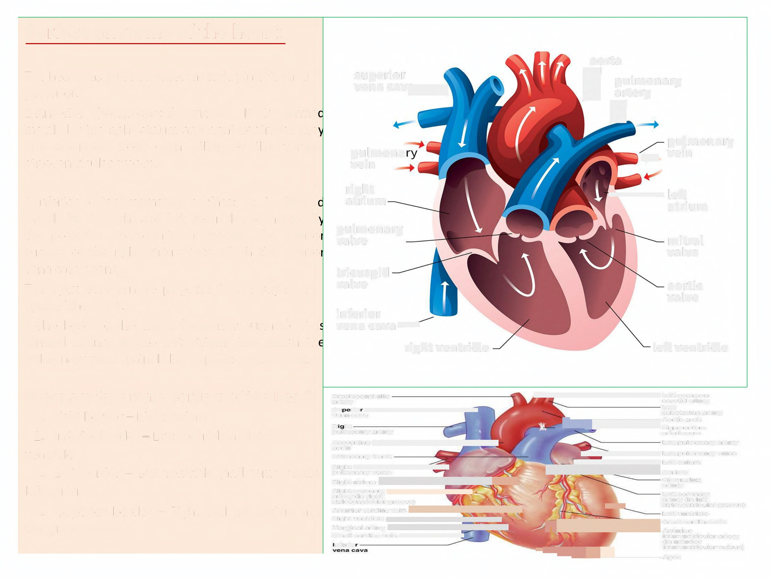
Surface anatomy of the heart:
aorta
pulmonary
The heart has three surfaces: anterior, inferior and
posterior.
1-Anterior (Sternocostal) surface: It is forme mainly by the right atrium and right ventricle. The
superior
vena cava
•
)
artery
are separated from each
atrioventricular groove.
other by the vertica
pulmona vein
pulmonary
4vein
right atrium
-left atrium
2-lnferior (Diaphragmatic)
mainly by the right and left
surface: It is forme
ventricles separated b
the posterior interventricular groove. The inferio
surface of the right atrium into which the inferio vena cava opens,.
pulmonary valve
mitral valve
tricuspid valve
The apex beat can
apex of the heart.
3-The base of the
be palpated in the region of
aortic valve
heart (posterior surface): It i
inferior
vena Cava•
right ventricle
formed mainly by the left atrium, into which th
pulmonary veins drain. It lies opposite to the apex.
left ventricle
There are four main borders of the heart:
1. Right border- Right atrium
2. Inferior border - Left ventricle and right ventricle
R.
Brachiocephalic artery
tie vena cava
S Left common
carotid artery
-~~~~::========Aortic arch
subclavian artery
R f
pulmonary artery
Ascending #.
aorta
Pulmonary trunk
Right s
pulmonary veins
++ant atodum Ht
Right coronary t.
artery (in right
atrioventricular groove)
Anterior craiac vein ~el
Right ventricle st
Marginal artery Pl
mall cardiac vein i
f ei
Llgamentum
arteriosumn
Left pulmonary artery
.Left pulmonary veins
. Left atrium
3.
left
4.
the
Left border - Left ventricle (and some of the
atrium)
Superior border - Right and left atrium and great vessels
@,are
circumflex
artery
Left coronary artery (in left
. a trioventricular groove)
7
Left ventricle
a( oa»ea.a.em
ads
Anterior interventricular artery (in anterior
-
;.;:;,;: ~ ~ ~ ~ - - - interventricular sulcus)
Apex

Slide 4
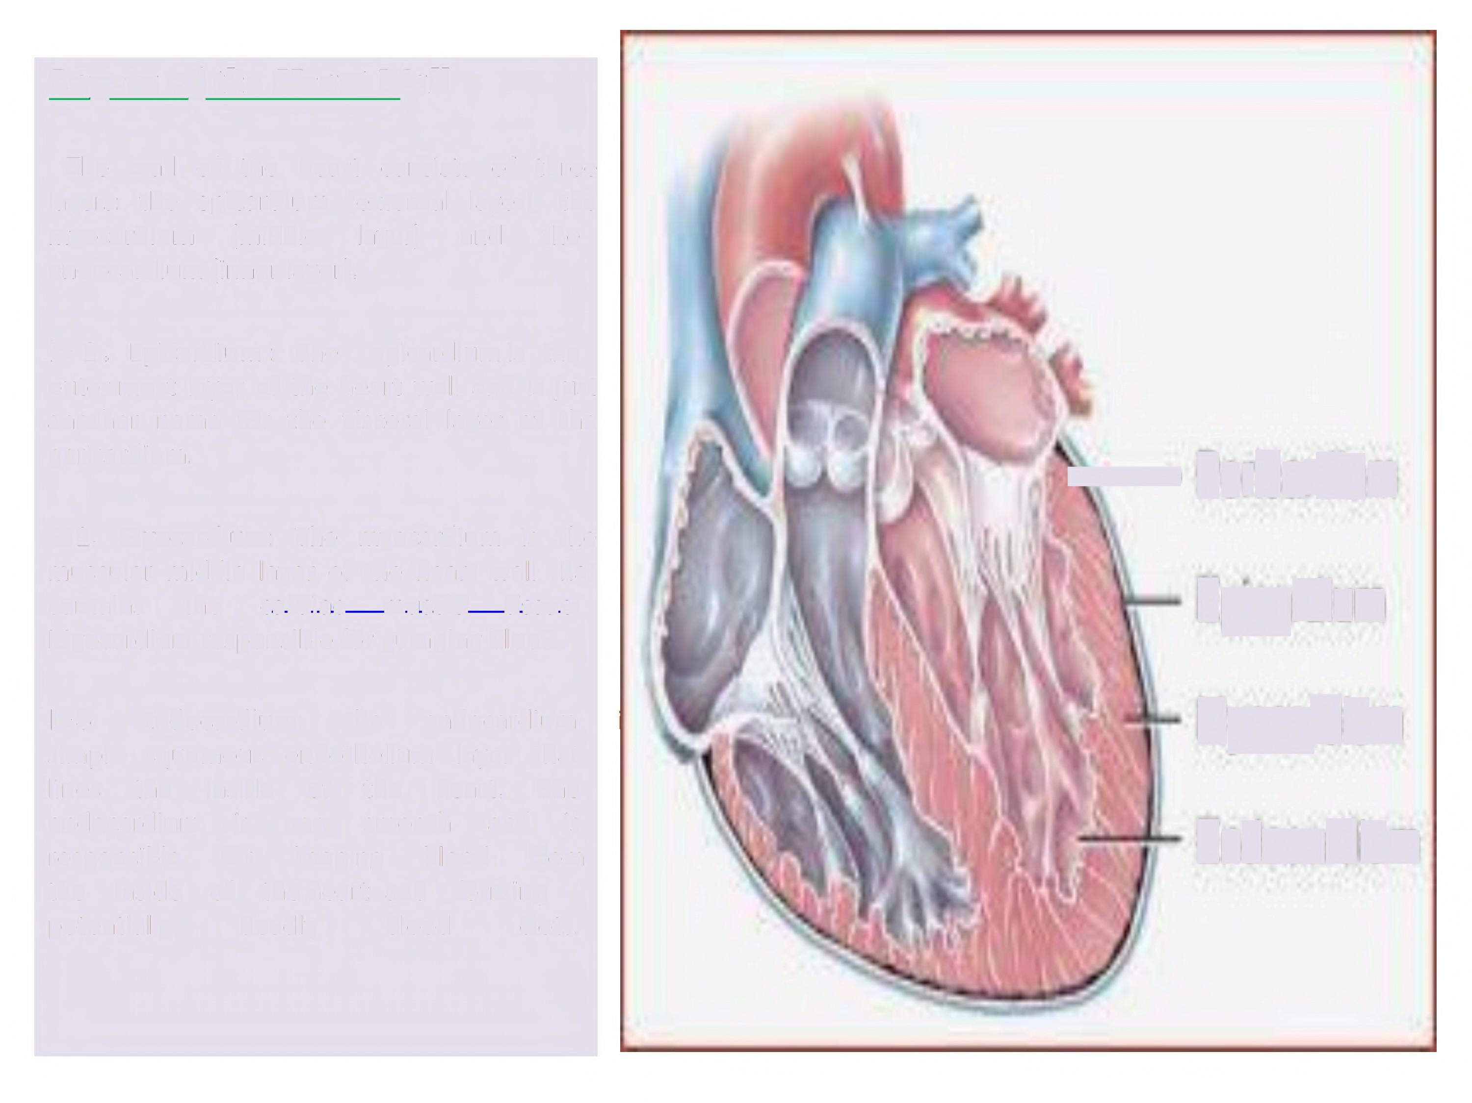
Layers of the Heart Wall
The wall of the heart consists of three
layers: the epicardium {external layer), the
myocardium
{middle
layer)
and
the
endocardium {inner layer).
► 1. Epicardium : The
epicardium is the
outer most layer of the heart wall and is
another name for the visceral layer of pericardium.
just
the
Pericardium
Epicardium
Myocardium
Endocardium
A
► 2. Myocardium: The myocardium is
the
that
muscular middle layer of the heart wall
contains
the
cardiac muscle tissue
Myocardium responsible for pumping blood.
► 3.
simple
lines
Endocardium:
the
endocardium
squamous
endothelium
layer that
the
inside
is for
of
very
the
heart.
The
is from
endocardium
responsible
smooth
and
keeping
blood
the
inside
of
the heart and
forming
clots.
potentially
deadly
blood

Slide 5
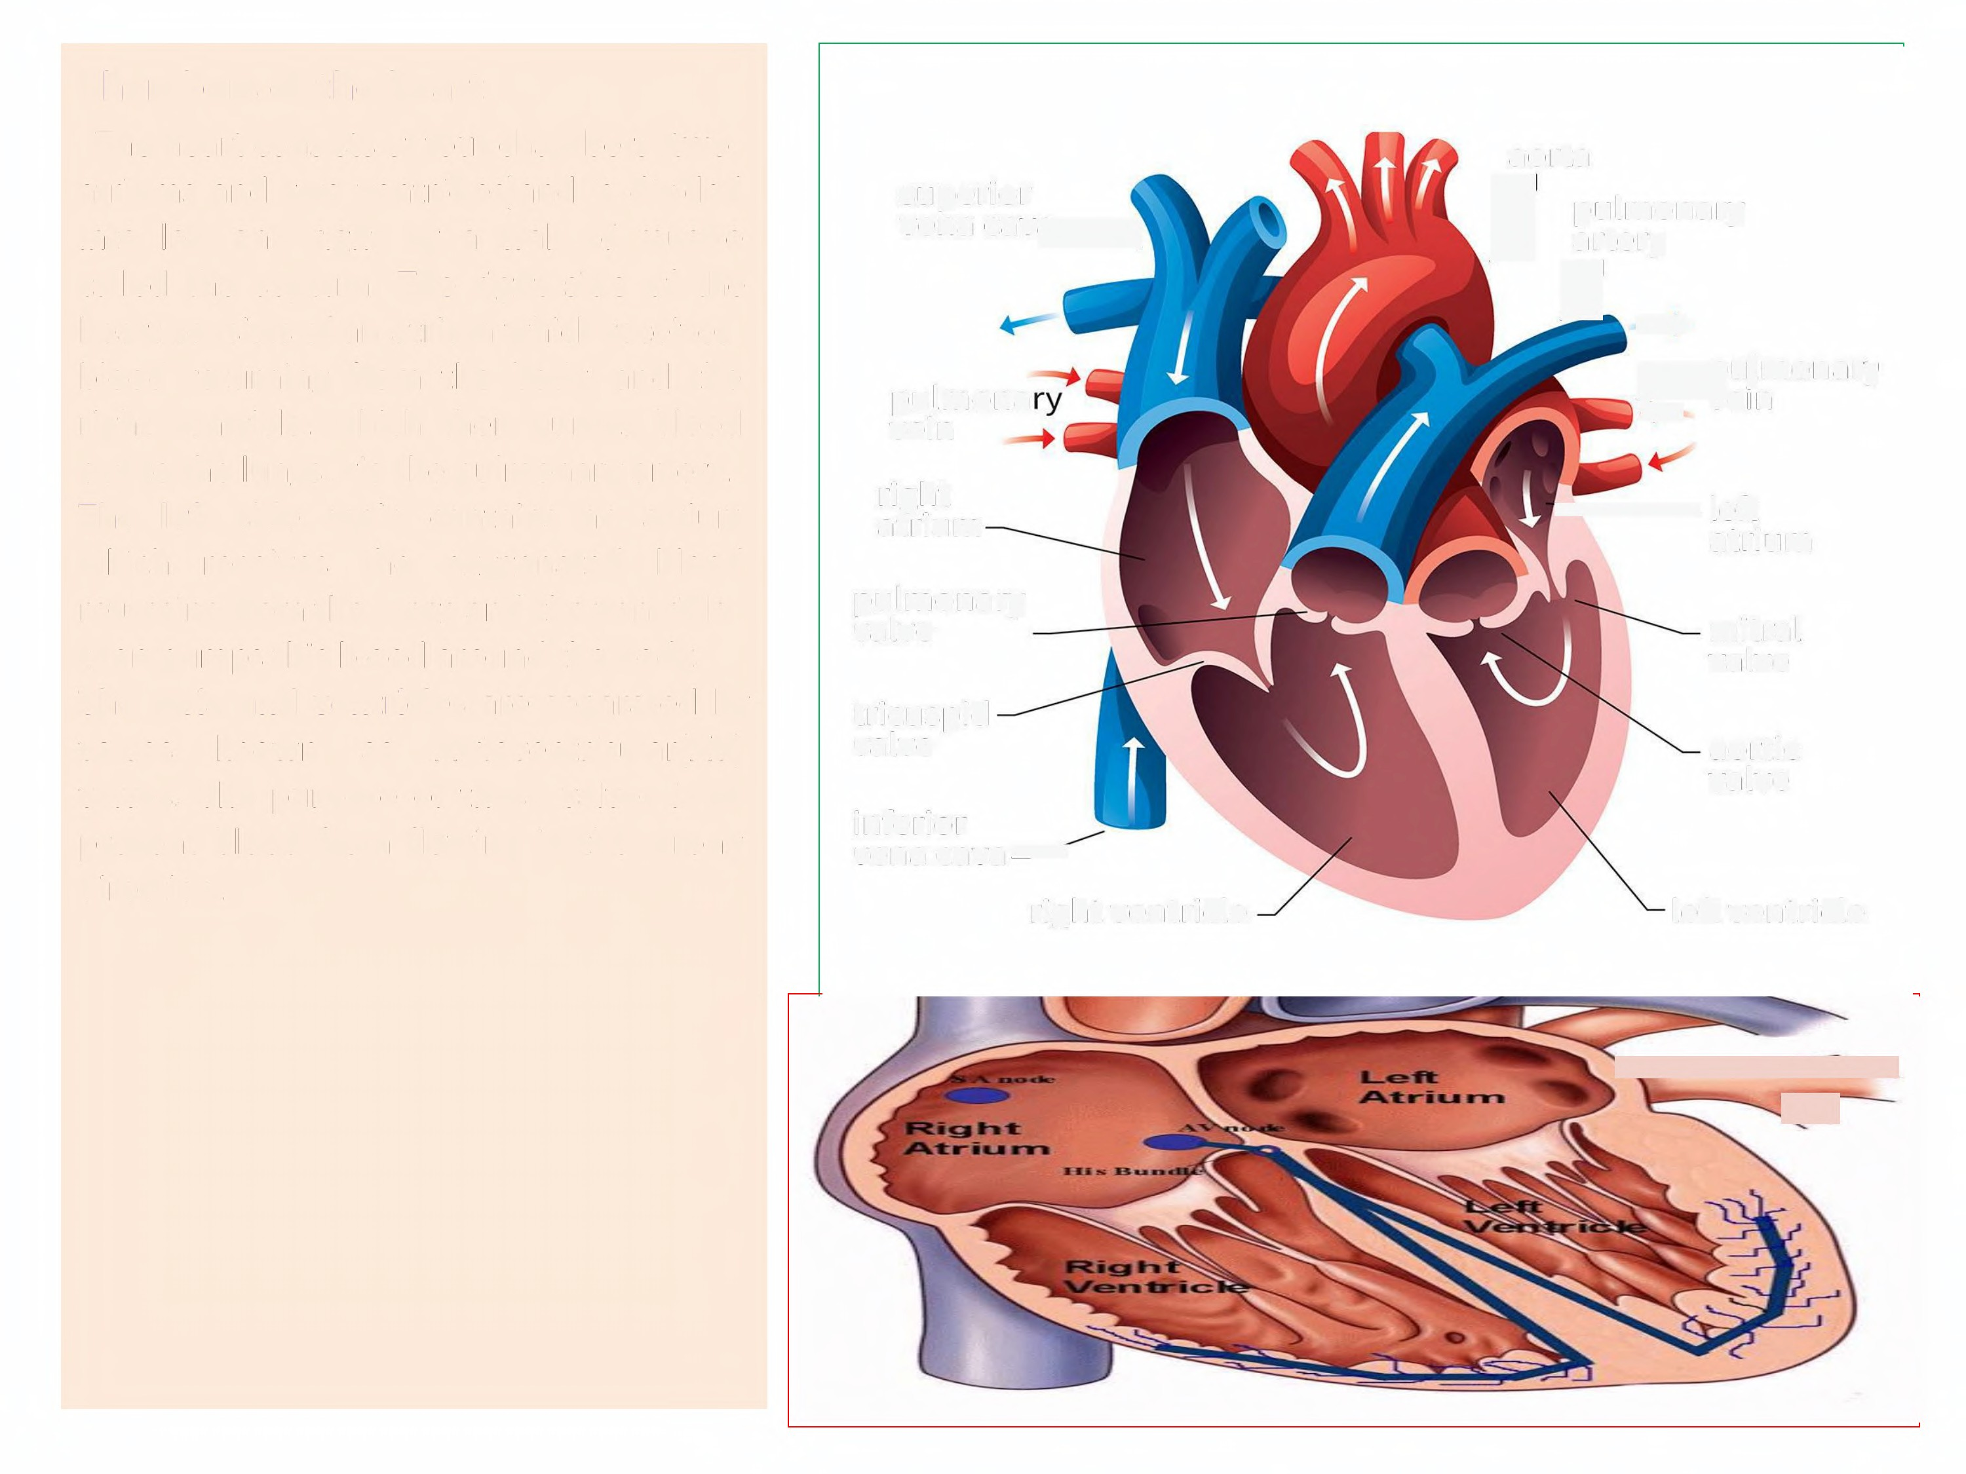
Chambers of the heart
The heart consists of four chambers {two
atriums and two ventricles)and is divided
into left and right by a wall of muscle
called the septum. The right side of the
heart consists of an atrium which receives
blood returning from the body, and the
right ventricle, which then pumps blood
out to the lungs, via the pulmonary artery.
The left side again contains an atrium
aorta
pulmonary
superior
vena Cava
)
artery
4..
pulmonary
4VeIr
pulmona
vein
right
atrium
-left atrium
which
receives
the
oxygenated
blood
returning from the lungs and the ventricle
then pumps this blood around the body.
The atria and ventricles are separated by
pulmonary
valve
mitral
valve
tricuspid
valve
valves known
as Atrioventricular{AV)
aortic
valve
valves. The purpose of these valves is to
prevent blood from flowing in the wrong direction.
inferior
vena Cava•
right ventricle
left ventricle
•s

Slide 6
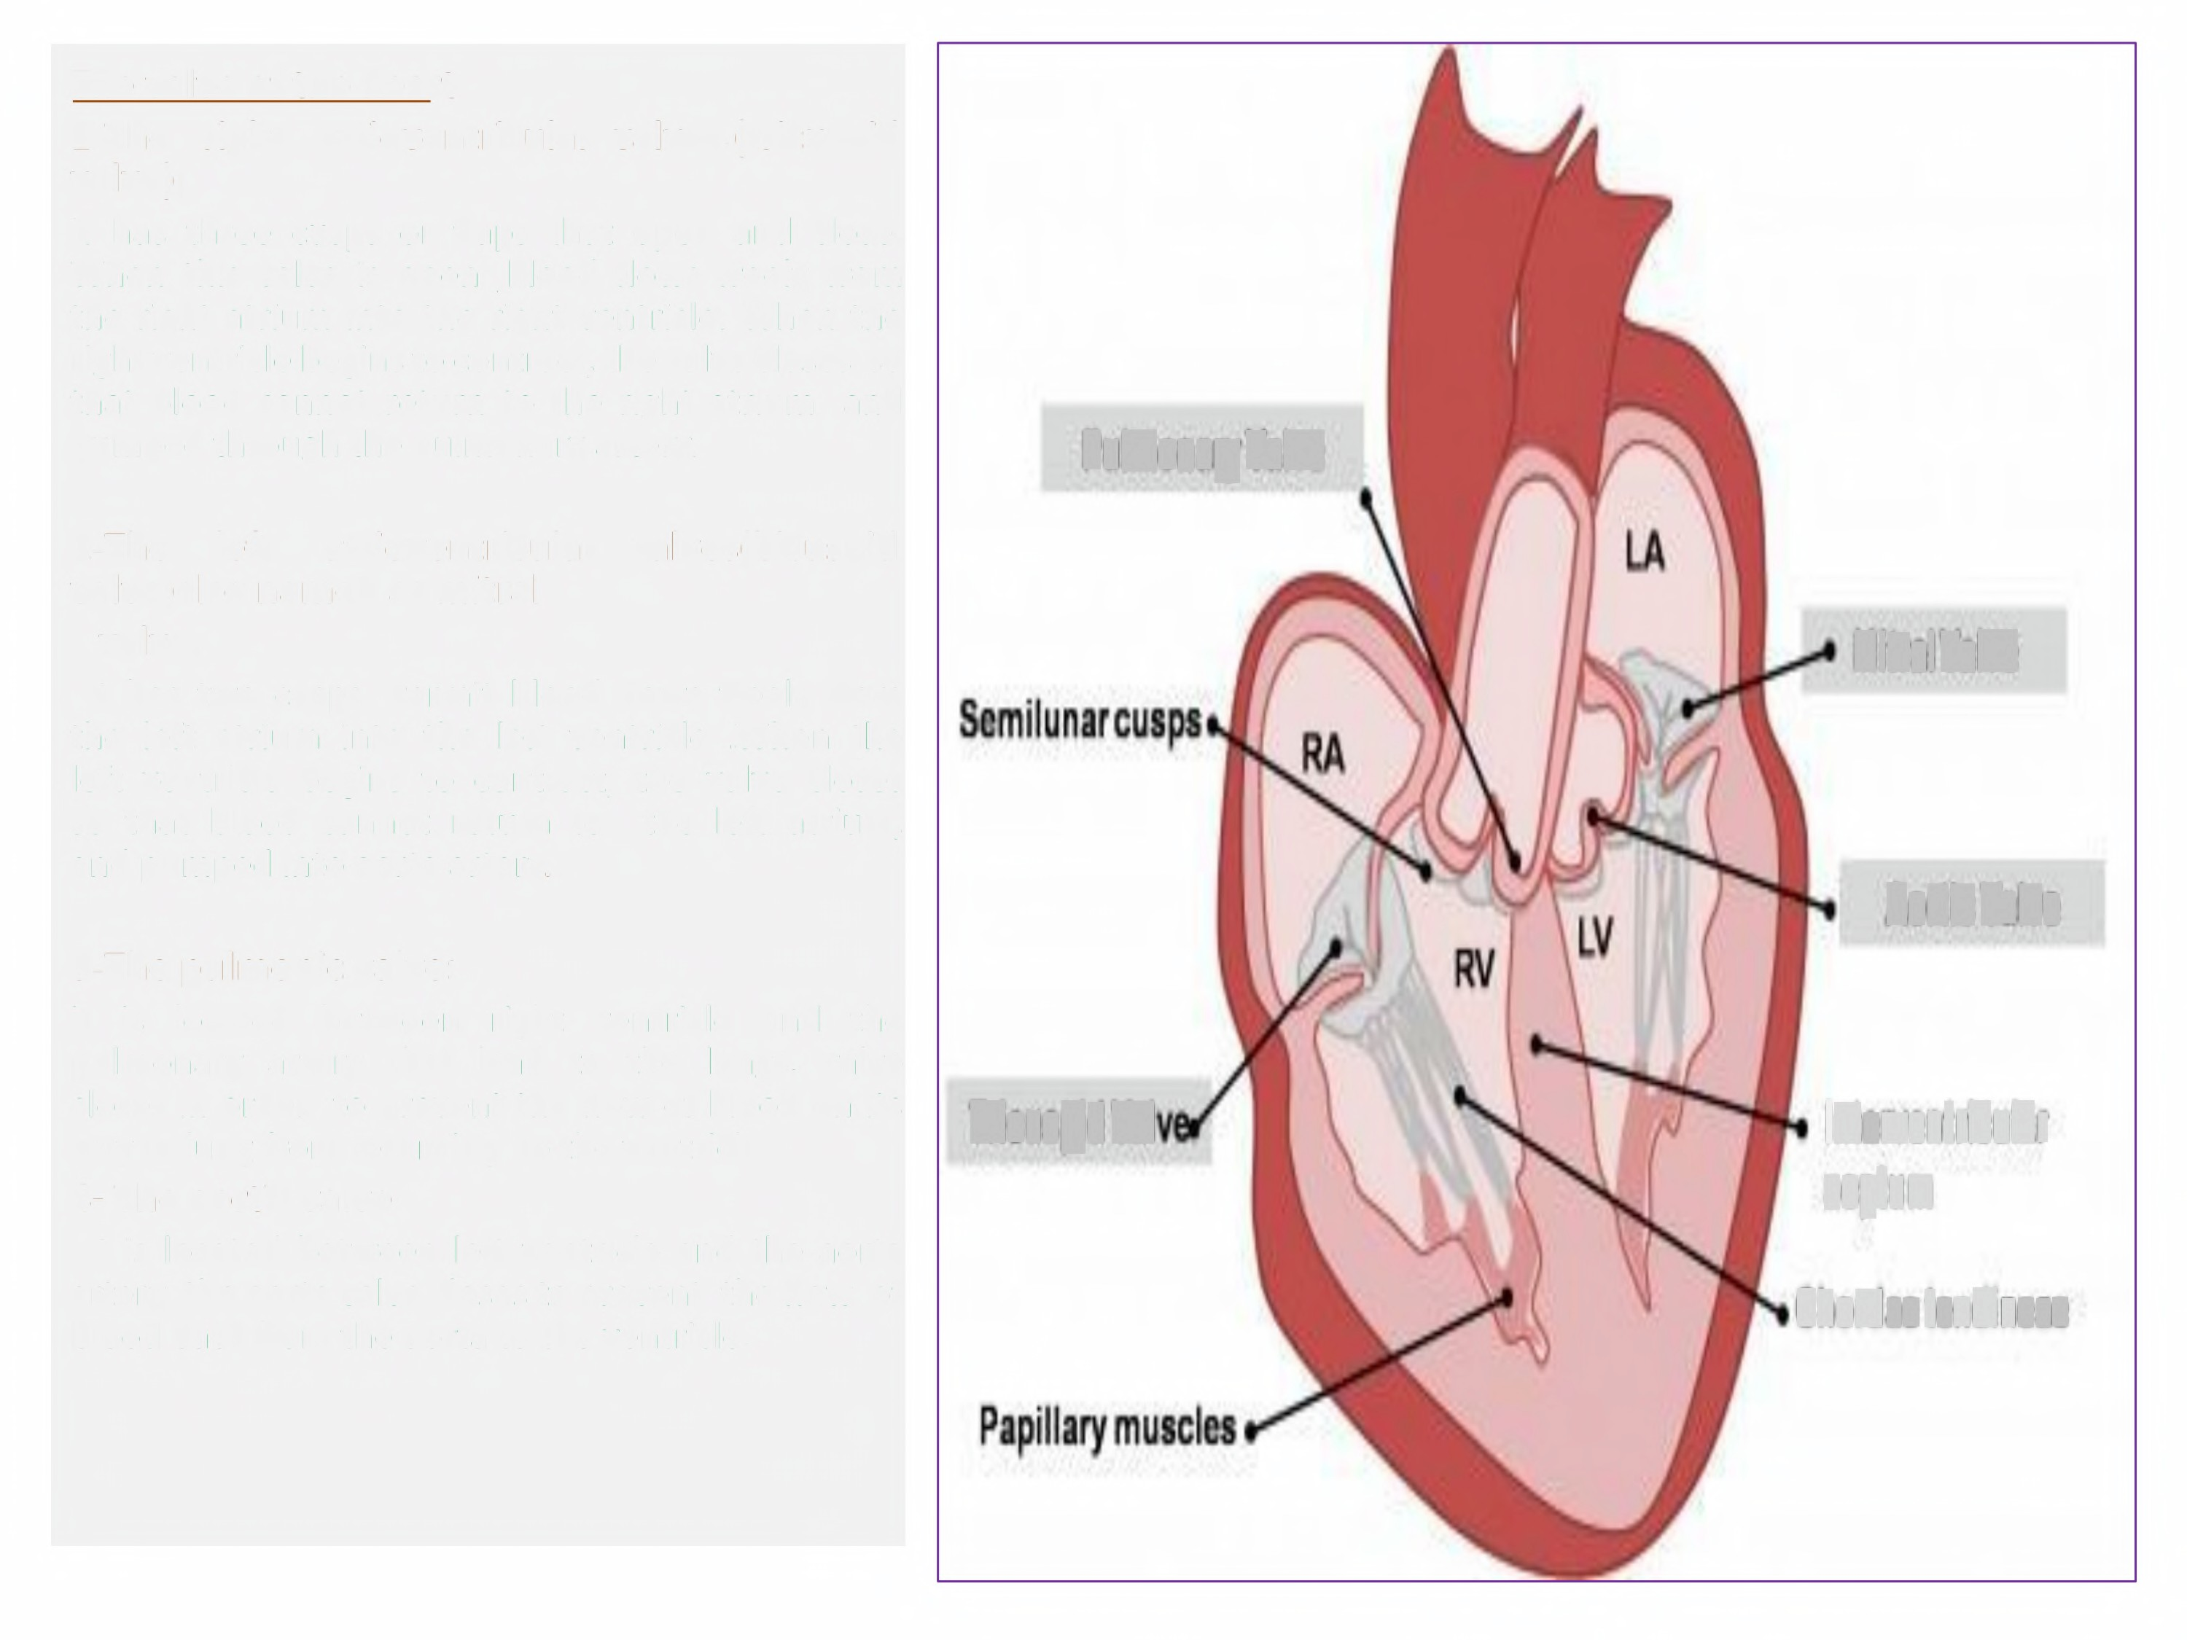
The valve of the heart
1-The right atrioventricular valves.(tricuspid valve);
it has three cusps or flaps that open and close.
When this valve is open ,blood flows freely from
the right atrium into the right ventricle. When the
right ventricle begins to contract, the valve closes so
that blood cannot return to the right atrium,
and pumped through the pulmonary artery.
Pulmonary Valve
2-The
left
atrioventricular valves(bicuspid
valve)also named as mitral
valve;
it has two cusps. Permit blood flows freely from
the left atrium into the left ventricle .When the
Mitral Valve
left ventricle begins to contract,
so that blood cannot return to
and pumped into aorta artery.
the valve closes
the left atrium,
Aortic Valve
3-The pulmonic valve:
it is located between right ventricle and the
pulmonary artery that lead to the lungs.
closes in order to prevent the flow of blood
way to lung from returning to the ventricle
4- The aortic valve
it is located between left ventricle and the
valve
on its
Iricuspid al
Interventricular
septum
aorta
artery ,the aorta valve closes to prevent the flow of
blood back from the aorta to the ventricle.
Chordaetendineae

Slide 7
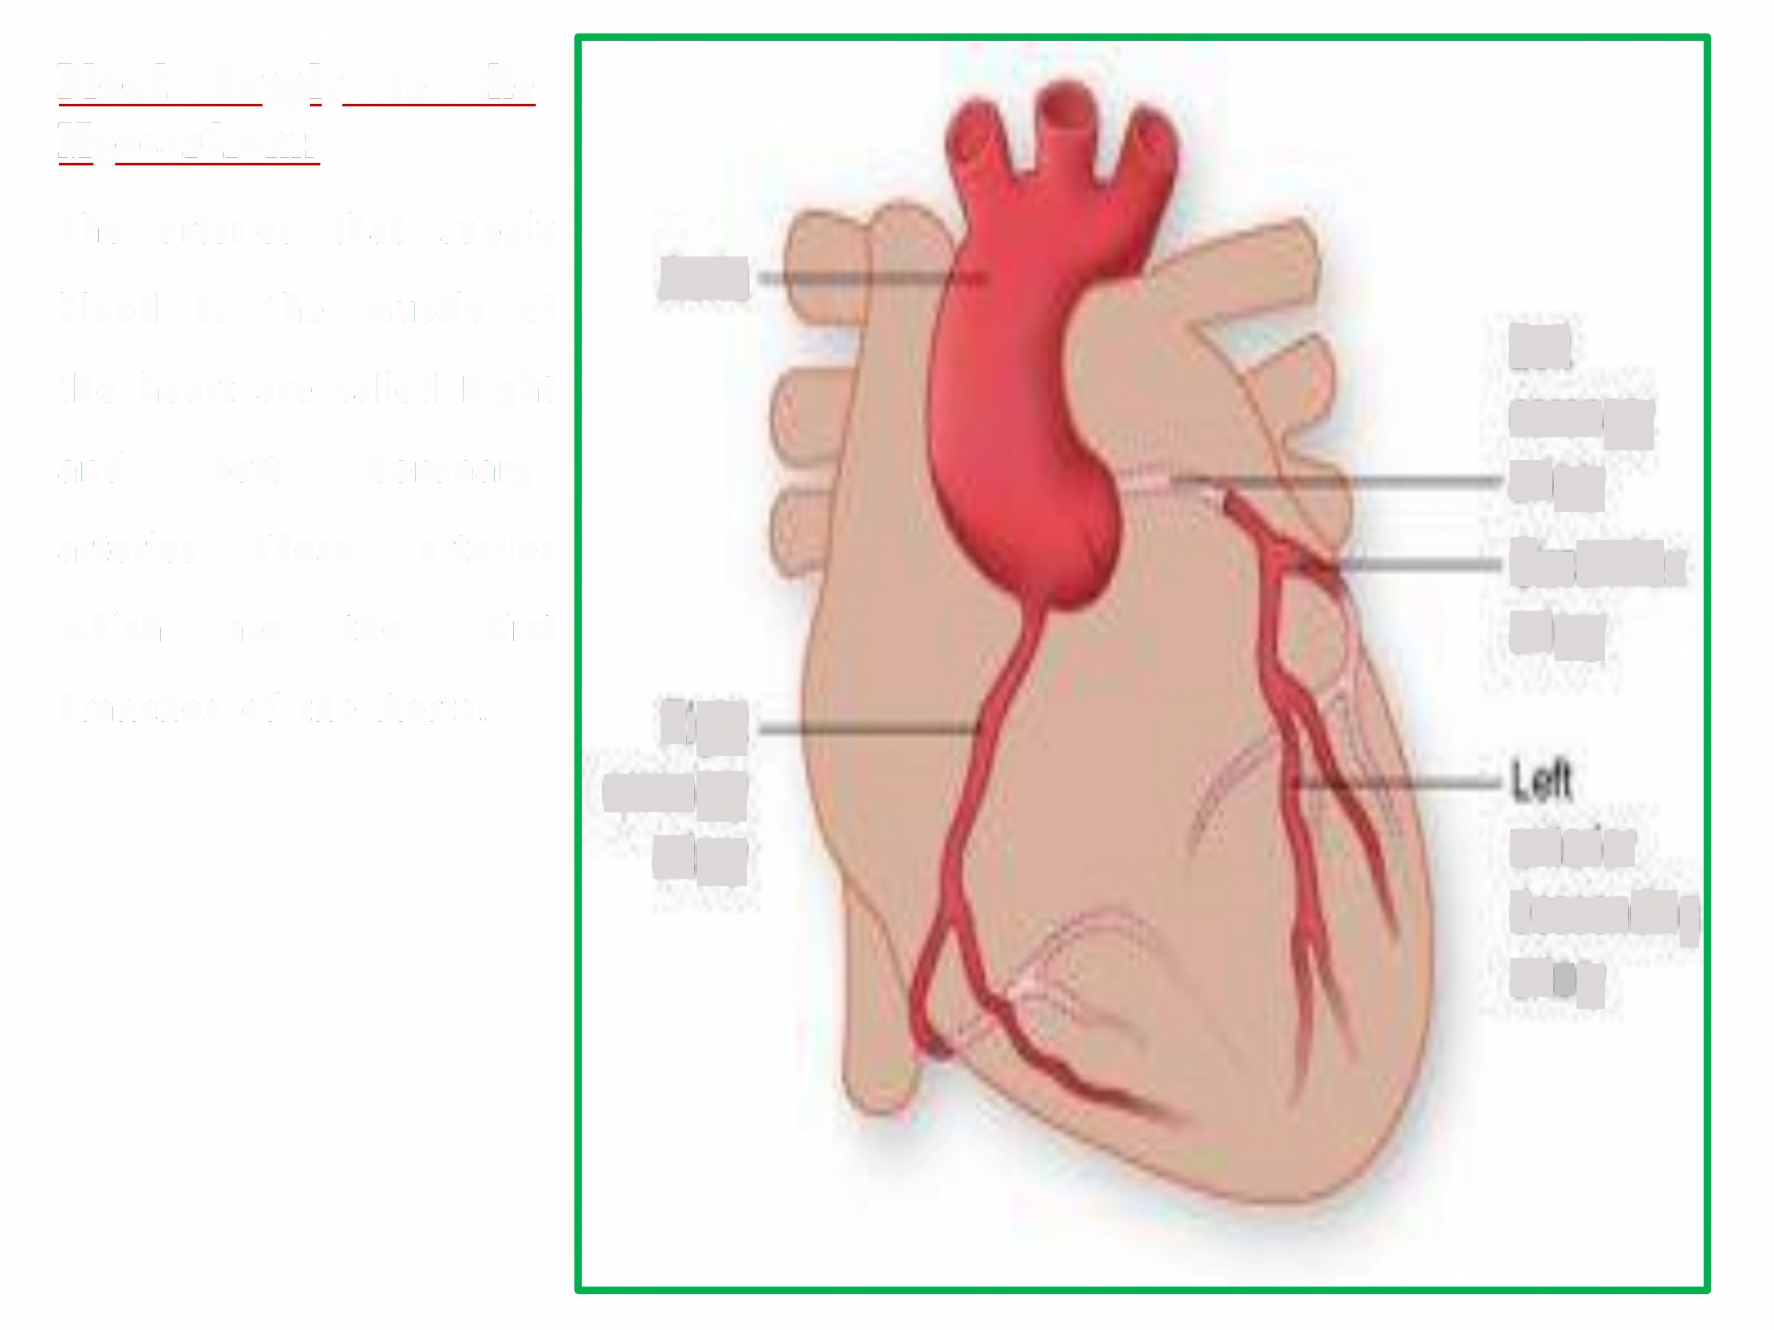
Blood
Supply to the
Myocardium:
The
arteries that supply
Aorta
blood
to the muscle
of
Let
or0nary
artery
CrcumMex
artery
the heart are called Right
and
Left
Coronary
arteries. These
arteries
which
are
the
first
branches of the Aorta.
Rig0
coronary
artery
anten0t
descendng
artery

Slide 8
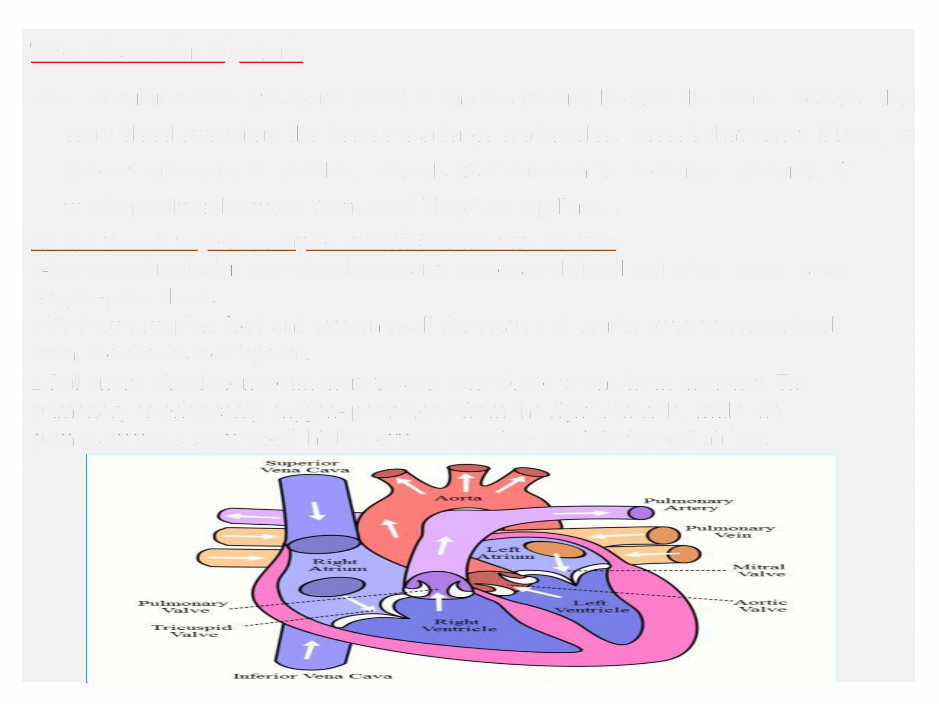
The Vascular System
The
vascular system transports blood to the tissues and back to the heart.
Vessels
that
to
carry blood away from the heart are arteries & arterioles.
Vessels that return bElood
exchange nutrients, &
th heart are veins & venules.
Vessels that function to
waste products between tissues and blood are capillaries.
All th e vessels together may be subdivision into two circuits:
1-Systemic circulation ;arteries always carry oxygenated blood oxygen-poor blood.
and veins always carry
This circuit supplies food and oxygen to all the tissue and carries away waste material
from the tissues for disposal.
2-Pul onary circulation; pulmonary vessels carry blood to and from the lungs. The
pulmonary arteries carry oxygen- poor blood from the right ventricle, while the
pulmonary veins carry blood high in oxygen from the lung into the left atrium.

Slide 9
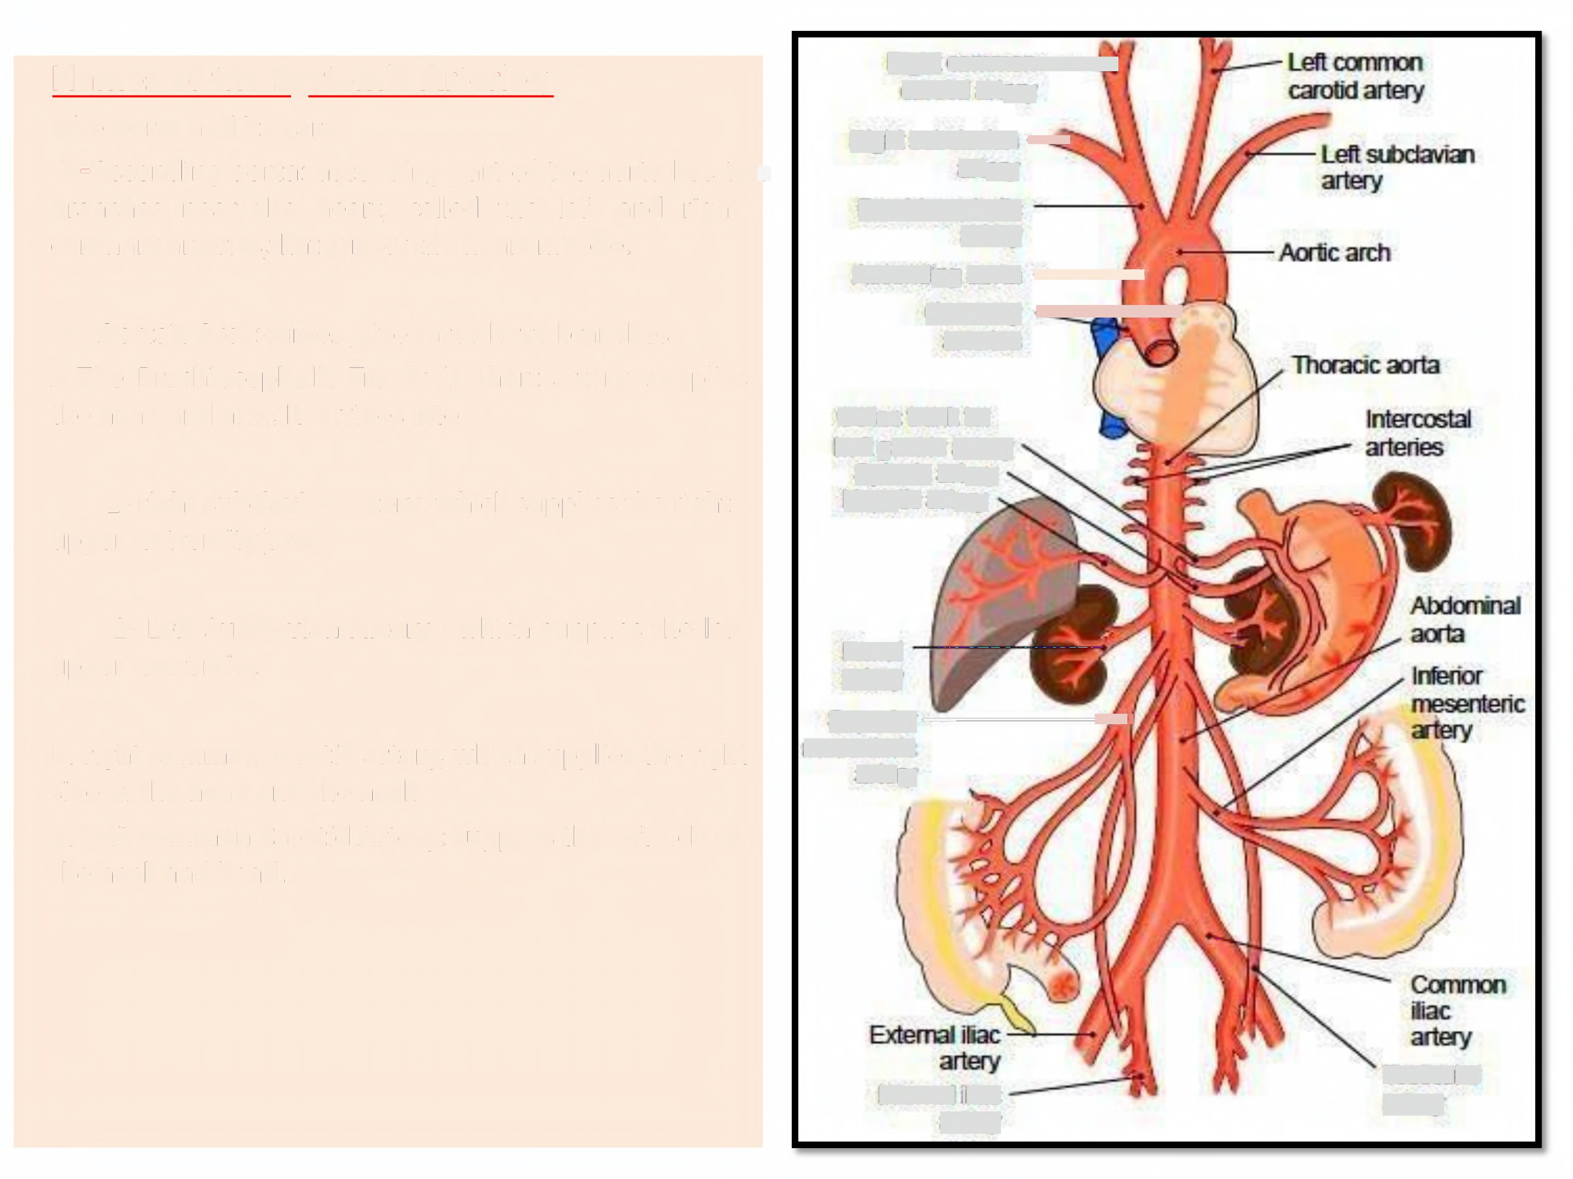
Names of the Systemic Arteries;
The Aorta and its parts
1-Ascending aorta: ascending part of the
Right common
carotid artery
Right subcdavian -d
artery
Brachiocephalic
artery
Ascendign aorta p"
aorta has two
branches near the heart, called the left and right
coronary arteries,that supply the heart muscle.
2- Aortaic Arch:curves ,give three large branches
A.The Brachiocephalic Trunk: is short artery, supplies the head and arm. It divides into
Coronary
arteries
-,
«y
Celiac trunk to:
Left gastric artery Splenic artery Hepatic artery
1- right subclavian artery, which supplies the right
upper extremity(arm).
2- Left Subclavian Artery : which supplies the left
upper extremity.
Renal artery
St4)eru-------#4l
mesenteric
artery
B. right common carotid artery, which supplies the right
side of the head and the neck
C. Left Common Carotid Artery: supplies the left side of the neck and head.
Internal iliac
artery
Testicular
artery

Slide 10
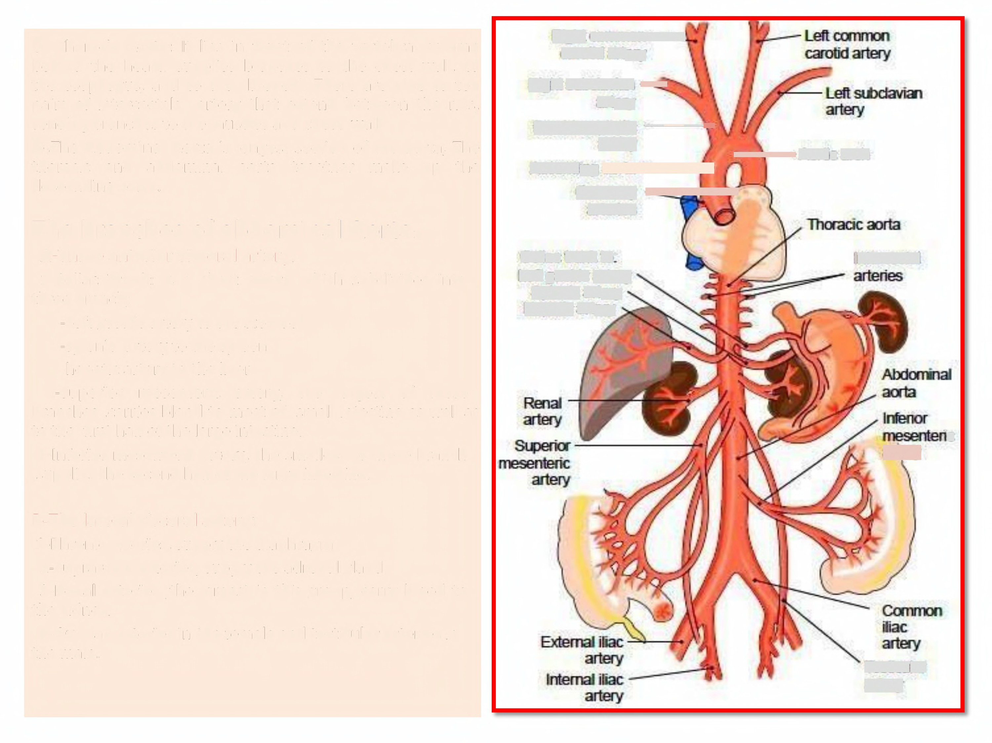
3- Thoracic Aorta: It lies in front of the vertebral column behind the heart. supplies branches to the chest wall, to
the esophagus, and to the bronchi. There are nine to ten
Right common
carotid artery
Right subdavian -d
artery
pairs of intercostals
artery that extend between the ribs,
sending branches to the muscles and chest wall.
4.The Abdominal Aorta is longest section of the aorta, The
Brachiocephalic ---•
artery
Ascendign aorta
thoracic and
abdominal
aorta together make
up the
•Aortic arch l
descending aorta.
Coronary
arteries
-
,
The branches of abdominal
A-Three anterior visceral artery:
1-Celiac Trunk: is a short artery which
three branch;
-Left gastric artery to the stomach
-splenic artery to the spleen
-hepatic artery to the liver
Aorta:
Celiac trunk to:
Left gastric artery Splenic artery Hepatic artery
Intercostal
subdivides into
2-Superior mesenteric artery, the
largest of these
branches ,carries blood to most of small intestine as well as
to the first half of the large intestine.
3-lnferior mesenteric artery, the smallest of these branch
,supplies the second half of the large intestine.
.
ic
artery
B-The lateral visceral artery:
1-Phrenic arteries, supply the diaphragm
2-Suprarenal arteries, supply the adrenal gland.
3-Renal arteries ,the largest in this group, carry blood to
the kidney.
4-0varian arteries in the female and testicular arteries in
the male.
Testicular
artery

Slide 11
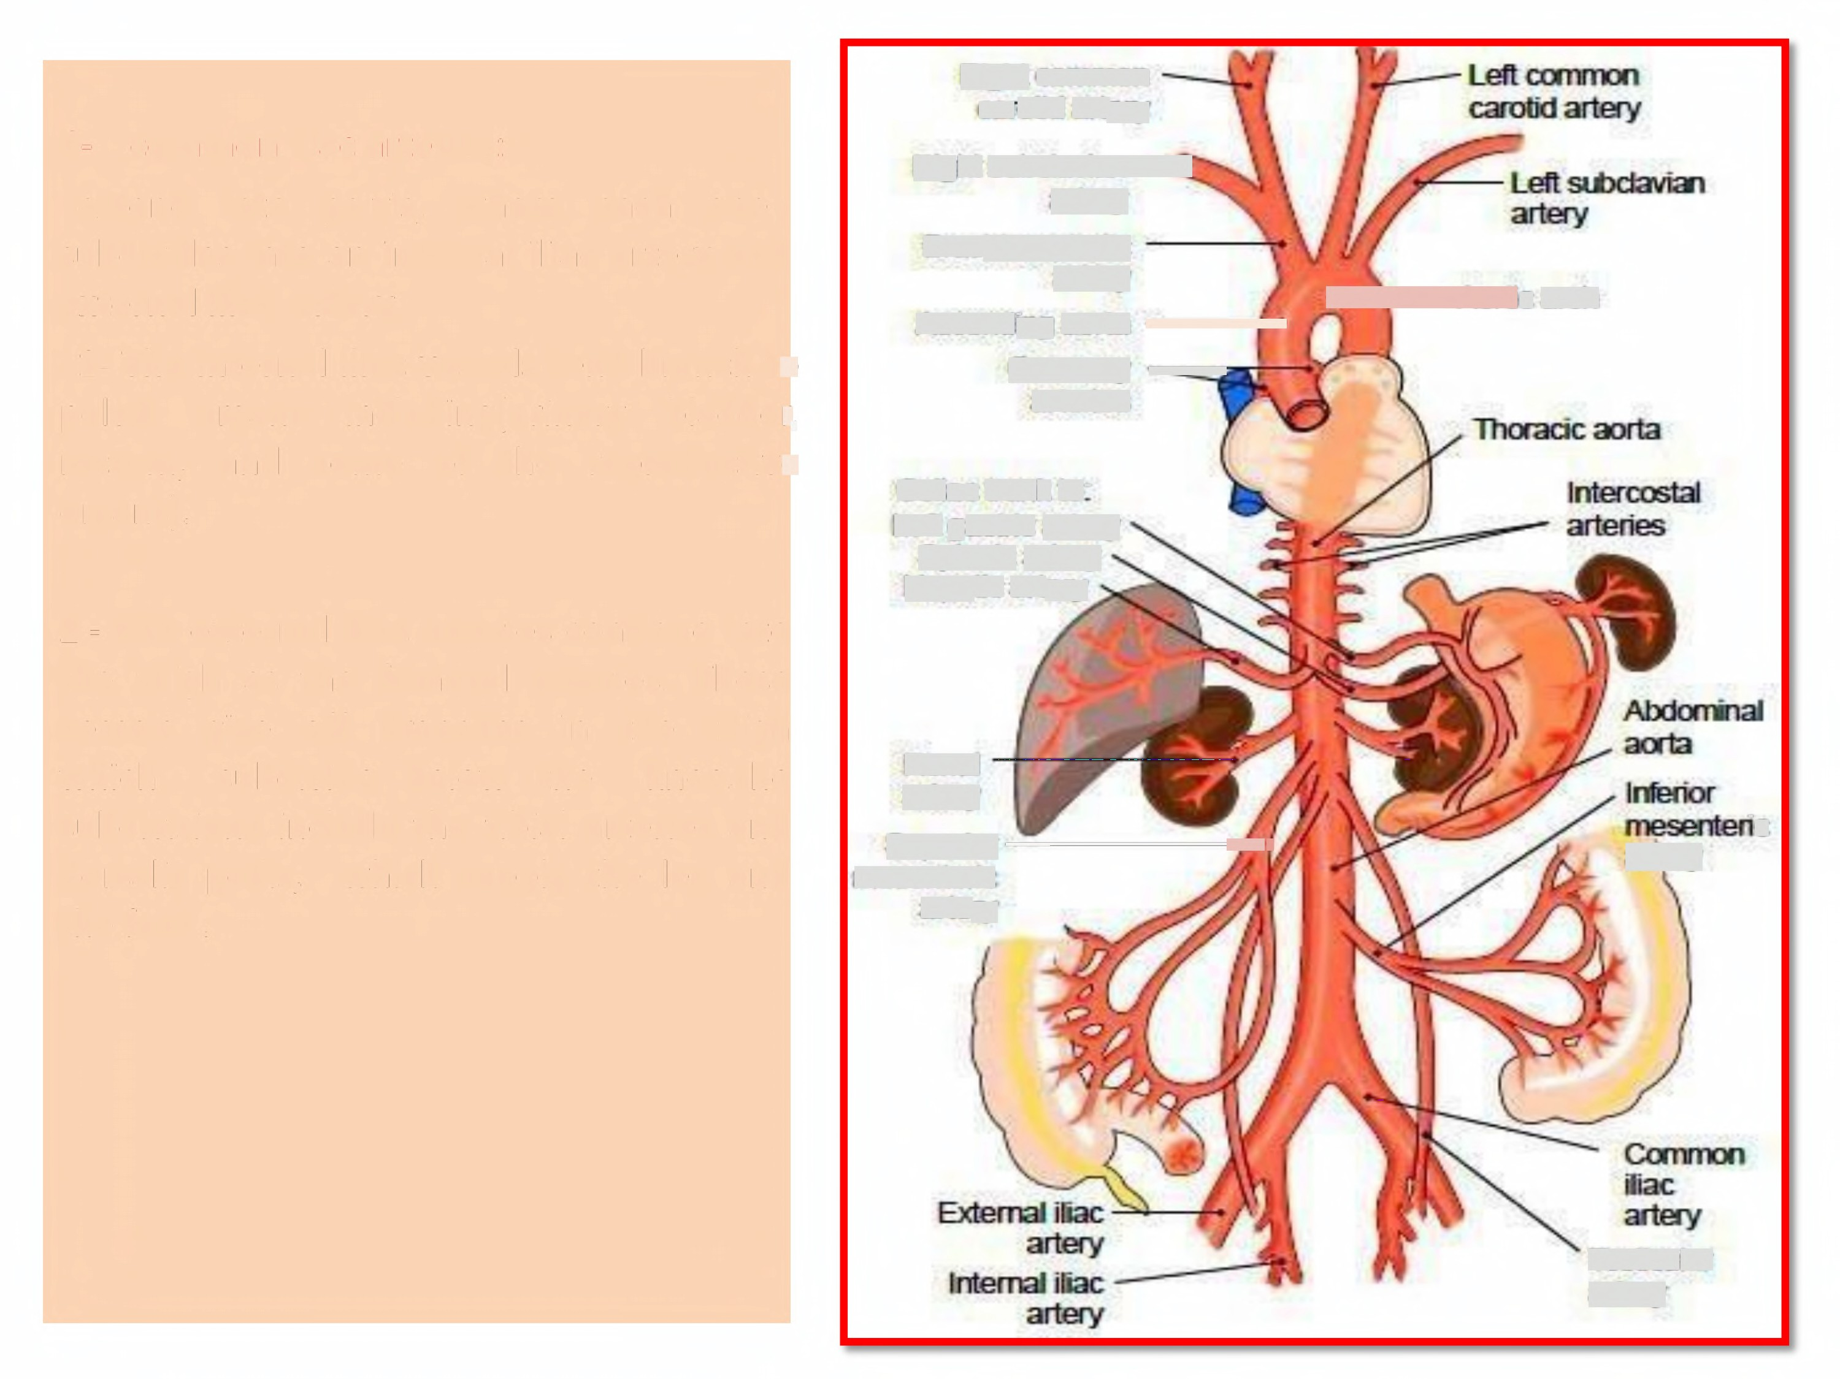
Right common
carotid artery
Right subdavian
artery
Brachiocephalic
artery
C-
common iliac arteries:
extend
into
pelvis,
where
each
one
subdivides into an internal
external iliac artery.
iliac
artery
and
Ascending aorta
Coronary
arteries
•
Aortic arch
t
1- The internal iliac
vessels send branch to
pelvic
rectum, organs).
organs
and
including(urinary
bladder,
some
of
the
reproductive
Celiac trunk to:
Left gastric artery Splenic artery Hepatic artery
2- The external iliac
arteries
continue into
the thigh as the femoral arteries. These
vessels
which
give
off
branches
in the
thigh
subdivide below
the
knee.the
Renal
artery
Sl.peru------+e,
mesenteric artery
subdivisions include the tibial
arteries
the leg
and
and
ic
dorsalis pedis,
the foot.
which supply
artery
Testicular artery

Slide 12
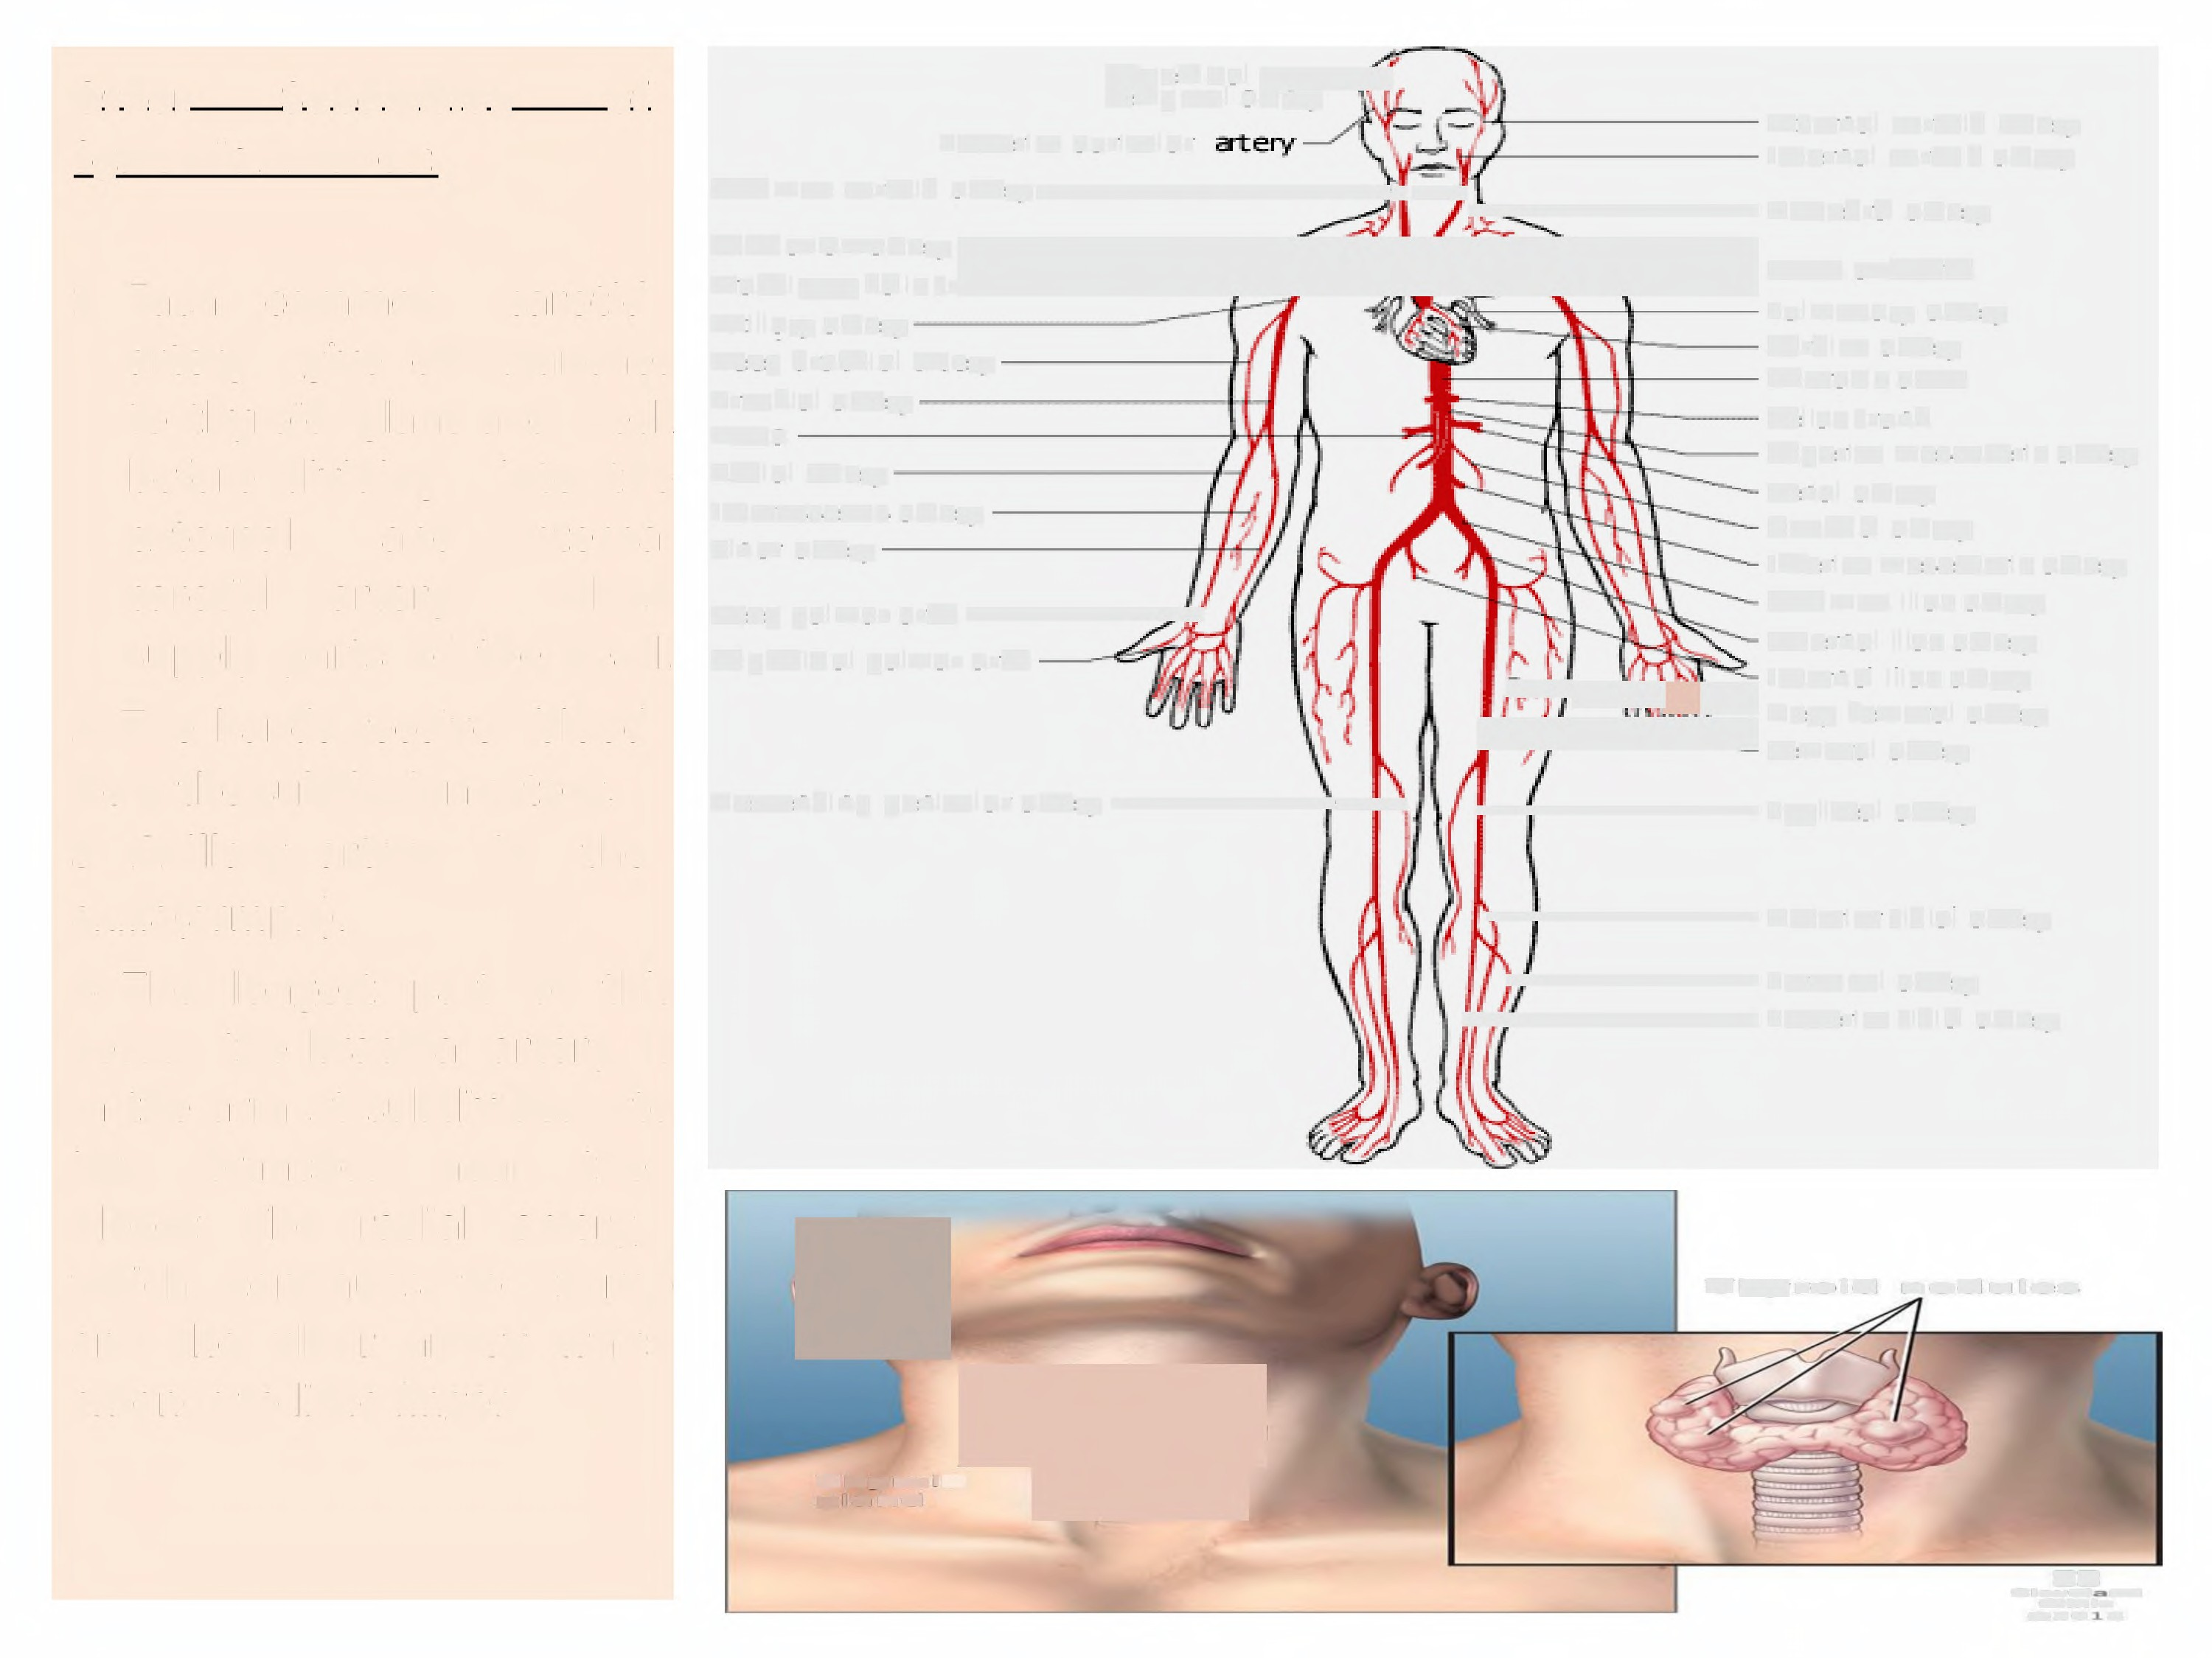
Other
Subdivision
of
Superficial 4]
terip oral artery
Postericr auricular
External carotid artery
Internal carotid artery
Systemic Arteries:
Cam man carotid arteryfl]iVetebral artery
s»=aa«a» ydk~
Brachiacephalic trunk
Axillary artery
Deep brachial artery
Brachial artery
Aorta
Radial artery
Interosseous artery
Ulnar artery
Deep palmar arch _ f
so=.a
Pulmonary artery
Cardiac artery
Thoracic aorta
Celiac trunk
Superior mesenteric artery
Renal artery
Ganadal artery
Inferior mesenteric artery
Common iliac artery
External iliac artery
1- Each common carotid
artery
give off branches
to thyroid gland
before dividing
and neck
into the
internal
which
the head.
external
carotid
and
artery,
supply parts of
Superficial palmar arch
s.}jit] Eternal iliac artery
t/4 remoral7artery U
4 Popliteal artery
2- The hands receive
blood
ti!
Deep femoral artery
from the subclavian artery.
Descending genicular artery }
El
3- Axillary artery
axilla(armpit).
in
the
]Anterior tibial artery
4- The longest
part
of this
4 Peroneal artery
[}}4 Posterigr tibial artery
vessel, the brachia! artery, is
in the arm .It subdivides into
two
branches
near
the
elbow: The
radial
artery,
4
which
continues
to thumb
I froid roiules
and the ulnar artery which
extends to little finger.
Thym •ct~
gland
~
«iw==«==«i
4ii«
oz0t

Slide 13
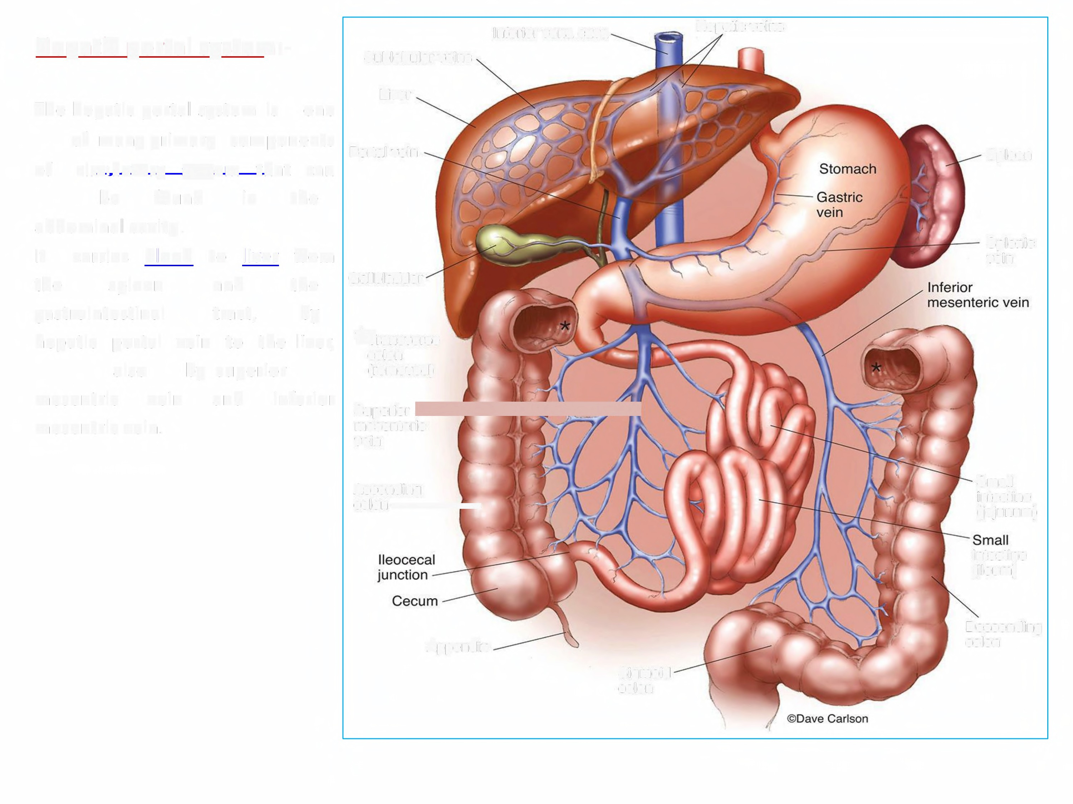
Inferior vena cava
Hepatic veins
Hepatic portal system:-
Sublobular veins
The hepatic portal system is
one
Liver
of many primary components
Portal vein
of
circulatory system
that can
the
Spleen
be
found
in
abdominal cavity.
It carries
blood to
liver
from
the by
Splenic vein
the
spleen
and
tract,
Gallbladder
gastrointestinal
hepatic portal vein to the liver,
Transverse colon (removed)
also
mesentric
by superior
vein
and
inferior
mesentric vein.
Superior [
mesenteric
vein
Ascending
Colon) l
Small intestine (jejunum)
intestine
(ileum)
Descending colon
Appendix
Sigmoid colon

