Slide 1
Endocrine System
Done by:
د. ثامر سعدي

Slide 2
INTRODUCTION
o The endocrine system is made up of glands and the hormones they secrete.
0 The vital function of this system is the production and regulation of hormones.
° A hormone is a substance that regulates different body functions.
° Hormones are chemical messengers that regulate growth and development, mood, tissue function metabolism and sexual function in males and females.
o The nervous system works closely with the endocrine system in the maintenance of homeostasis.

Slide 3
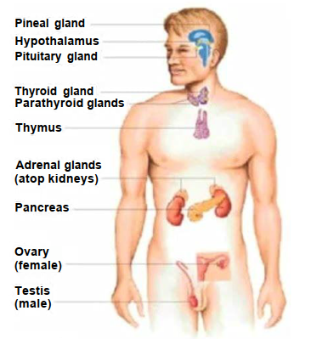
PRIMARY GLANDS OF THE PITUITARY SYSTEM

Slide 4
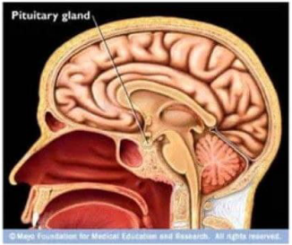
PITUITARY GLAND
o Located near the base of the brain.
o Attached to the hypothalamus:
° “Master Gland of the Body”- regulates all other endocrine glands
° Consists of anterior and posterior lobes

Slide 5
PITUITARY GLAND
Anterior Lobe
Posterior Lobe
Produces these hormones:
o Growth hormone
° Adrenocorticotropin
o TSH
o FSH
° Lutenizing hormone
° Prolactin
° Melanocyte-stimulating hormone
o ADH- antidiuretic hormone
° Oxytocin

Slide 6
PINEAL GLAND
Found in the brain:
° Secretes melatonin-released at night for sleep.
° Secretes serotonin- neurotransmitter.

Slide 7
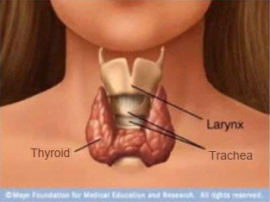
THYROID GLAND
Responsible for metabolism.
Secretes the following:
T4 and T3 - too much hyperthyroid, too little hypothyroid.
Calcitonin- influences bone and calcium metabolism.
Parathyroid glands are located around the dorsal and lower aspects of the thyroid gland.
Regulates calcium- “tetany”

Slide 8
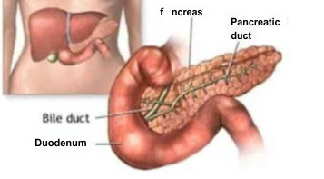
PANCREAS
o Secretes glucagon-helps break down glycogen to glucose
° Secretes insulin-lowers blood sugar.
° Helps transport sugar to cells in the body
Pancreas
Bile Duct

Slide 9
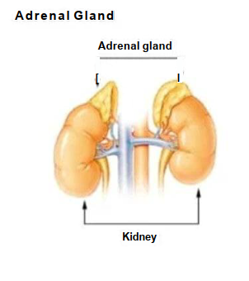
ADRENAL GLANDS
Found on top of each kidney.
Secretes groups of hormones essential for life.
Consists of the adrenal cortex and the adrenal medulla

Slide 10
ADRENAL GLANDS
Adrenal medulla
Adrenal cortex
° Epinephrine.
° Norepinephrine Hormones to stimulate the body to quickly produce energy in emergencies
° Glucocorticoids- regulate metabolism of carbohydrates.
° Mineralocorticoids-regulates the amount of salt and water lost and absorbed by the kidneys.
° Male and female sex hormones

Slide 11
GONADS
Ovaries: secretes estrogen
and progesterone
Testes: secrete
testosterone

