Slide 1
MEHODS OF ANALSIS
NODEL

Slide 2
Nodal analysis
The methods introduced thus far have all been to find the currents of the network
We now turn our attention to nodal analysis—a method that provides the nodal voltages of a network
The method is developed through the use of Kirchhoff’s current law in much the same manner as Kirchhoff’s voltage law was used to develop the mesh analysis approach
It is a good practice to select a reference node with zero reference voltage.
All the other voltage levels are then found with respect to this reference level
the number of equations required to solve for all the nodal voltages of a network is 1 less than the total number of independent nodes.

Slide 3
PROCEDURE

Slide 4
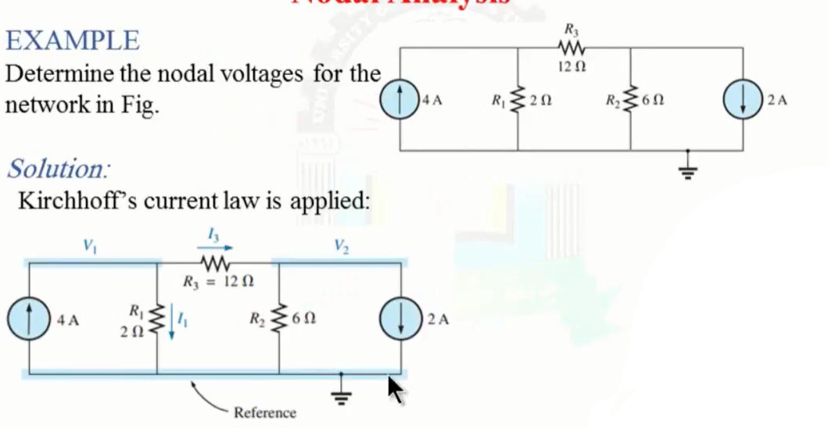
EXAMPLE

Slide 5
CONTINUE

Slide 6
Continue

Slide 7
continue

Slide 8
Conclusion

