Slide 1
Lect. 10 -Y-Δ (T-P) AND Δ-Y (P-T) CONVERSIONS
conversion

Slide 2
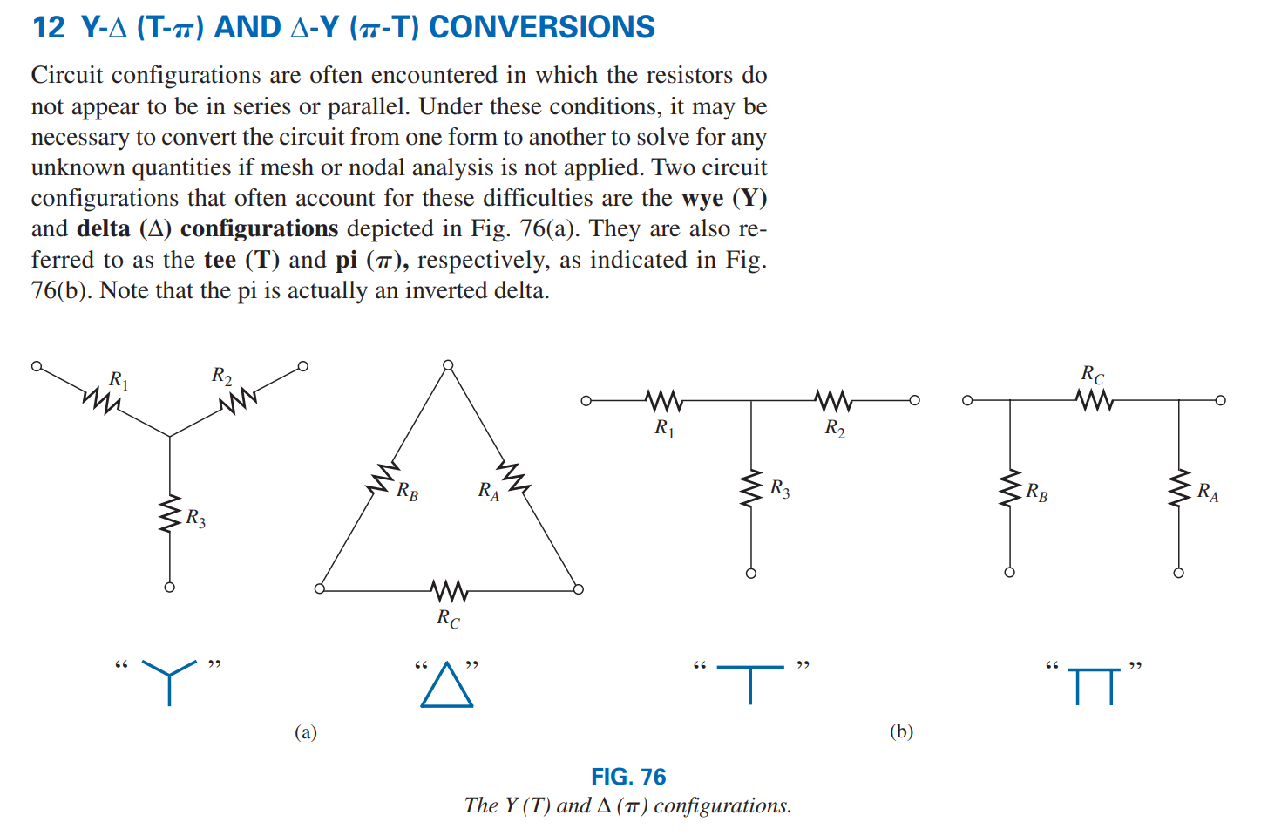

Slide 3
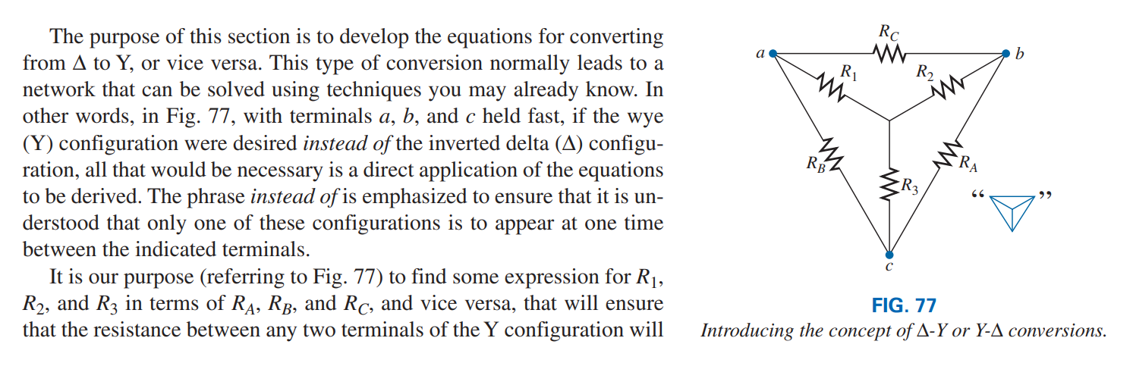
be the same with the Δ configuration inserted in place of the Y configuration (and vice versa).

Slide 4
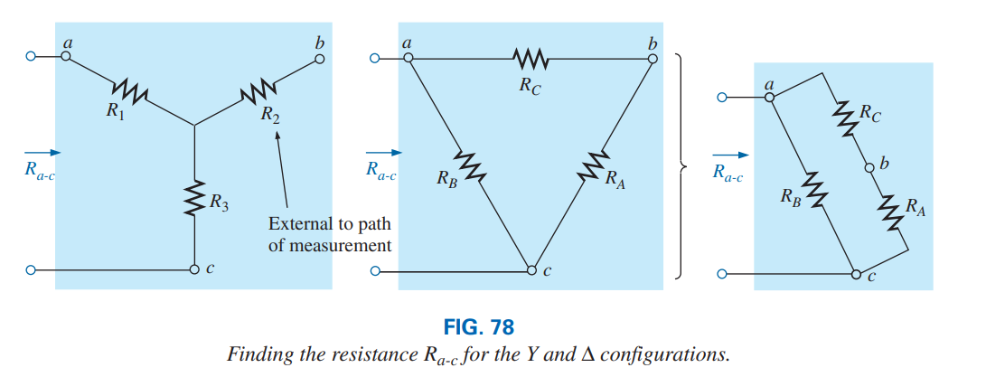
Developing the equations for converting from Δ to Y, or vice versa.
If the two circuits are to be equivalent, the total resistance between any two terminals must be the same. Consider terminals a-c in the Δ-Y configurations in Fig. 78.

Slide 5
Converting the Δ (RA, RB, RC) to the Y (R1, R2, R3).

Slide 6
Continue

Slide 7
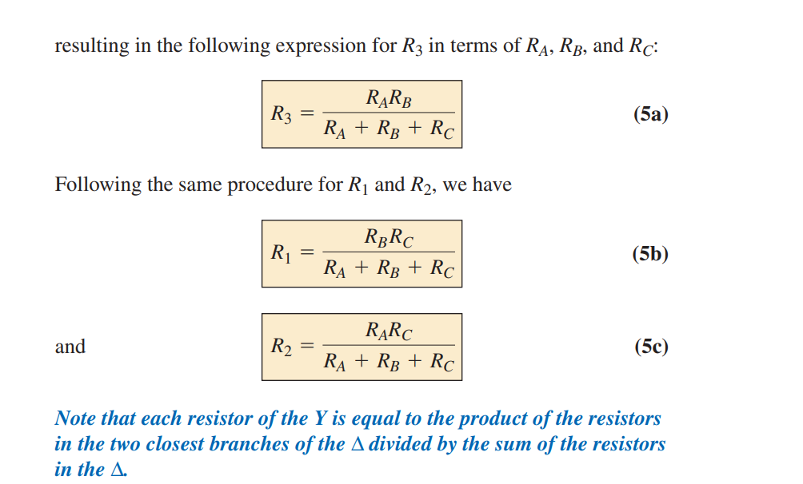

Slide 8
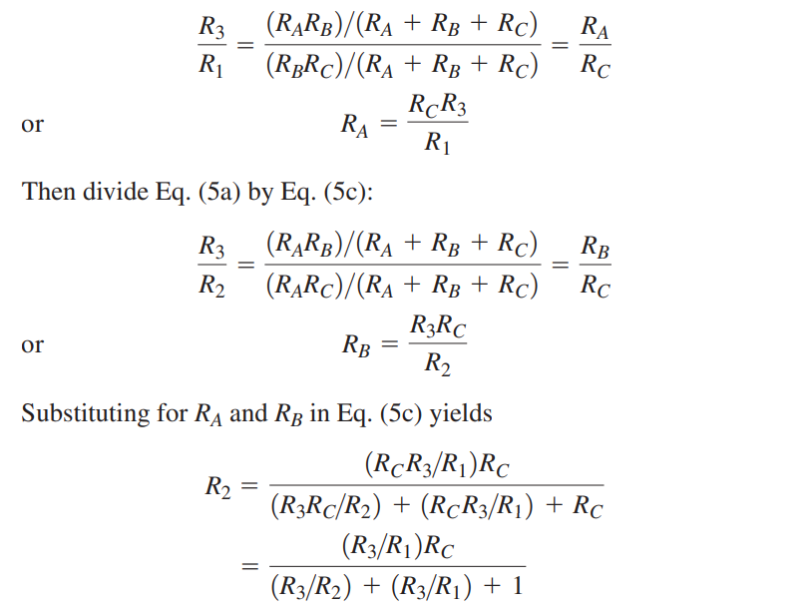
Converting from a Y to a Δ,
first divide Eq. (5a) by Eq. (5b):

Slide 9
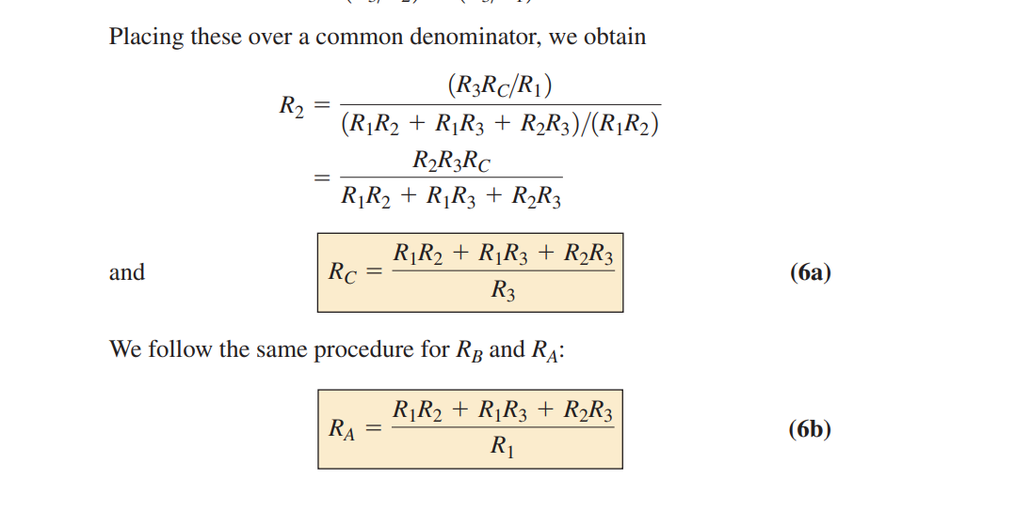

Slide 10
Special case where all the values of a Δ or Y were the same. If RA =RB = RC

Slide 11
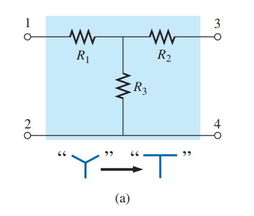
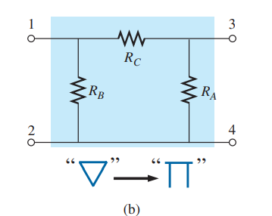
Continue
The Y and the Δ often appear as shown in Fig. 79. They are then referred to as a tee (T) and a pi (p) network, respectively. The equations used to convert from one form to the other are exactly the same as those developed for the Y and Δ transformation

Slide 12
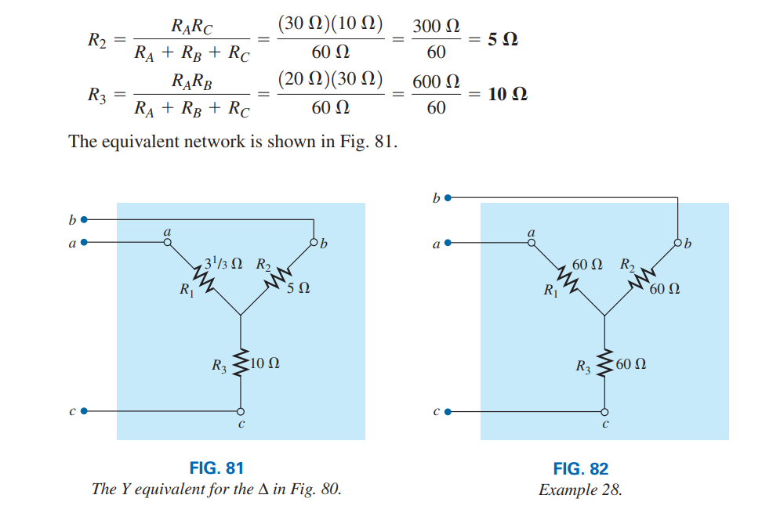
EXAMPLE- 27 Convert the Δ in Fig. 80 to a Y.

Slide 13
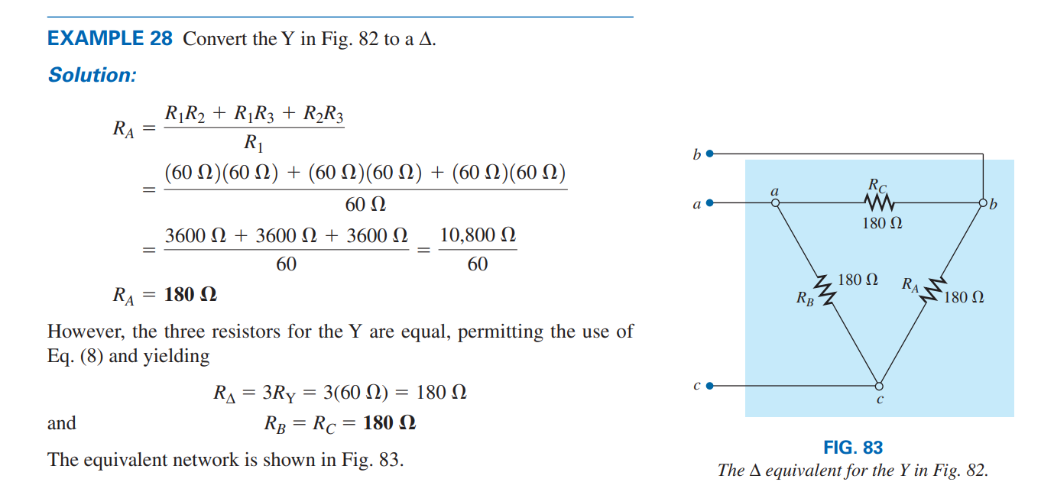

Slide 15
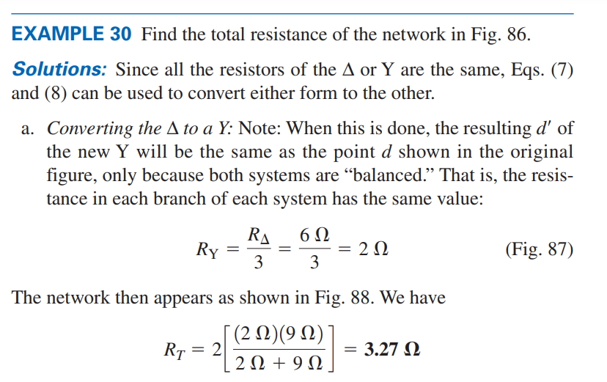
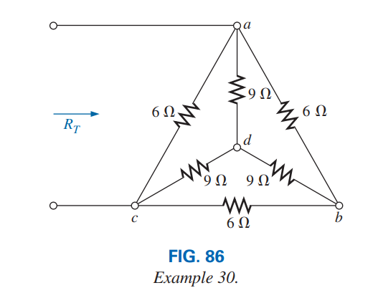

Slide 16
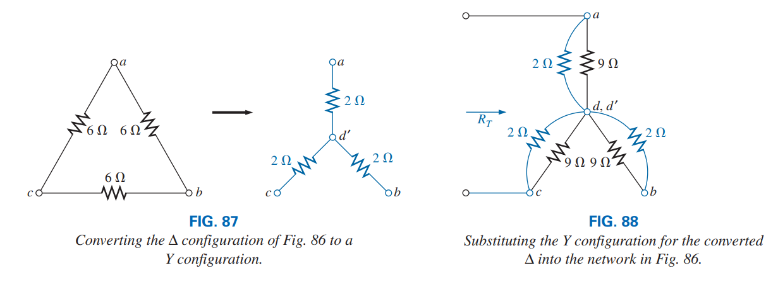

Slide 17
