Slide 1
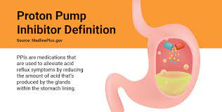
Msc.Sarmad Mohammed

Slide 2
PROTON PUMP INHIBITOR
What Are PPIs?
How PPIs Work
What do PPIs treat?
Types of PPIs
Common Side Effects of PPIs

Slide 3
What Are PPIs?
Proton Pump Inhibitor Definition:PPIs2 are medications that are used to relieve acid reflux symptoms by reducing the amount of acid that’s produced by the glands within the stomach lining.

Slide 4
How PPIs Work
Proton pump inhibitors (PPIs) effectively block gastric acid secretion by irreversibly binding to and inhibiting the hydrogen-potassium ATPase pump that be located in the luminal surface of the parietal cell membrane.
Rather than reacting to acid reflux symptoms, PPIs aim to stop stomach acid right in its tracks. When taken just before a meal, PPIs3 prevent cells in the stomach from producing and “pumping” out stomach acid that causes some individuals to experience heartburn and related symptoms.

Slide 5
What do PPIs treat?
Proton pump inhibitors are used to treat the following conditions:
Acid reflux
Gastroesophageal reflux disease (GERD)
Duodenal or stomach (gastric) ulcers
Damage to the lower esophagus as a result of acid reflux

Slide 6
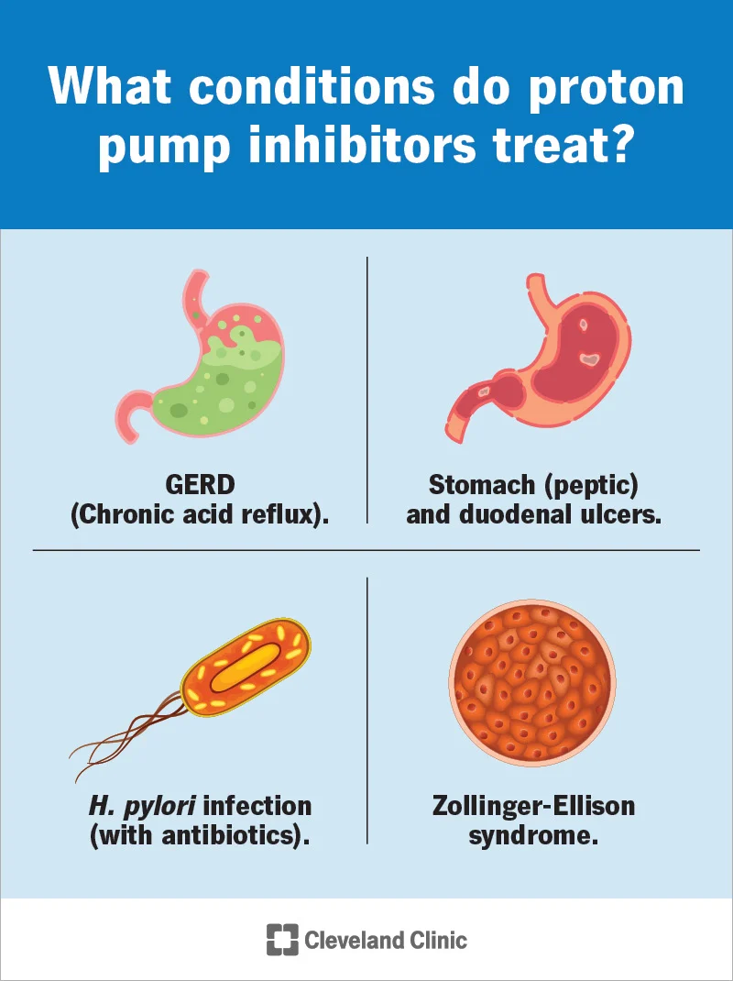
What do PPIs treat?

Slide 7
Types of PPIs
There are several different types and brands of PPIs, including:
Omeprazole (Prilosec), also available over-the-counter (without a prescription)
Esomeprazole (Nexium), also available over-the-counter (without a prescription)
Lansoprazole (Prevacid), also available over-the-counter (without a prescription)
Rabeprazole (AcipHex)
Pantoprazole (Protonix)
Dexlansoprazole (Dexilant)
Zegerid (omeprazole with sodium bicarbonate), also available over-the-counter (without a prescription)

Slide 8
Common Side Effects of PPIs
Like any other medication, PPI side effects vary categorically as well as in severity. Some of the more common, less extreme side effects2 associated with PPIs include:
Headache
Diarrhea
Constipation
Nausea
Itching

Slide 9
What are antiemetic drugs?
Antiemetic medications used to treat nausea and vomiting. These two symptoms are very common and can be caused by many different conditions, therapies, procedures, and medications (such as opioids).
However vomiting is considered to be a protective reflex of the body to eject toxic substances in the stomach and gut, antiemetic drugs are often necessary to suppress vomiting, especially if there’s severe dehydration.

Slide 10
How do antiemetics work?
work on the neural pathways involved with vomiting by blocking specific receptors that respond to neurotransmitter molecules, such as serotonin, dopamine, and histamine. Most of these are central receptors found in the vomiting center of the brainstem, while peripheral receptors are found in the vagus nerve. When the gastrointestinal tract senses a danger, it sends information to the peripheral receptors, which in turn transport the information to the central receptors in the vomiting center. In response, the vomiting center triggers nausea and vomiting by stimulating the gastrointestinal tract, abdominal muscles, and the diaphragm.

Slide 11
What are antiemetic drugs used for?
drugs are taken to treat nausea and vomiting, and can be administered as tablets, sublinguals, oral solutions, transdermal patches or intravenous injections.
Nausea and vomiting can be symptoms of various conditions,
motion sickness,
upper abdominal irritation,
food poisoning,
gastroenteritis.
Post-operative nausea and vomiting (PONV)

Slide 12
What are antiemetic drugs used for
Nausea and vomiting are also common side effects of many drugs including
opioid analgesics
anaesthetics (postoperative nausea),
chemotherapy directed against cancer.
ocuur in pregnancy-related morning sickness or hyperemesis, which is extreme morning sickness including severe vomiting, during pregnancy.
antiemetic medications should not be taken during pregnancy without first consulting with your familydoctor, who might prescribe them only after evaluating the risks and benefits.

Slide 13
How does vomiting occur ?
Motion sickness: The vestibular system is an inner ear organ that detects motion (acceleration) in all three dimensions of the body and sends signals to the cerebellum to keep the body balanced.
Drug (cancer chemotherapy/radiotherapy) induced vomiting. Cytotoxic drugs or radiation induce nausea and vomiting by causing cellular damage, which causes release of mediators including 5-HT and substance-P from intestinal mucosa.
5-HT activate vagal afferents in the gut to send emetogenic signal to CTZ/NTS as well as spill into circulation and reach CTZ via the vascular route. 5HT3 antagonists like ondansetron blocks emetogenic impulses both at their peripheral origin and central relay. Hence 5HT3 antagonists are 1st choice for drug induced vomiting. Cisplatin is the most emetogenic drug ever

Slide 14
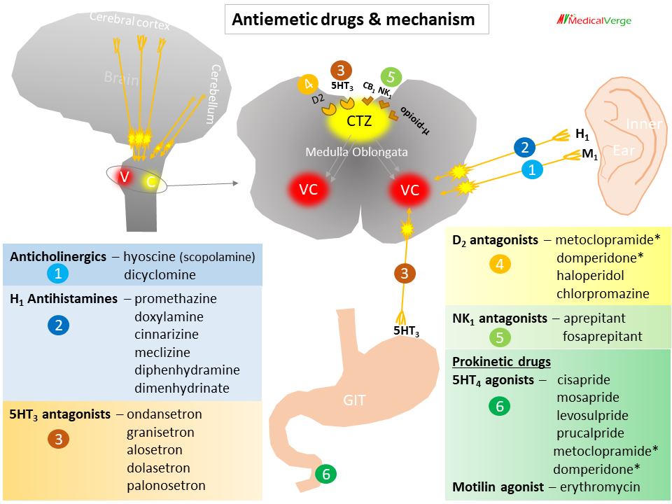

Slide 15
What are some examples of antiemetics?
There are a few classes of antiemetic medications?
5-HT3 receptor antagonists, such as ondansetron (Zofran), granisetron, and palonosetron (2nd generation) are medications that work on central serotonin receptors in the vomiting center, as well as the peripheral serotonin receptors in the vagus nerve. 5-HT3 receptor antagonists are indicated for use against vomiting caused by acute gastroenteritis or postoperative nausea. It’s also the first go-to antiemetic class for radiotherapy- and chemotherapy-induced nausea and vomiting, which are common side effects.
Dopamine antagonists, such as metoclopramide (Reglan), domperidone (Motilium), and chlorpromazine, are amongst the most commonly used antiemetics, and they’re also indicated for postoperative nausea and motion sickness.

Slide 16
What are some examples of antiemetics?
H1 antihistamines, such as cyclizine, promethazine, and antimuscarinics (anticholinergics) like scopolamine (Hyoscine) are often used to treat and prevent nausea and vomiting induced by vestibular disturbances like vertigo or motion. Scopolamine is predominantly used to prevent motion sickness, and can come in a transdermal patch, making it easier to administer, especially for people with swallowing problems. The transdermal patch is also useful for maintaining a steady release of the medication and lowering the risk of side effects. Antihistamines generally lead to sleepiness.

Slide 17
What are some examples of antiemetics?
Neurokinin 1 (NK-1) receptor antagonists, like aprepitant (Emend) and rolapitant (Varubi), are a relatively new medication class that can be used as antiemetics, especially for suppressing radiotherapy- and chemotherapy-induced nausea and vomiting, as well as to prevent nausea and vomiting after surgery. NK-1 receptor antagonists should not be taken while pregnant or breastfeeding.
Glucocorticoids are also indicated as antiemetics against chemotherapy-induced emesis. They are effective and generally well-tolerated, but insomnia ارق .

Slide 18
What are the side effects of antiemetic drugs?
are generally well-tolerated, but can have potential side effects, such as
constipation or diarrhea,
headache, fatigue,
sickness, dizziness,
unclear vision, dry mouth,
photosensitivity.
It is essential to see your family doctor before using prescription or over-the-counter antiemetic medications.

